Slide 1
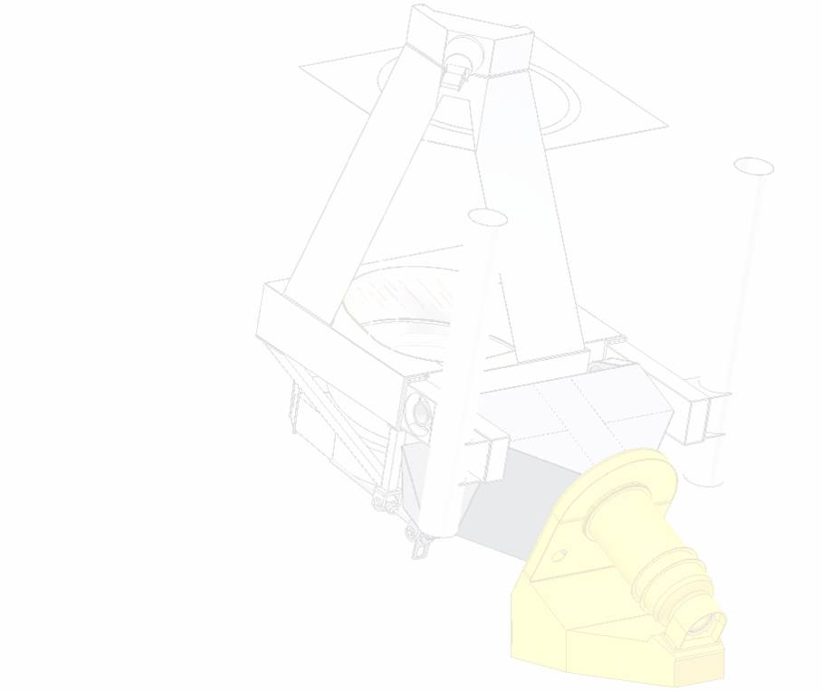
The 1.6 m NST in Big Bear
Wenda Cao
Big Bear Solar Observatory
New Jersey Institute of Technology
Notes:
1
After several years of effort, in January 2009, the 1.6 meter New Solar Telescope attained its first light at Big Bear Lake, California. (Now, the NST is undergoing its commissioning phase.) When celebrating the NST’s success, I would like to salute all these NST builders and collaborators. A number of engineers and scientists made solid contribution to this project.

Slide 2
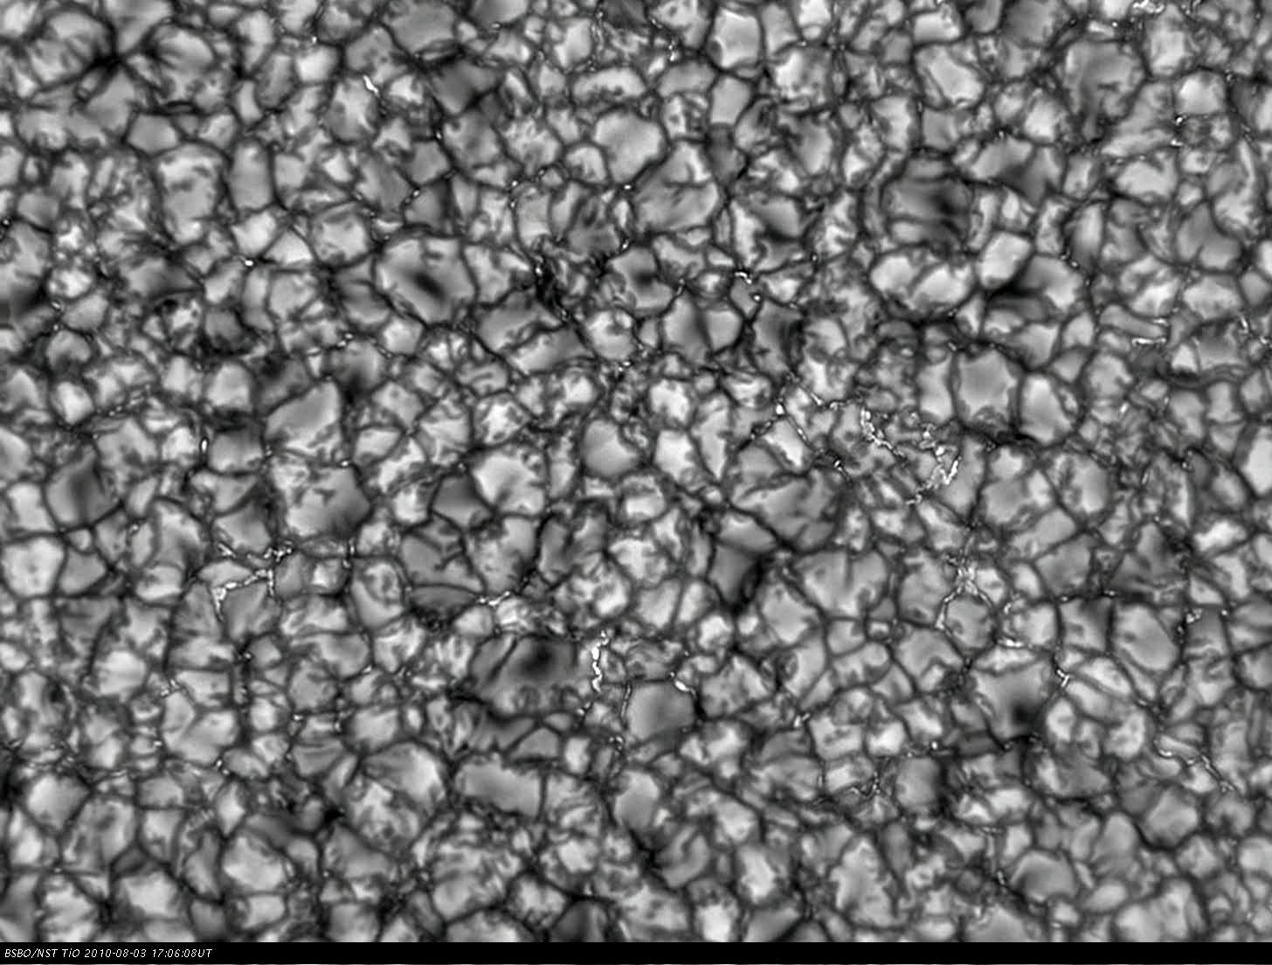
Photosphere in TiO 705.7 nm
Notes:
2
(The NST focuses on high resolution observation of solar atmosphere. Before going into main topic,) Here, I will play two movies to help you learn the current performance of this telescope. This 40-mins long movie was taken in 2010 with the NST at TiO 706 nm. What I like in this movie is these BPs. They typically have a characteristic scale of 35-70 km, and are commonly believed to be the magnetic concentration on the photosphere. (Here, you can clearly see these fine structure dynamics, such as emergence, motion, collision and cancellation.)
Collisions destroying field and causing other elements to spin around each other. These trigger storms somehow.

Slide 3
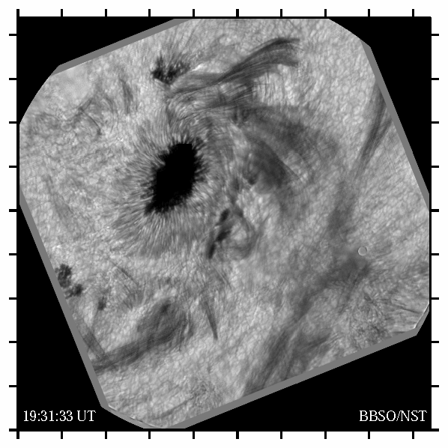
M1.2 Flare Observed
in He I 1083 nm
Notes:
Here is the other event obtained on July 2 in HeIium 1083 nm line. This 3-hour long movie recorded the whole process of a M-class flare. The FOV is 95” by 95” and the data cadence is 10s. From these two examples, you can clearly see that our data set are close to diffraction limit of the telescope with the assistance of AO, Speckle reconstruction technique.

Slide 4
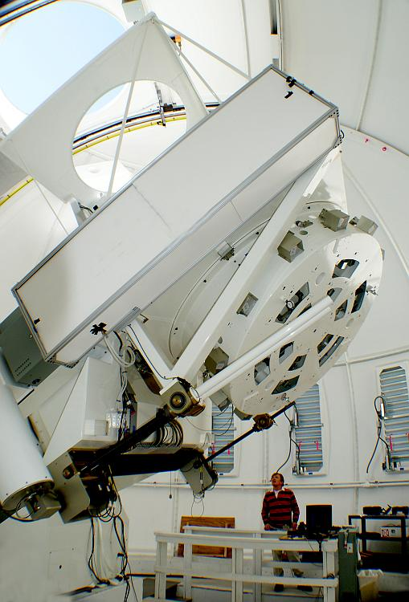
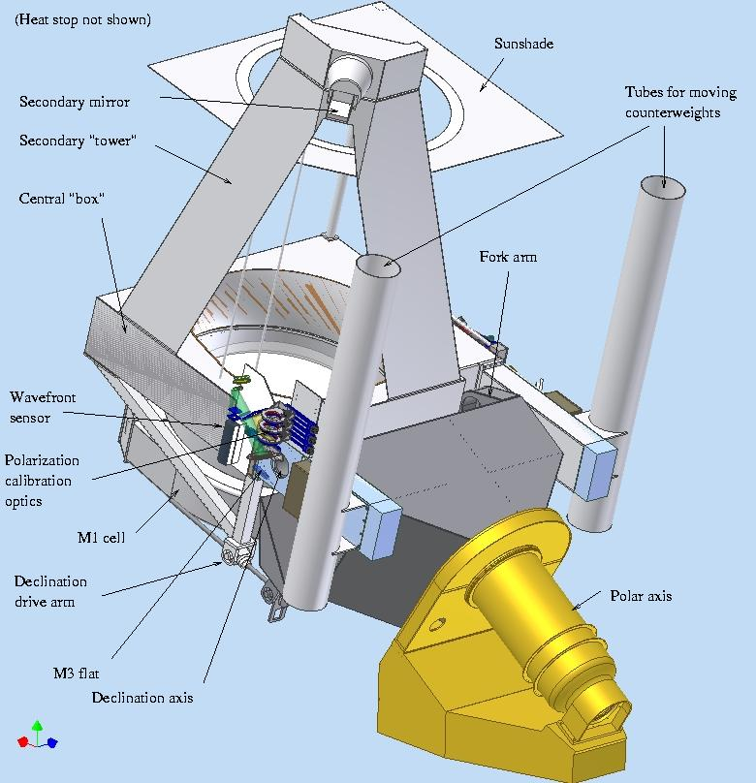
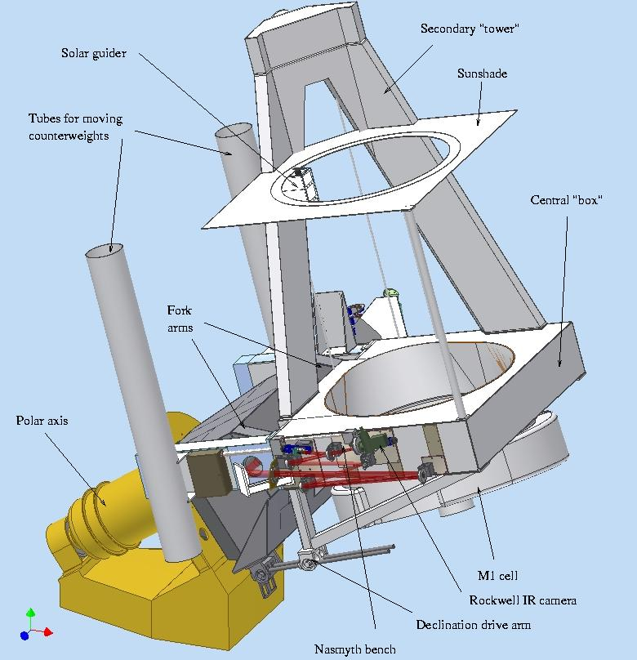
NST Features
All reflecting, off-axis Gregory optical configuration
PM: off-axis 1.6 m clear aperture (1.7 m blank) with f/2.4
Figuring PM to 16 nm rms
Effective focal length: 83.2 m (F/52 at Gregorian focus and F/26 at Coudé focus)
FOV: 2' in prime focus
Wavelength range from 380 nm to NIR in Coudé lab with AO
Integrated active optics (ao) and adaptive optics (AO)
Quasi-static telescope alignment
Diffraction limited: 0.06″@ 500 nm and 0.2″@ 1.56 μm with AO
WFS, polarization and calibration optics immediately before M3
Facility-class instruments
Notes:
These figures show the west and east views of the NST. The NST is an all reflecting, off-axis Gregory system which consists of a parabolic primary, heat-stop, elliptical secondary and diagonal flats (M3, M4 ….). The final F ratio is 52 (and FOV is 2’). The working wavelength range covers from the visible 0.4 to the NIR in the coude lab. The NST integrates both active optics and adaptive optics to help acquire diffraction-limited observation in visible and NIR.

Slide 5
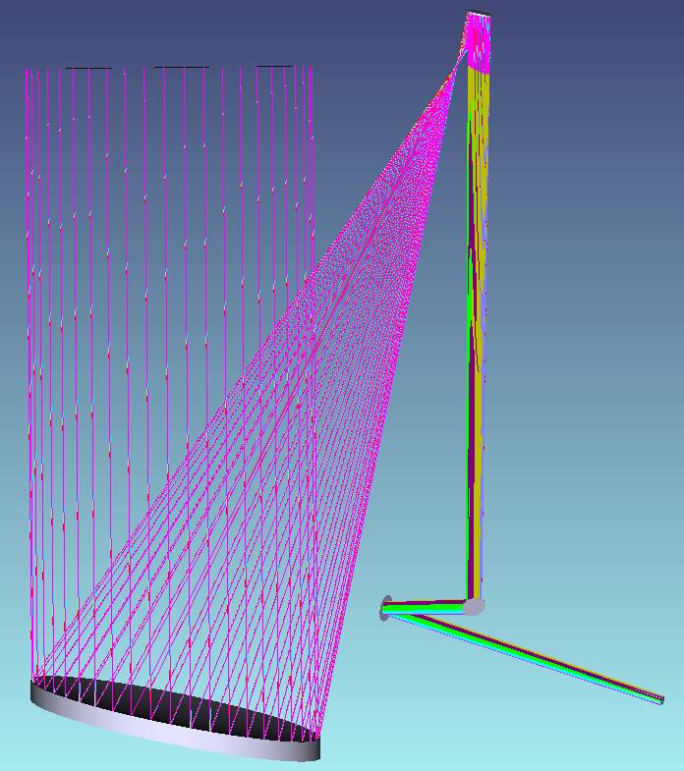
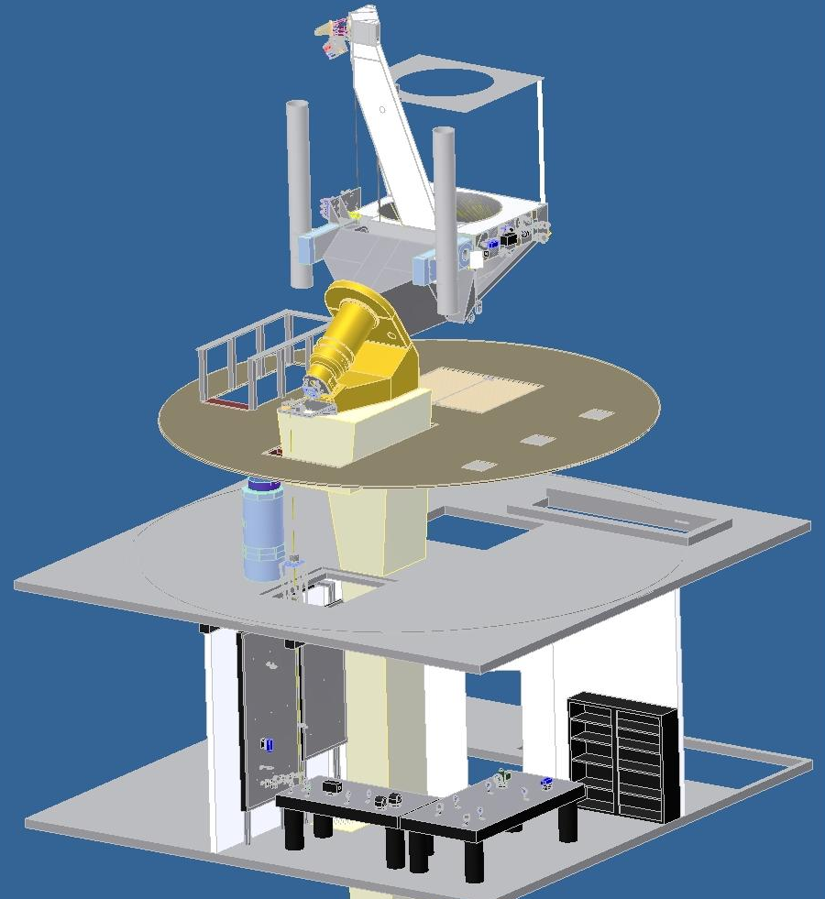
NST Scientific Instruments
Broad-band Filter Imager (BFI)
Cryogenic Infrared Spectrograph (CYRA)
Adaptive Optics (AO: AO-76, AO-308, MCAO)
InfraRed Imaging Spectro-polarimeters (IRIM, NIRIS)
Visible Imaging Spectro-polarimeters (VISP)
Fast Imaging Solar Spectrograph (FISS)
BFI
CYRA
AO
FISS
BFI
IRIM
VISP
Notes:
5
This figure shows a cutaway sketch of the NST relative to all scientific instruments. The NST is located on the top-floor telescope deck. It has multiple foci to accommodate these scientific instruments.
Solar light is imaged by PM and SM, then folded through the declination axis by M3 and M5 to the Nasmyth focus. (Nasmyth bench on the east side of the telescope structure can accommodate small to medium size solar instruments which don’t need AO system.)
If a folding mirror M4 flips up, the solar beam will be directed along the polar axis down to the telescope Gregorian focus, around here. Relay optics can further feed light down to the Coud´e Lab, two floors beneath the telescope deck.
The NST scientific instruments include: …..Here, I will only highlight three of them.

Slide 6
Broad-band Filter Imager
First-light scientific instrument
Serves as scientific analysis and engineering feedback
Nasmyth and Coudé foci
Local correlation tracker at Nasmyth and AO in Coudé lab
FOV: 70″by 70″(square)
Visible photometry
  2 PCO cameras: 2K by 2K
  TiO 705.7 nm BF, FWHM 10 Å
  G-band 430.5 nm BF, FWHM 5.0 Å
  H_{α} Lyot NF, FWHM 0.25 Å
Near infrared photometry
  Rockwell camera: 1K by 1K
  1.6 μm BF, FWHM 2.5 Å (deepest layer of photosphere)
  2.23 μm BF (cold clouds)
  1.083 μm NF, FWHM 0.5 Å (corona loops, filaments, flares … )
BFI
BFI
Notes:
6
Broad-band filter imager (BFI) is the first available scientific instrument for the NST, which was originally mounted at the Nasmyth bench. This system has been moved into Coude lab after we installed AO in the Spring of 2010. BFIs focus on high spatial resolution photometric observations in the visible and NIR, with the assistance of AO and speckle reconstruction technique. Wavelength of interest include titanium oxide 706 nm, G-band, and Ha, as well as several NIR lines. As of now, two visible PCO-2000 cameras and one infrared Rockwell camera can be used simultaneously in three different wavelengths.

Slide 7
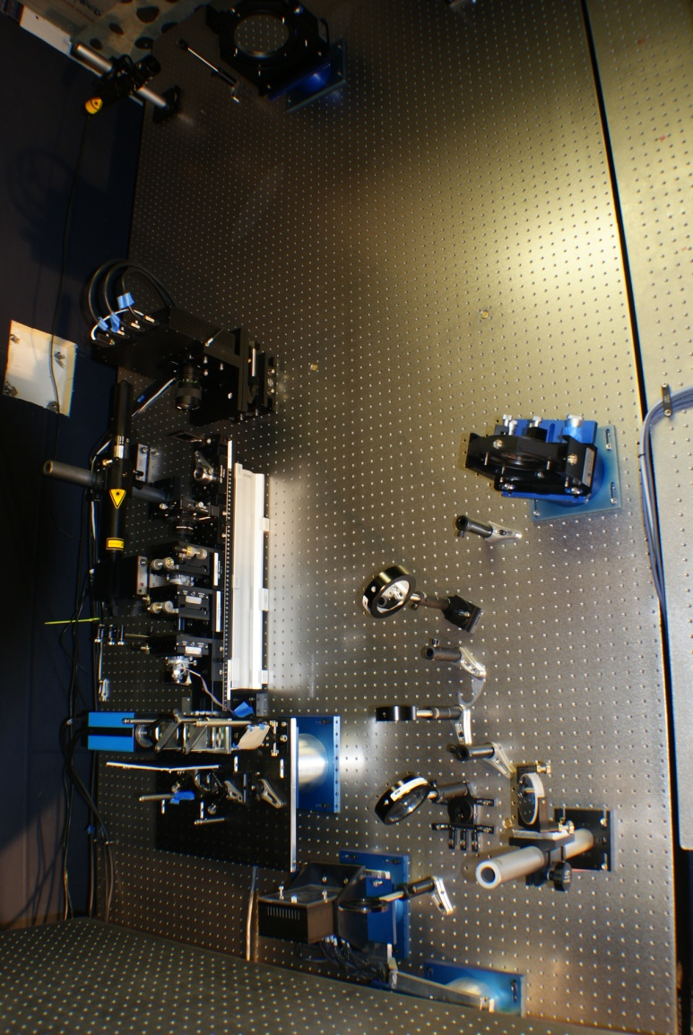
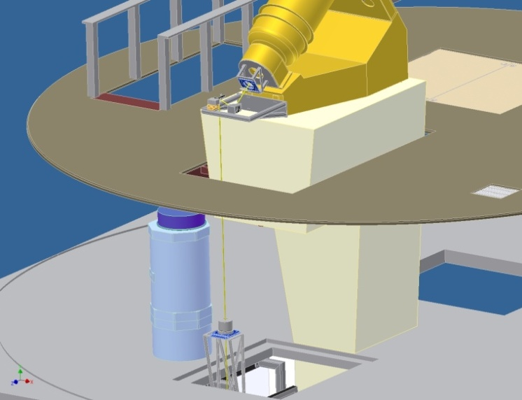
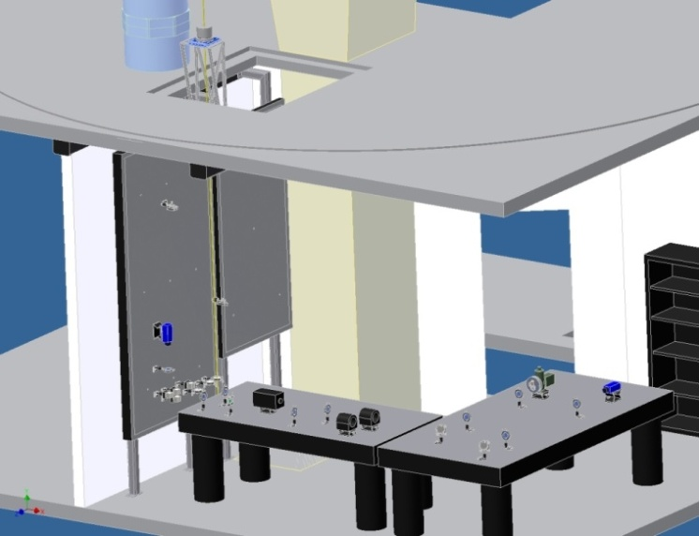
Adaptive Optics (AO-76)
1st generation is AO-76 which was used for BBSO 65 cm telescope
Shack Hartmann WFS with 76 sub-apertures (AO-76): 10 sub-apertures across the NST PM
Xinetics Deformable Mirror with 97 actuators and 7 mm spacing
Baja camera with a frame rate of 2500 Hz for 200 by 200 sub-array
Bitware Hammerhead Boards with 40 digital signal processors (DSPs)
Closed-loop Bandwidth: 120 Hz
Strehl ratio: 0.7 in the NIR under median BBSO seeing
Notes:
To correct atmosphere turbulence, we have installed the 1st generation AO system, the AO-76 (, on one of the vertical benches in the Coude lab). AO-76 was used for the now-retired 65 cm telescope: WFS, DM, DSP and fast camera …

Slide 8
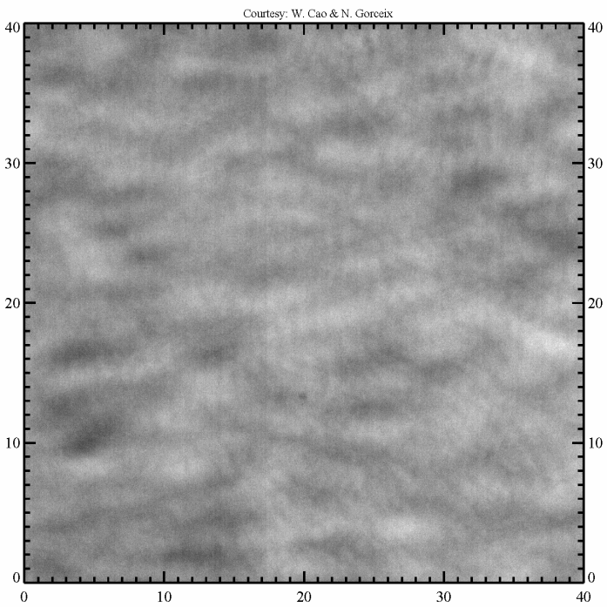
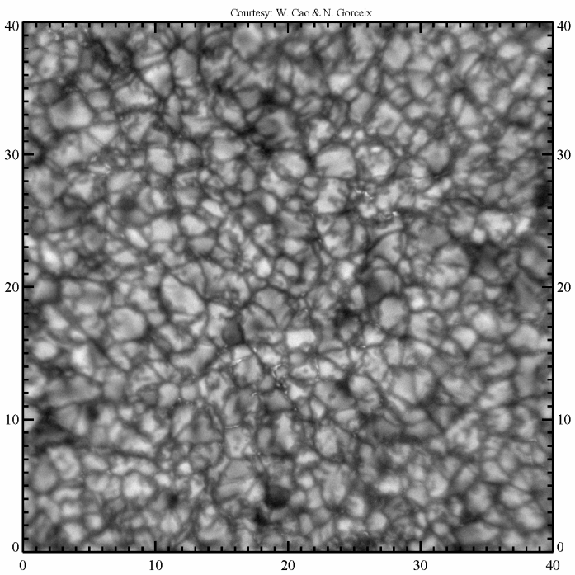
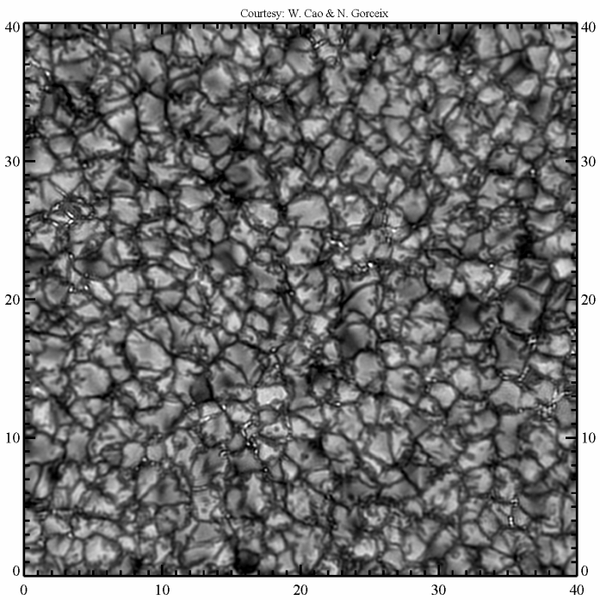
Solar Images with AO and NST
AO-76 off
AO-76 on
With AO-76 and
Speckle Reconstruction
Courtesy : F. Wőger & O. von der Lühe and KISIP v.6
Notes:
These movies can help you to learn the current performance of AO-76. ( I don’t think I need to explain too much here.)
These raw data were taken at 706 nm with the NST and AO off.
Now, AO-76 is on. You can see that the images quality are improved significantly, but we still do not reach the diffraction limit.
After speckle reconstruction processing, I believe that the images are close to the telescope diffraction limit.

Slide 9
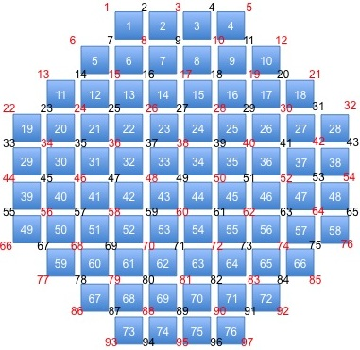
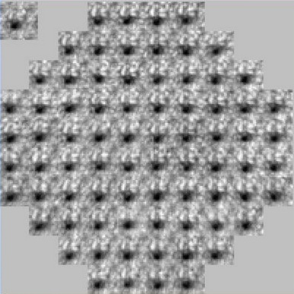
2nd Generation: AO-308
AO System: DM, TT and lenslet of wavefront are conjugated to the PM
Wavefront Sensor Baseline:
  160 cm clear aperture PM
  BBSO r₀ = 6 ~ 8 cm @ 500 nm
  20 sub-apertures across pupil
  308 sub-apertures over pupil
Deformable Mirror Baseline:
  357 actuators
Control System Baseline:
  Median r₀ = 6 cm @ 500 nm
  Median wind speed 4 ~ 8 m/s
  Greewood frequency 30 ~ 60 Hz
  Close-loop bandwidth > 120 Hz
  Open-loop bandwidth > 2000 Hz
AO-76
Notes:
We are working on the 2nd generation AO system because AO-76 is unable to correct the seeing very well in the visible.
This figure shows the geometry of AO-76. You probably notice there are only 10 sub-apertures across the pupil of the 1.6 m PM.
Fried parameter at Big Bear is about 6-8 cm in the visible. To acquire enough spatial sampling over the 1.6 m NST, we need at least 20-26 sub-apertures across the telescope pupil. In this case, the 1st generation AO-76 is currently under-sampling in the visible for the NST under typical BBSO seeing condition.
Basically, AO design depends on the telescope aperture and local seeing condition. The NST PM has 1.6 m clear aperture and r0 at Big Bear is about 6-8 cm in the visible. To acquire enough spatial sampling, we need at least 20-26 wfs sub-apertures across the telescope pupil. Right now, AO-76 has only 10 sub-apertures. That is why we need the 2nd generation AO to correct seeing in the visible. If we choose 20 sub-apertures across pupil as the baseline, totally, WFS will have 308 sub-apertures and DM should have 349 actuators.

Slide 10
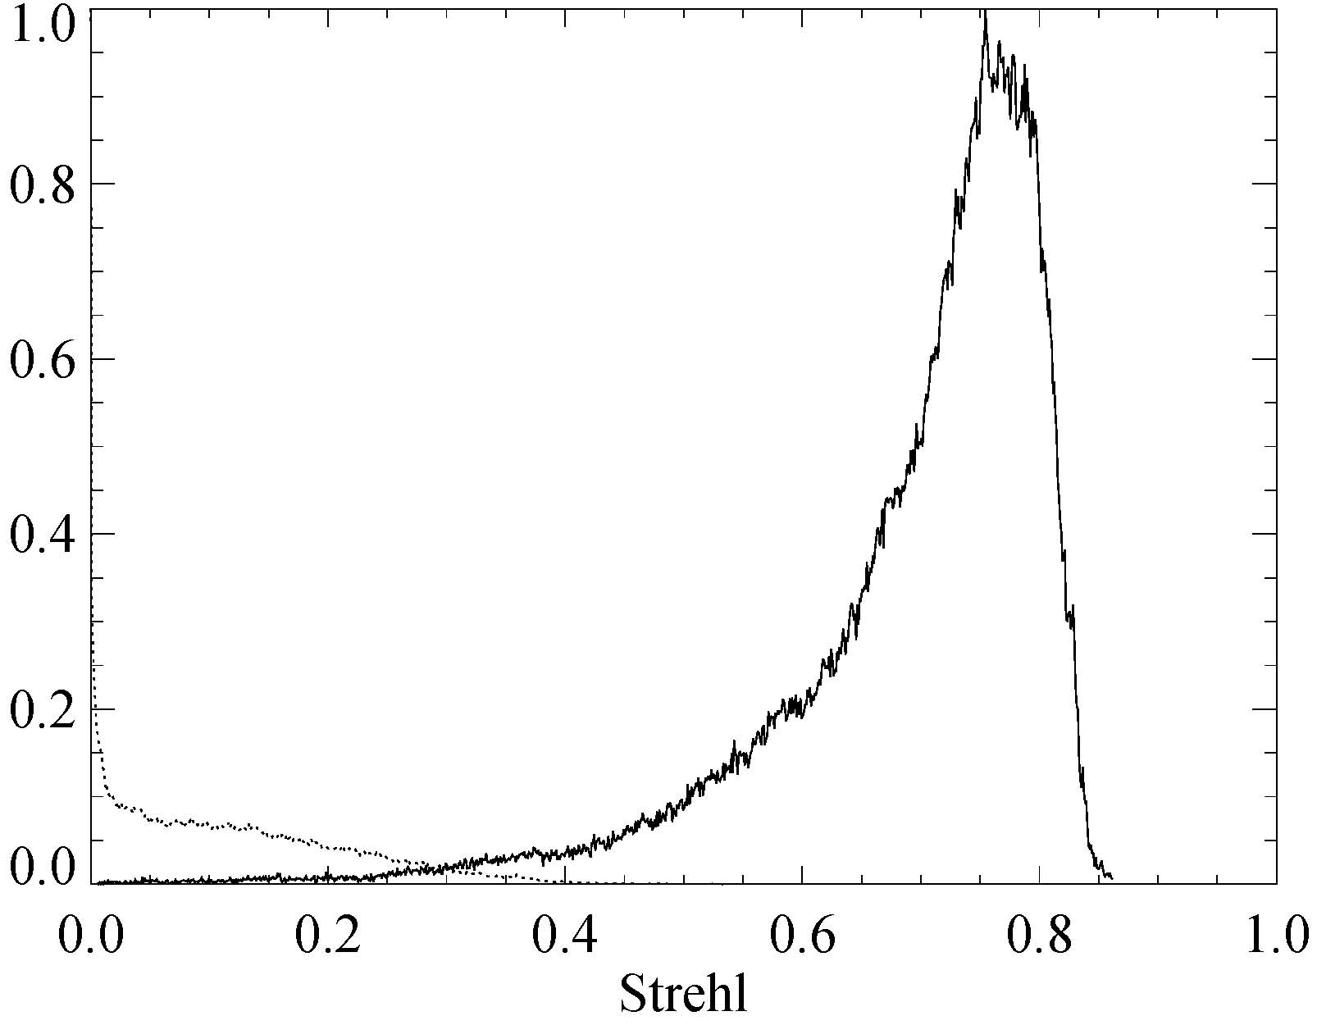
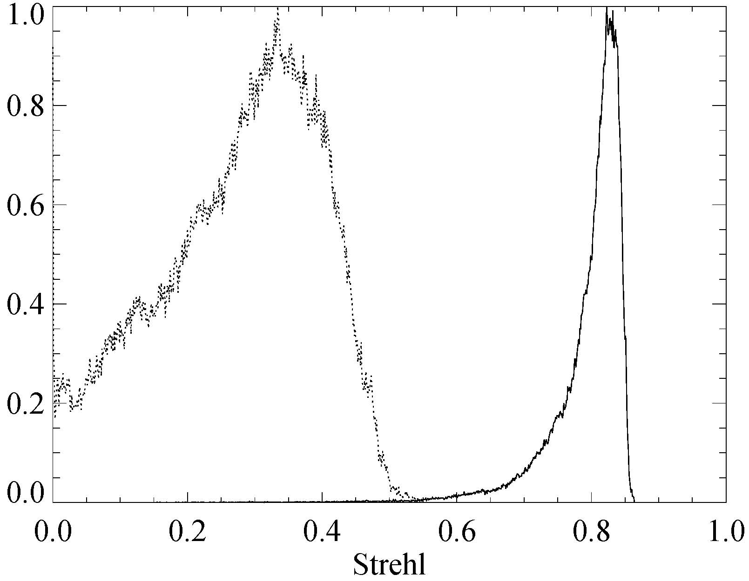
2nd Generation: AO-308
2nd generation AO-308 which is underway, is a collaboration between BBSO and NSO
Shack Hartmann WFS with 308 sub-apertures (AO-308): 20 sub-apertures across the NST primary mirror
Xinetics Deformable Mirror with 357 actuators and 5 mm spacing
Phontom V.7.3 camera with a frame rate of 2000 Hz for 400 by 400 pixel sub-array
Bitware TigerSHARC Boards with 16 digital signal processors (DSPs)
Closed-loop Bandwidth: 120 Hz
Acquire diffraction limited imaging over the telescope’s full range of operation
AO-76
1
VIS
NIR
135
136
142
147
153
154
AO-308
VIS
NIR
308
Courtesy : T. Rimmele
Notes:
Simulation performed by Dr. Rimele also demonstrate this point.( This is why we need to develop the 2nd generation AO). AO-308 will integrate a SH wfs with 308 sub-apertures and a DM with 357 actuators. AS of now, AO-308 has been installed in the Coude lab for commissioning. It will be running side-by-side with AO-76 for a while, and next year it will fully replace the current AO-76.

Slide 11
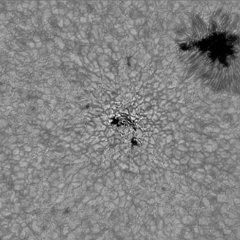
3rd Generation: MCAO
Multi-Conjugate AO (MCAO) is a collaboration with KIS & NSO
Two Shack Hartmann wavefront sensor for narrow and wide field measurement
Two or three DMs with 357 actuators to conjugate levers of ground, 3 km (and later 12 km)
Multi-CPU parallel computation
High speed camera with frame rate of 2000 Hz
Closed-loop Bandwidth: 120 Hz
Expand field of view of diffraction limited observations to ~ 1 arcmin in the visible
Notes:
11
Traditional AO systems, such as AO-76 and AO-308 confine diffraction limited observations to the isoplanatic patch (6" at 500 nm on average in summer) with a gradual roll-off away from the patch. Look at this AO-76 corrected image, the central part within the isoplanatic patch looks pretty sharp, while the image is getting blur in the periphery. In collaboration with NSO and KIS, we are actively developing the 3rd generation AO: MCAO. It will enable diffraction limited observations over an extended field (like 1-2 min in the visible). MCAO will employ two DMs to correct the turbulence in the ground layer (< 500 m), and the boundary layer (3-6 km) respectively. First light of the NST MCAO system is expected in Summer 2013 with regular operation in Summer 2014.

Slide 12
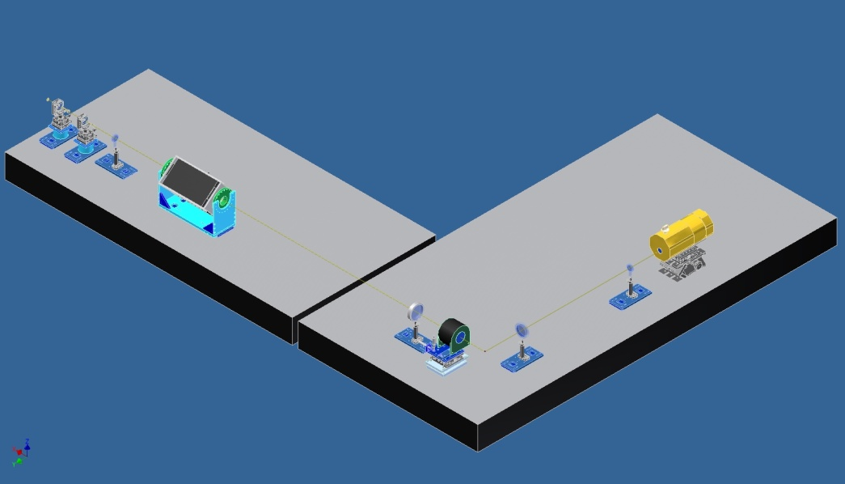
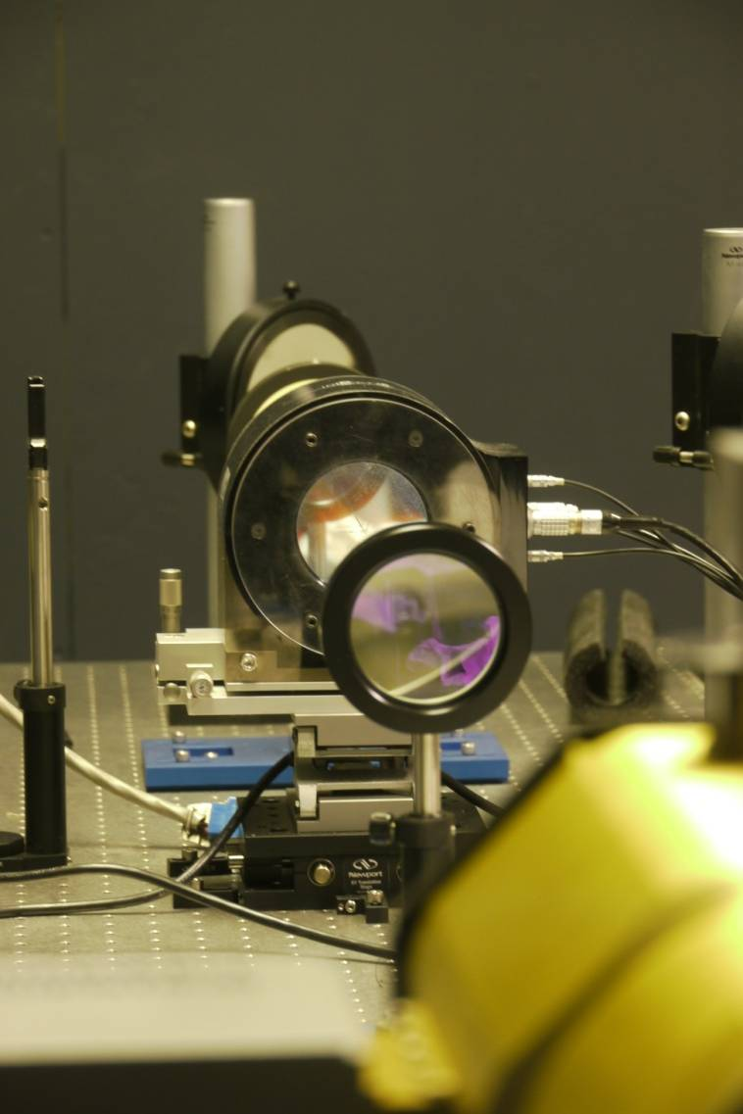
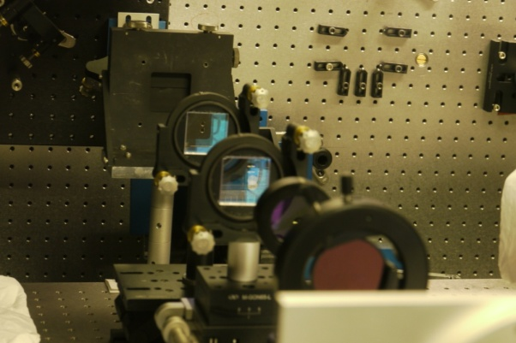
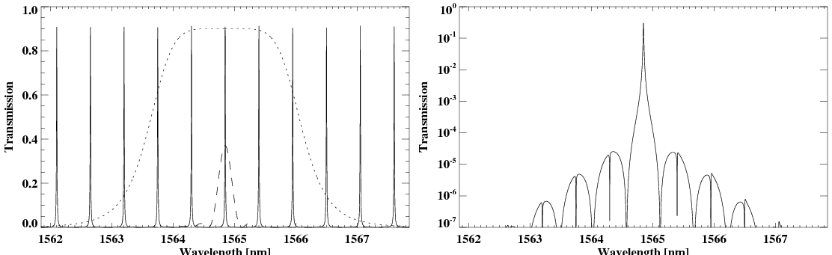
IR Imaging Magnetograph (IRIM)
NIR Fabry-Pérot etalon plus Lyot filter and interference filter
Wavelength coverage: 1 – 1.7 μm
  Fe I 15648.5 Å & Fe I 15652.9 Å
Band pass: 10 pm
Telecentric configuration with F/120
Field of view: 50” by 25”
Dual beam polarimetry
Rotating waveplate modulator
Spectral resolving power: > 10⁵
Zeeman sensitivity: ~ 10⁻³ I_{c}
Spectrometric cadence: < 15 s
Spectro-polarimetry cadence: < 45 s
Notes:
12
AO-corrected beam will be channeled into scientific instruments in Coude Lab. (Besides the BFI for photometric observation, we developed the IR imaging magnetograph,) the IRIM is one of them for the measurement of solar magnetic field. IRIM is based on an NIR Fabry-Perot interferometer which provides 0.1 A band-pass in a telecentric configuration. A Lyot filter and an interference filter act as the lobe-sorting filter.
As of now, IRIM only focuses on an infrared spectral line pair at 1.56 um. A dual beam design was adopted to minimize seeing-induced crosstalk. Available FOV is 50” by 25”. Vector spectropolarimetry cadence is less than 1 min.

Slide 13
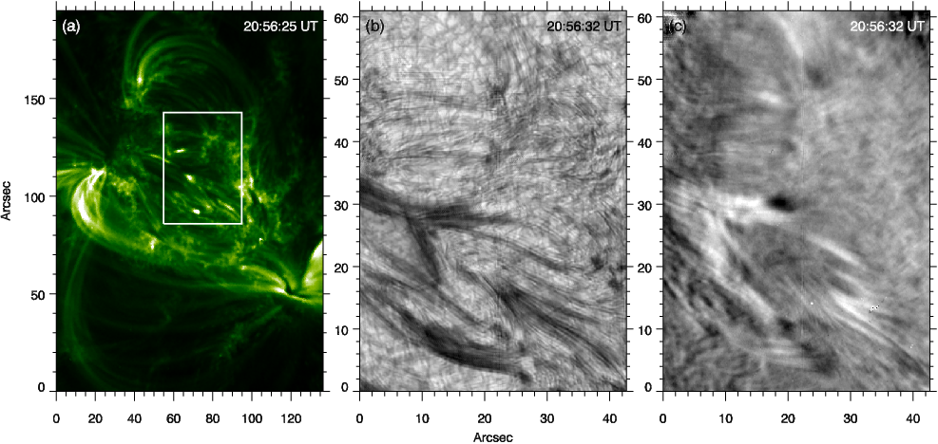
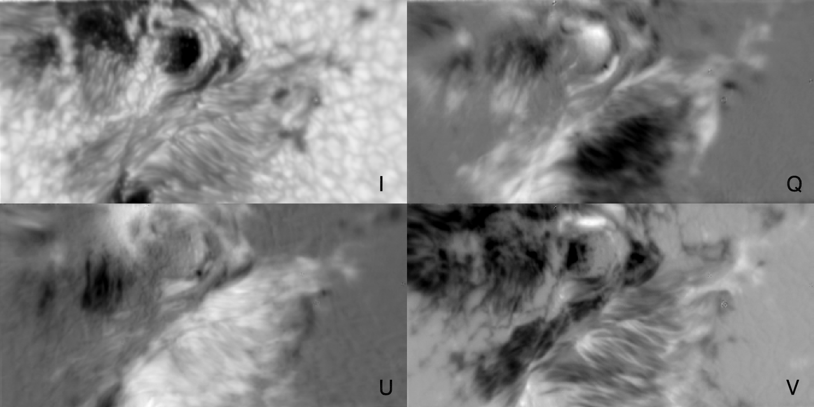
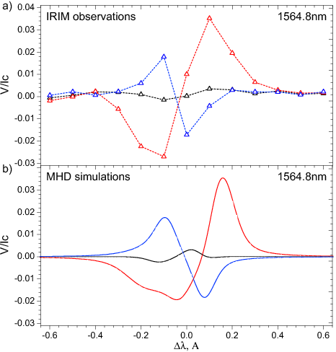
IRIM Observation
Implement telescope polarization calibration in collaboration with NSO
Develop priority scientific program and define observing sequences …
Integration of Stokes inversion code in collaboration with Univ. of Stanford
Upgrade IRIM into dual Fabry-Pérot etalon system (NIRIS)
Notes:
IRIM has been put into routine operation. Here is one sample of vector magnetic field measurement with IRIM. What we are doing is to further optimize calibration system and integrate Stokes inversion code to the spectropolarimetry profiles.
Calibrated IRIM VMG (7 Sept. 2011) in Fe I 1564.85 nm w/o Image Reconstruction.
“IRIM” LoS Magnetogram (1.0830 μm) & AIA/SDO 171 A (10 Feb. 2012),
Right now, we are working on the polarization calibration with collaboration with Dr. Elmore.

Slide 14
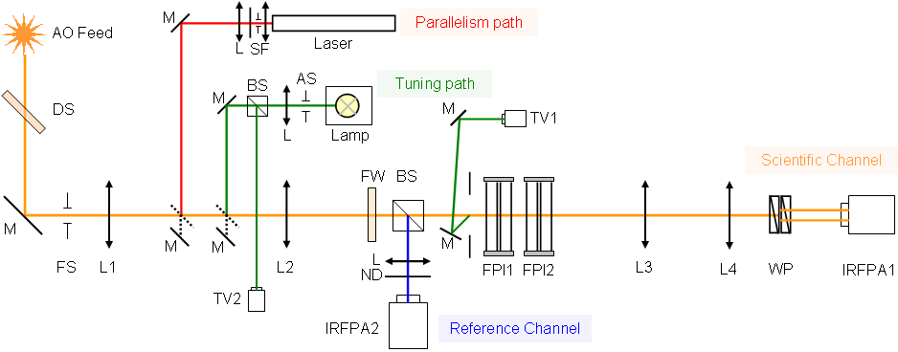
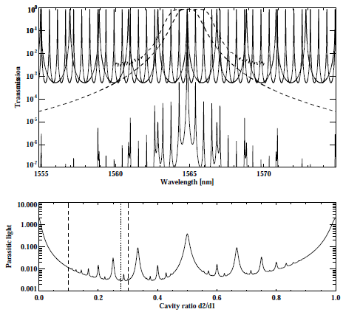
What’s Next ? -- NIRIS
Upgrade IRIM to NIRIS, in collaboration with KIS and UH
Dual Fabry-Pérot Interferometers with apertures of 100 mm
Wavelength coverage: 1000–1600 nm (HeI 1083 and FeI 1565 nm)
Spectral resolving power: > 10⁵
Telecentric optical configuration
Field of view: 85”
Polarimetry sensitivity: 10⁻⁴ I_{c}
Spectroscopy cadence: < 5 s
Vector spectro-polarimetry cadence: < 10 s
Notes:
14
IRIM has several unsatisfied limitations. For example, FOV is only 50” by 25” which is not sufficient to observe flares. Transmission is low due to the Lyot filter. The typical exposure time exceed 180 ms. Again, IRIM can only observe a narrow wavelength region at 1.56 micron.
These drawbacks push us to upgrade the IRIM to NIR imaging spectropolarimeter. NIRIS will base on dual FPI with apertures of 100 mm and operate from 1-1.6 um. FOV will be extended to 85”. Since the Lyot filter is replaced by a high-throughput FPI, the exposure time is significantly reduced by a factor of six times. Vector spectropolarimetry cadence will be less than 10 s.
NIRIS will focuses on two spectral lines: one is on photosphere, 1.56 mu, the other is on chromosphere, 10830 line. Using our Lyot filter, we have performed some polarimetry measurement with HeI 10830. The left panel shows an active region in AIA 171. The white box indicates the FOV of the right two panels which are Stokes I and V.
These figures show the optical design of the NIRIS and simulation of parasitic light as a function of two etalon cavities.

Slide 15
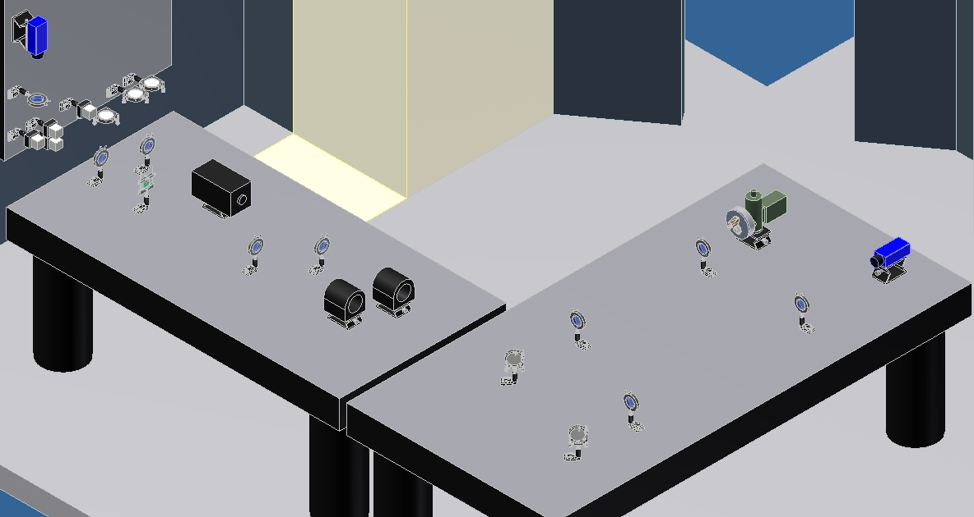
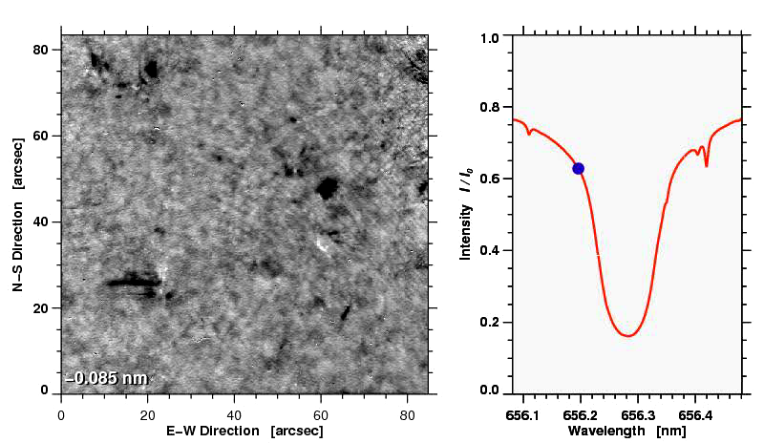
Visible Imaging Spectrometer
Single Fabry-Pérot etalon plus narrow band interference filter
Spectrometer before NST AO-308 installation
Wavelength coverage: 550 – 700 nm
Band pass: 5.8 pm
Telecentric optical configuration
Field of view: 45” by 45”
Available spectral lines:
  Hα (656.3 ± 0.15 nm )
  Fe I (630.2 ± 0.15 nm)
  NaD₂ (588.9 ± 0.15 nm )
Spectrometry cadence: < 15 s
Courtesy : C. Denker
Notes:
15
After AO-308 is put into operation, we will install VIS, a visible Fabry-Perot based spectrometer. A single Fabry-Perot interferometer is set up in a telecentric optical configuration to offer a 0.06 A band-pass. The currently available lines include Ha, iron 630 and D2. This movie illustrates a typical spectroscopy observation with a scanning over Ha line.

Slide 16
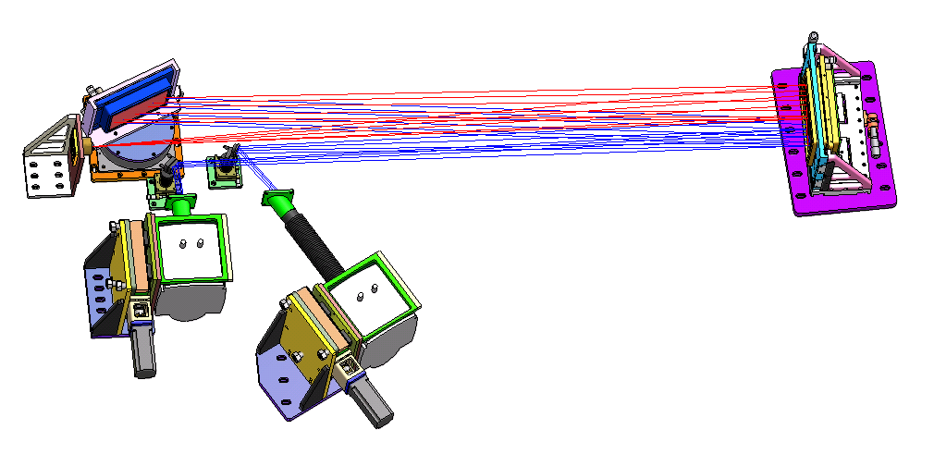
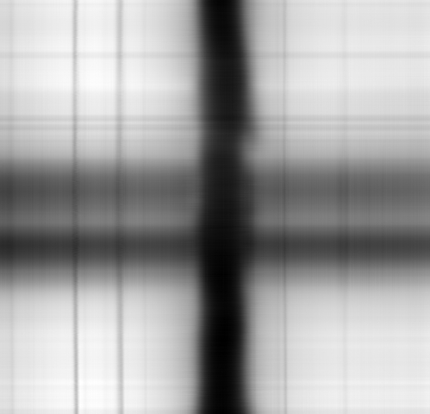
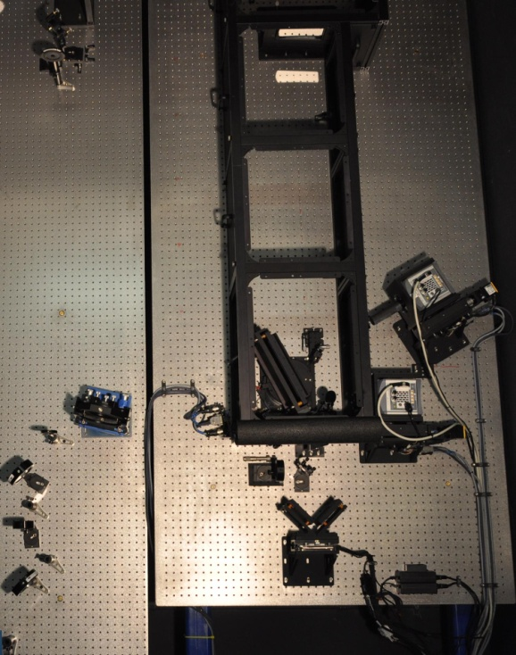
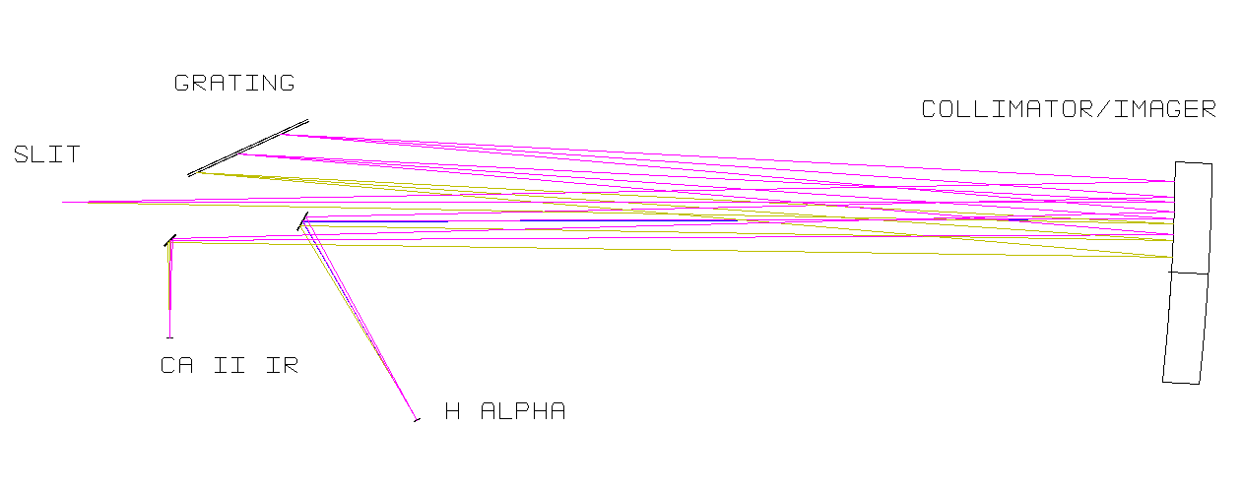
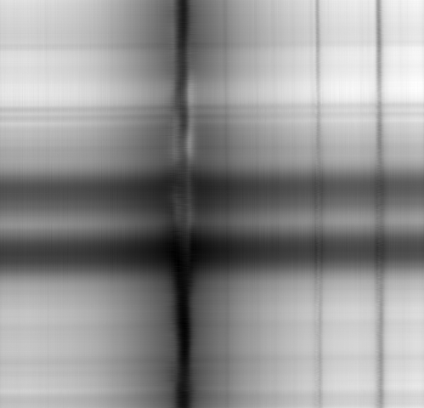
FISS
FISS – Fast Imaging Solar Spectrograph
A collaboration between BBSO and Korean Solar Community
Focus on fine structures of chromosphere: filaments, spicules, mottles, jets microflares …
Slit-scan imaging spectrograph
Quasi-Littrow configuration
Spectral resolution : 1.4×10⁵
60” scanning cadence : 60 sec.
Dual-band spectra at Hα and Ca II 854 nm using dual CCD cameras
Echelle grating with order-selecting filters
Notes:
16
The last available instrument is FISS – Fast imaging solar spectrograph. FISS is a collaboration between the BBSO and Korean solar community. The purpose of this instrument is to study the fine structure and its dynamics of chromosphere especially with two important spectral lines: Ha and calcium 8542. It is a routine operating instrument.

Slide 17
Cryogenic IR Spectrograph
CYRA is in its construction phase, a collaboration with NSO, HAO & UH
Fully cryogenic IR solar spectrograph
Scientific motivation
  Dynamics of weak photospheric field
  Chromospheric field variation with altitude
  Characterize cool regions in chromosphere
  Dimmer targets: umbra, off-limb …
High Zeeman Sensitivity: δλ ~ λ²g_{eff} B
NIR Bands of Interest for CYRA
  TiI 2.231 μm, λgeff = 5578, photosphere
  FeI 4.064μm, λgeff = 5080, photosphere
  SiI 4.143 μm, λgeff = 9321, photosphere
  CaI 3.697 μm, λgeff = 4067, chromosphere
  MgI 3.682 μm, λgeff = 4307, chromosphere
  CO 4.6 molecular band, chromosphere
High spatial resolution, high cadence spectrometry and polarimetry
CYRA
Notes:
17
CYRA is a cryogenic IR spectrograph operating over a spectral range from 2 to 5 um. This wavelength region is very challenging and has not been well exploited.
In contrast to the traditional solar IR spectrograph in operation, CYRA is based on fully cold optics. In another words, all components including slit, collimator, grating, order sorting filters and detector will be placed in a cryostat and are cooled to a very low temperature around 77 K. In this case, we can tremendously minimize thermal background emission.
NIR bands of interest include a couple of high zeeman sensitivity photosphere lines and several promising chromosphere lines.

Slide 18
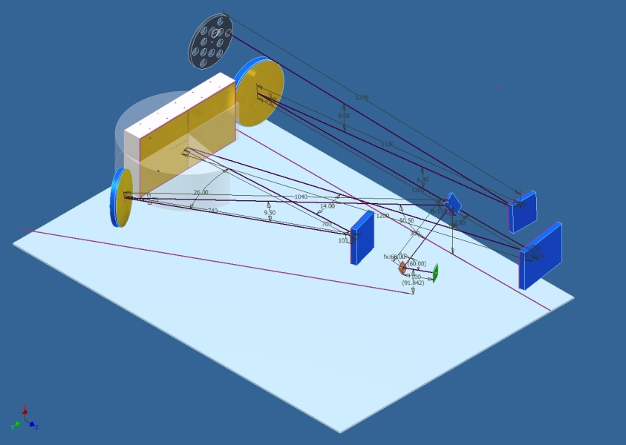
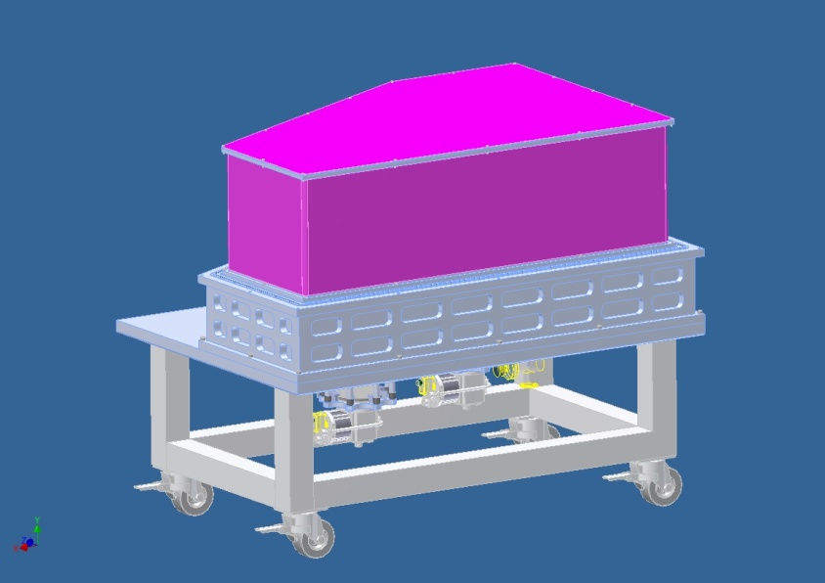
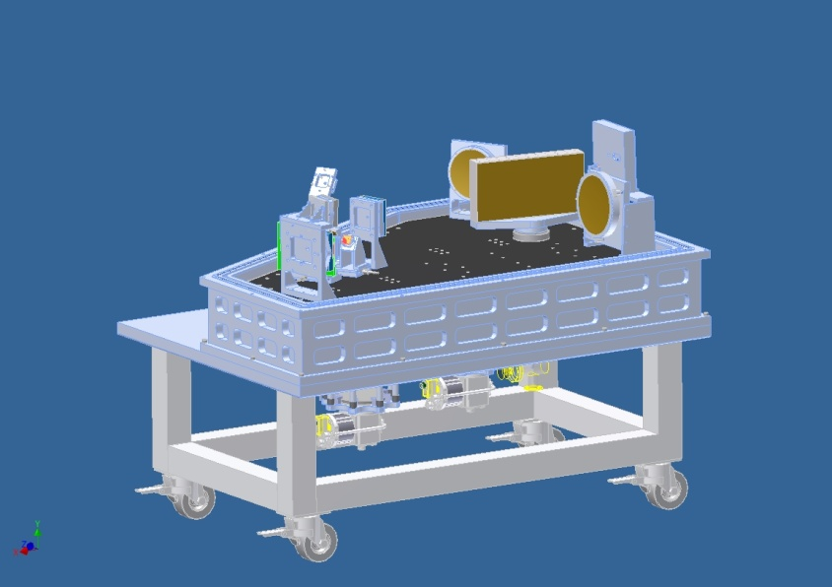
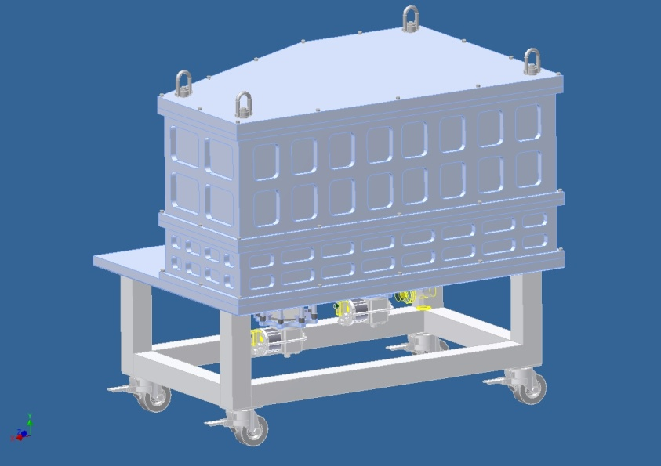
Cryogenic IR Spectrograph
CYRA is the only fully cryogenic NIR solar spectrograph
Operating Temperature of 77 K to minimize background thermal emission
Third floor of the BBSO dome
Spectral range 1.0 to 5.0 μm
Spectral resolving power > 10⁵
Spatial resolution: diffraction-limited for wavelengths > 2 μm
Temporal modulation 10 Hz with dual beam differential polarimetry
Field of view: 75"
Image stabilization: Tip/tilt
Image rotation compensator and image scanner
Context imaging and guiding
Notes:
18
At present, CYRA is in its construction phase. These figures show the optical layout and mechanical design of the CYRA. This nice coffin is the cryostat of the CYRA, which need to pumped into vaccum. Three stages compressor keep the operating temperature of the cryostat down to 77K and IRFPA to 35 K.
The spectrograph will operate over a range from 1 to 5 um. Spectral resolving power is larger than 10 to the power of 5. Dual beam differential polarimetry will be required to minimize seeing-caused polarization. In addition, the hardware outside the cryostat include correlation tracker, image rotator and scanner, slit-jaw imaging and guiding system…

Slide 19
NST Scientific Results
Observation of Ultrafine Channels of Solar Corona Heating, 2012, Ji, H.S., Cao, W., Goode, P.R. ApJ Lett., 750/1, L25
First Simultaneous Detection of Moving Magnetic Features in Photospheric Intensity and Magnetic Field Data 2012, Eun-Kyung Lim, Vasyl Yurchyshyn, Philip Goode, ApJ, 753, 89
Properties of Umbral Dots as Measured from the New Solar Telescope Data and MHD Simulations, 2012, Kilcik, A., Yurchyshyn, V. B., Rempel, M., Abramenko, V., Kitai, R., Goode, P. R., Cao, W., and Watanabe, H. ApJ., 745/2, 163
Turbulent Diffusion in the Photosphere as Derived from Photospheric Bright Point Motion, 2011, Abramenko, V. I., Carbone, V., Yurchyshyn, V., Goode, P. R., Stein, R. F., Lepreti, F., Capparelli, V., & Vecchio, A. ApJ., 743/2, 133
Photospheric Signatures of Granular-scale Flux Emergence and Cancellation at the Penumbral Boundary, 2011, Eun-Kyung Lim, Vasyl Yurchyshyn, Valentyna Abramenko, Kwangsu Ahn, Wenda Cao, and Philip Goode, ApJ., 740/2, 82
On the Origin of Intergranular Jets, 2011, Yurchyshyn, V., Goode, P. R., Abramenko, V. I., & Steiner, O., ApJ Lett., 736, L35
Response of Granulation to Small-scale Bright Features in the Quiet Sun, 2011, Andic, A., Chae, J., Goode, P. R., Cao, W., Ahn, K., Yurchyshyn, V., Abramenko, V., ApJ, 731, 29A
Statistical Distribution of Size and Lifetime of Bright Points Observed with the New Solar Telescope, 2010, V. I. Abramenko, V. B. Yurchyshyn, P.R. Goode, A. Kilcik, ApJ Lett., 725/1, L101-L105
Chromospheric signatures of small-scale flux emergence as observed with NST and Hinode instruments, 2010, V. B. Yurchyshyn, P.R. Goode, V. I. Abramenko, J. Chae, W. Cao, A. Andic, K. Ahn, ApJ, 722/2, 1970-1976
Evidence of Filament Upflows Originating from Intensity Oscillations on the Solar Surface, 2010, W. Cao, Z. Ning, P.R. Goode, V. Yurchychyn, H. Ji, ApJ Lett, 719/1, L95-L98
Oscillatory Behavior in the Quiet Sun Observed with the NST, 2010, A. Andic, P.R. Goode, J. Chae, W. Cao, K. Ahn, V. Yurchyshyn, V. Abramenko, ApJ Lett, 717, L79-L82
Highest Resolution Observations of the Quietest Sun, 2010, P. R. Goode, V. Yurchyshyn, W. Cao, V. Abramenko, A. Andic, K. Ahn, J. Chae, ApJ Lett, 714, L31
New Solar Telescope Observations of Magnetic Reconnection Occurring in the Chromosphere of the Quiet Sun, 2010, J. Chae, P. R. Goode, K. Ahn, V. Yurchyshyn, V. Abramenko, A. Andic, W. Cao, Y. D. Park, ApJ. Lett, 713, L6
Notes:
19
Thanks to the NST data, a number of scientific results have been achieved since the NST commissioning. Due to the limited available time, I will quickly go through (highlight) some of them.

Slide 20
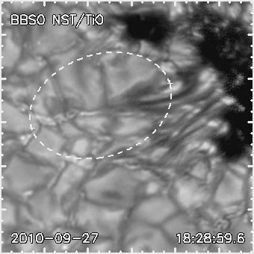
Flux Emergence and Cancellation
Notes:
With NST/TiO and SDO/HMI data, we found the signature of a flux emergence and cancellation.
Please pay attention to the elongated feature appearing here in TiO images. If we compare these two magnetograms, we can see that this negative part slightly protruded outward, and here the new positive magnetic patch appeared at the farther footpoint. The dark thread connecting those two footpoints.
So, those two opposite polarities seem to be connected and the elongated feature formed as this bipolar magnetic field emerges through the surface.
Let’s look at the HMI magnetograms. Green contours represent the outline of the pore,
and our object of interest is inside this yellow oval.
The elongated feature appeared here in TiO images. This is the outer footpoint of the feature.
If we compare these two magnetograms, we can see that this negative part slightly protruded outward,
And it’s even clear in the lower panels.
And here the new positive magnetic patch appeared at the farther footpoint.
I hope you remember the dark thread connecting those two footpoints.
So, those two opposite polarities seem to be connected and the elongated feature formed as this bipolar magnetic field emerges through the surface.
Although we don’t have the Doppler velocity information, this TiO and HMI observations are well-consistant with the picture of small-scale flux emergence.

Slide 21
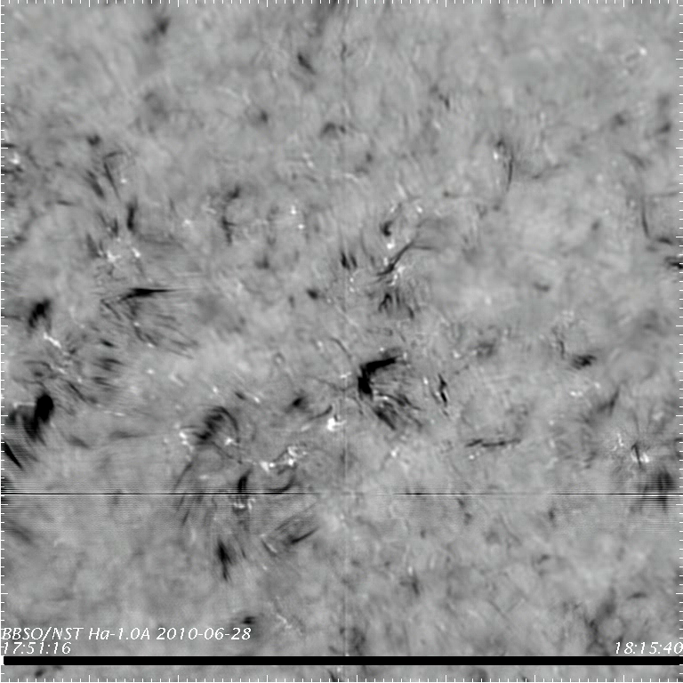
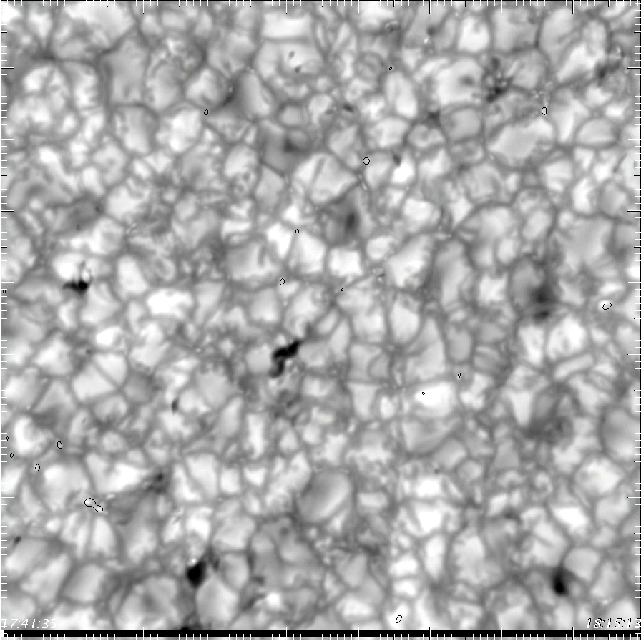
Granular Scale Jet Discovered
Notes:
We also found the granular scale jets. The image is a combination of TiO (granulation) and Hα-0.1 nm (dark jets) filtergrams. From this movie, you can see most of the jets are coming from the intergranular lanes. Some of them are associated with BPs
NST data for a CH acquired on Aug 31, 2010. The image is a combination of TiO (granulation) and Hα-0.1 nm (dark jets) filtergrams. The black contours encircle Hα-01.nm bright patches are to illustrate co-alignment b/w the data sets.
Coronal holes do not possess strong network fields so there are neither large clusters of bright points (BPs) nor intense rosettes formed by type I and II spicules.

Slide 22
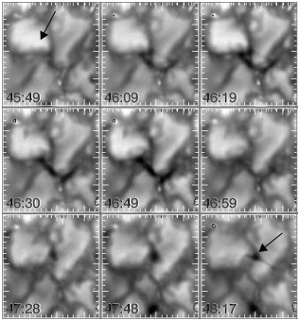
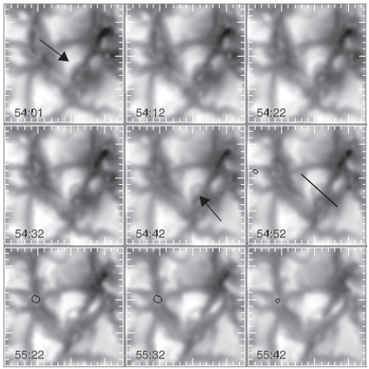
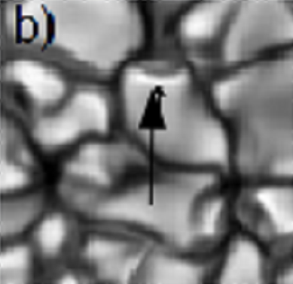
Origin of Intergranular Jets
Notes:
We try to discover the origin of these intergranular jets. Yesterday, Oscar has mentioned this results. So, I don’t go to the detail.
It is very interesting to find that most of them tend to be associated with granular fragmentation, in particular, with the formation and evolution of the bright granular lane (BGL) within individual granules. The BGLs have recently identified as vortex by Prof. Bob Stein, a professor of Michigan University.
Prof. Bob Stein has predicted that once this kind of pattern appearing on a granulation imply the flux vortex structure. From the NST high resolution data, we did find this pattern. Further, we found that this vortex structure may the origin of intergranular jets.
NST data for a CH acquired on Aug 31, 2010. The image is a combination of TiO (granulation) and Hα-0.1 nm (dark jets) filtergrams. The black contours encircle Hα-01.nm bright patches are to illustrate co-alignment b/w the data sets.
Coronal holes do not possess strong network fields so there are neither large clusters of bright points (BPs) nor intense rosettes formed by type I and II spicules.
NST Observations Verify Simulations of Granular Evolution, But…

Slide 23
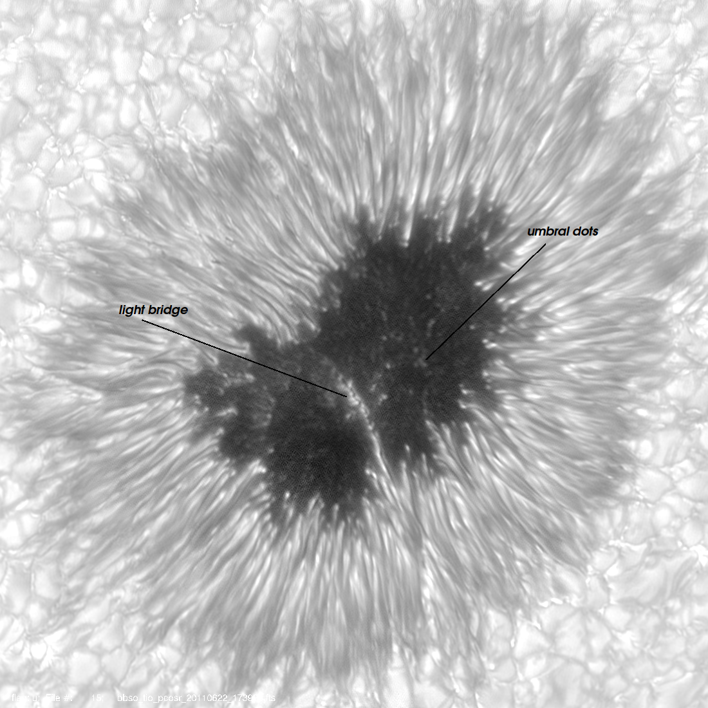
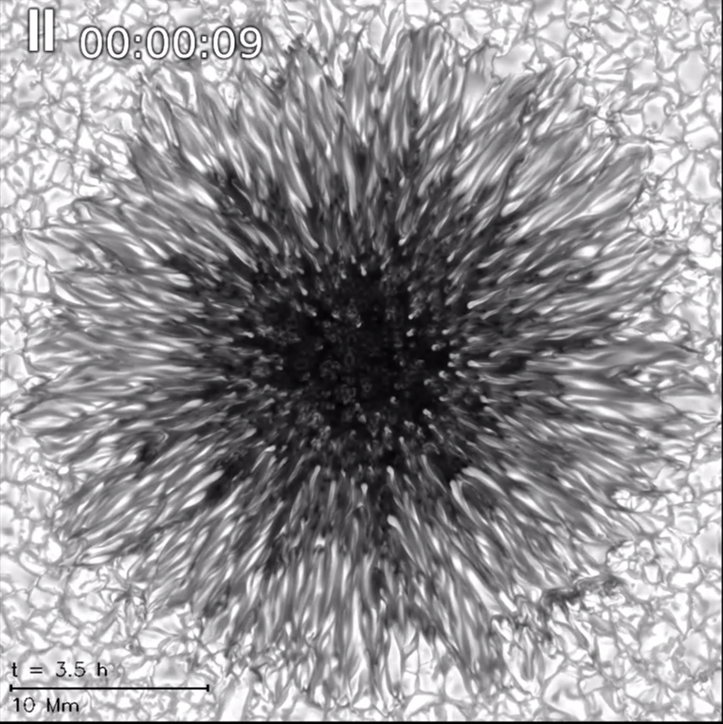
Sunspot & UDs: Real vs Simulated
Rempel, M.

Slide 24
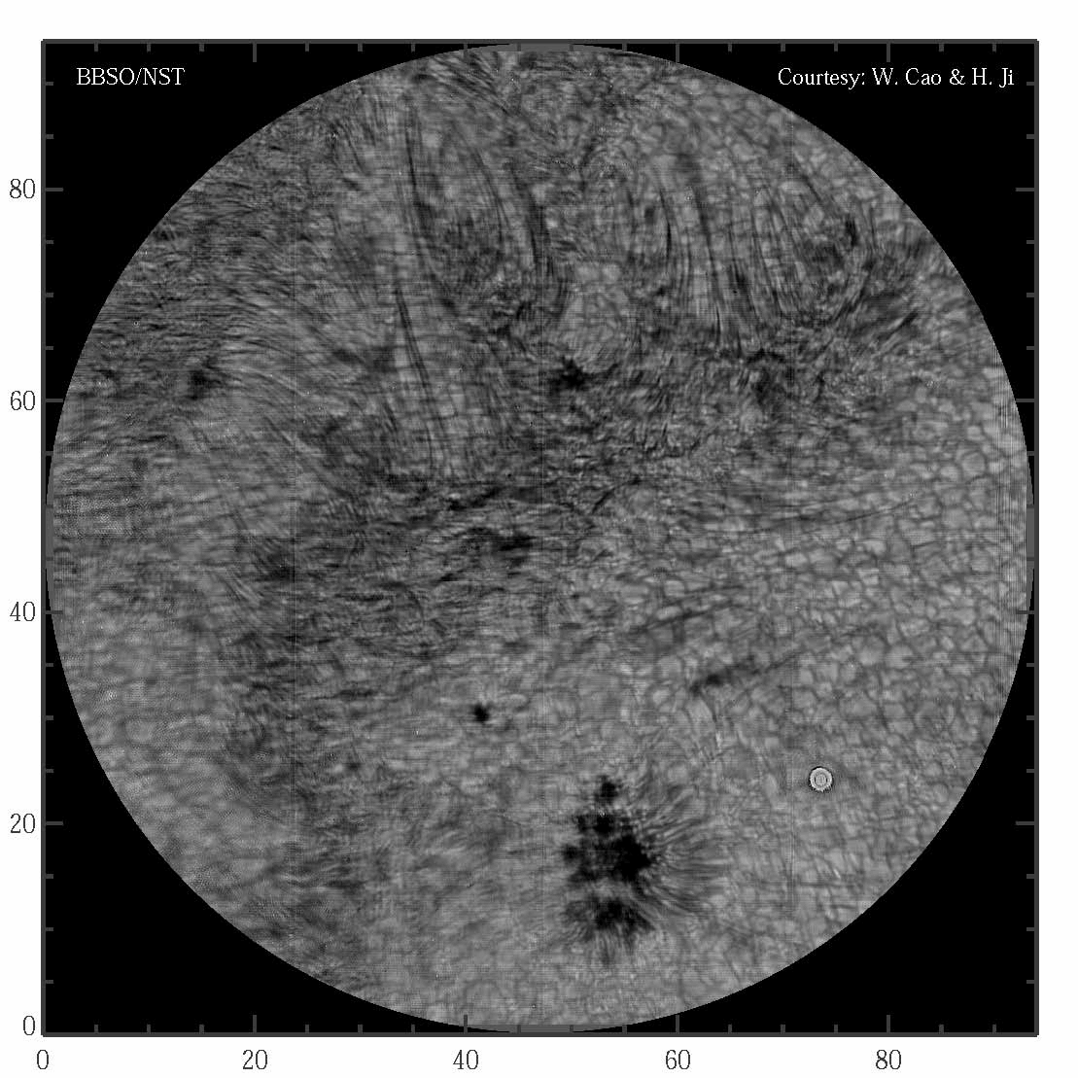
He I 1083 nm Ultrafine Loops
Notes:
We found ultrafine loop structures in HeI 10830 line. Also, we found a number of ejection moving up and down along these loops. This feature is quite consistent with what Oscar mentioned in his talk yesterday.
This movie shows our observation in HeI 10830 line on a normal active region. You can clearly see that ubiquitous ultrafine loops structure spanning over two regions with opposite magnetic polarities. What’s interesting is that something happen on the photosphere and subsequently lighting up the corona.

Slide 25
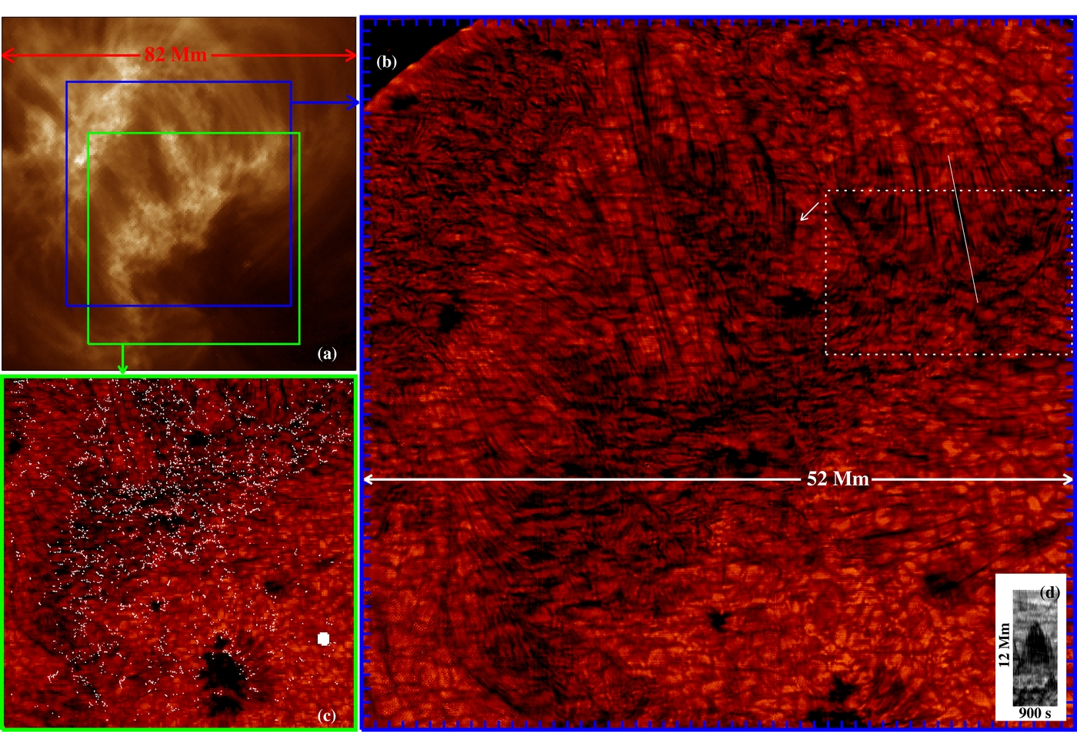
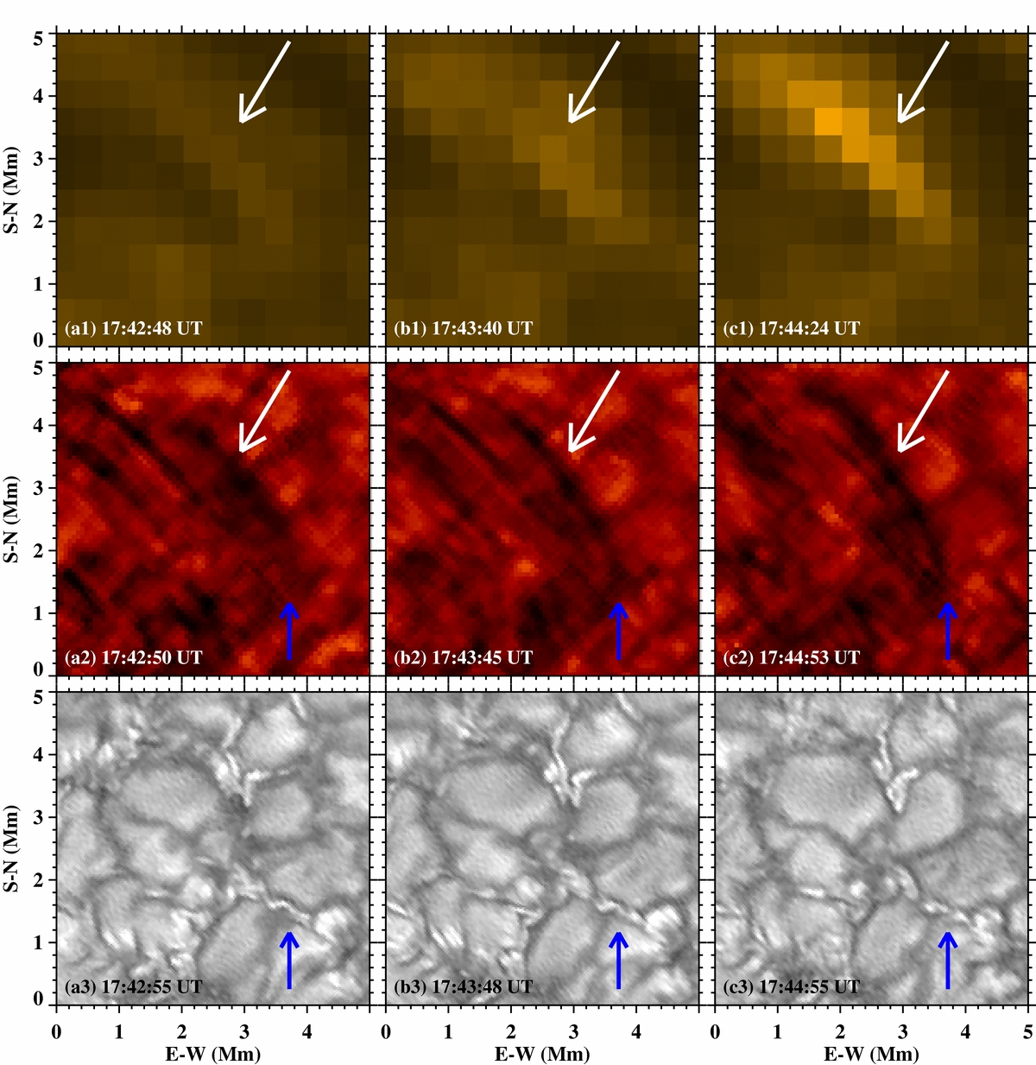

Ultrafine Loops and Ejections
AIA/SDO 193 Å
He I 10830 Å
Notes:
We found that the cross-section of the thinnest loop structure is about 100 km, which is close to the NST’s diffraction limited resolution at this wavelength.
Also we found that ultrafine magnetic loop structures originate from compact magnetic flux concentrations in the intergranular lanes and reach up to corona.
We track the individual ejection from photosphere to chromoshphere up to corona. We found that at least part of the solar energy that heats the corona is channeled through the ultrafine magnetic loop structures in form of plasma ejecta.
We detect continuous plasma ejections along the magnetic structures, which cause local impulsive coronal heating events seen in the overlying AIA/SDO loops..
The HeI images clearly reveal fine loops structure (we called ultrafine structure loops) which we have never seen before. The cross-section of the thinnest loop structure is about 100 km, which is close to the NST’s diffraction limited resolution at this wavelength.
Ultrafine magnetic loop structures originate from compact magnetic flux concentrations in the intergranular lanes and reach up to corona.
The absorbing features in HeI 10830 are painted in pink color. So, we can see that the 10830 A absorbing plasma are right over the intergranular lanes.
We detect continuous plasma ejections along the magnetic structures, which cause local impulsive coronal heating events seen in the overlying AIA/SDO loops.
These observations indicate that at least part of the solar energy that heats the corona is channeled through the ultrafine magnetic loop structures in form of plasma ejecta.

Slide 26

BBSO was built by Caltech in 1969. The dome sits at the end of a 1000 ft. causeway on Big Bear Lake’s north shore at 6,750 foot elevation.
Observatory was transferred from Caltech to NJIT in July 1997.
The surrounding waters of Big Bear Lake reduce ground level convection, and predominate winds bring smooth air flows across the flat surface of the lake providing superb conditions for solar observing.
Notes:
The largest aperture solar telescope has been put into operation in Big Bear. We are gradually making the observation time available to solar community. The data which were taken in the past few years will also be available online for download very soon.
It is our hope that in the next few years, the NST and these instruments can shed new light on some of your unanswered questions.
We have every reason to believe that the NST will play a critical role in ground-based high resolution observation in the next few years (and these scientific instruments will shed new light on some of your unanswered questions).

Slide 27

Timeline
2008 | 2009 | 2010 | 2011 | 2012 | 2013 | 2014
NST construction
NST commissioning & operation
Nasmyth BFI
Coudé Lab BFI operation
CYRA design and construction
CYRA operation
install
AO-76 design
install
AO-76 operation
AO-76 operation
AO-308 design and develop
AO-308 operation
MCAO design and develop
IRIM design
install
IRIM operation
NIRIS design
upgrade
NIRIS operation
VIS develop
VIS operation
FISS design and lab test
install
operation
Notes:
Hopefully, my talk gives you a glimpse into NST post-focal instruments. The NST will be open to the solar community. It is our hope that the NST with these state-of-the-art instruments are able to shed new light on your researches.
The NST construction completed near the end of 2009. In the beginning of 2010, we had solar light in Coude Lab. Right now, the NST is already well into its commissioning phase;
Broad-band filter imager is a routine instrument, which was initially operated at Nasmyth focus and then moved into the Coude Lab after we had AO-76;
CRYA is in its construction phase. We anticipate to install it next year and to run it in 2013;
AO-76 was installed in the spring of 2010. This system is planned to operate for two years before we have AO-308, a high order AO system for the visible and NIR;
IRIM’s installation followed the AO-76 project. We are working on the polarization calibration and expect it to be in routine operation this summer. Also, it will be upgraded into a dual FPI in a near future;
We will install the VIM pretty soon. Considering the limited ability of AO-76 in correcting the visible seeing, VIM will only work as a spectrometer before 2013. After the AO-308 is well developed, VIM will be upgraded into a spectropolarimeter;
The installation and commissioning of FISS have completed. Now, FISS is a routine instrument.

