Slide 1

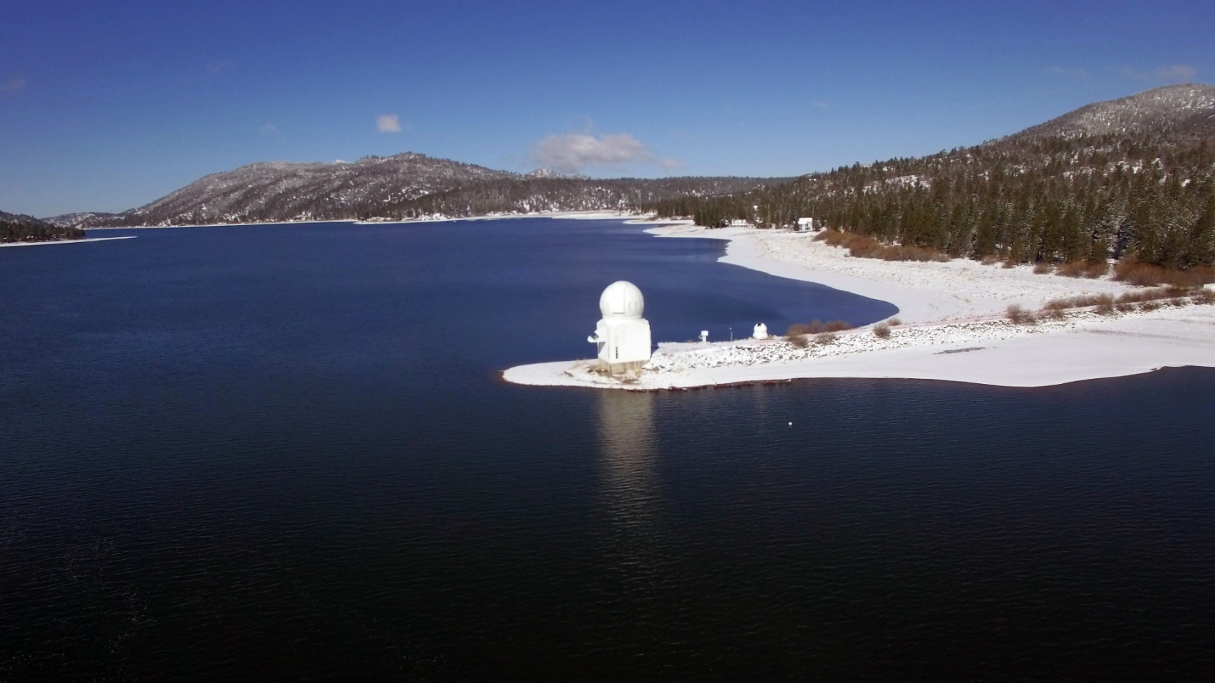
Big Bear Solar Observatory
The Sun is vitally important to all life on Earth and provides an ideal laboratory
for understanding our star and its effects on life on Earth.
Big Bear shares the good “astronomical seeing” and weather statistics found at
other SoCal mountain observatories such as Mt. Wilson, Mt. Palomar and Mt. Laguna.
Lake water has been found to stabilize the daytime “seeing” by suppressing near- ground atmospheric turbulence caused by heating thermals that plague most solar observatories.

Slide 2
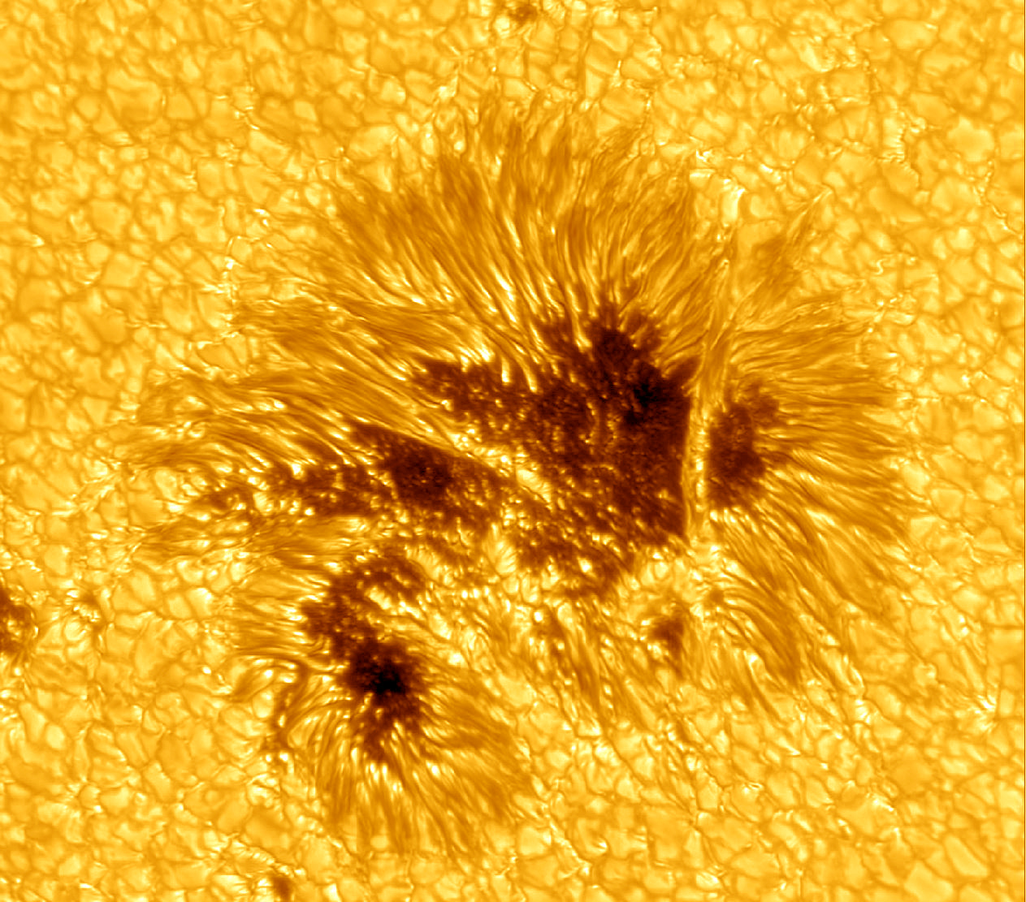
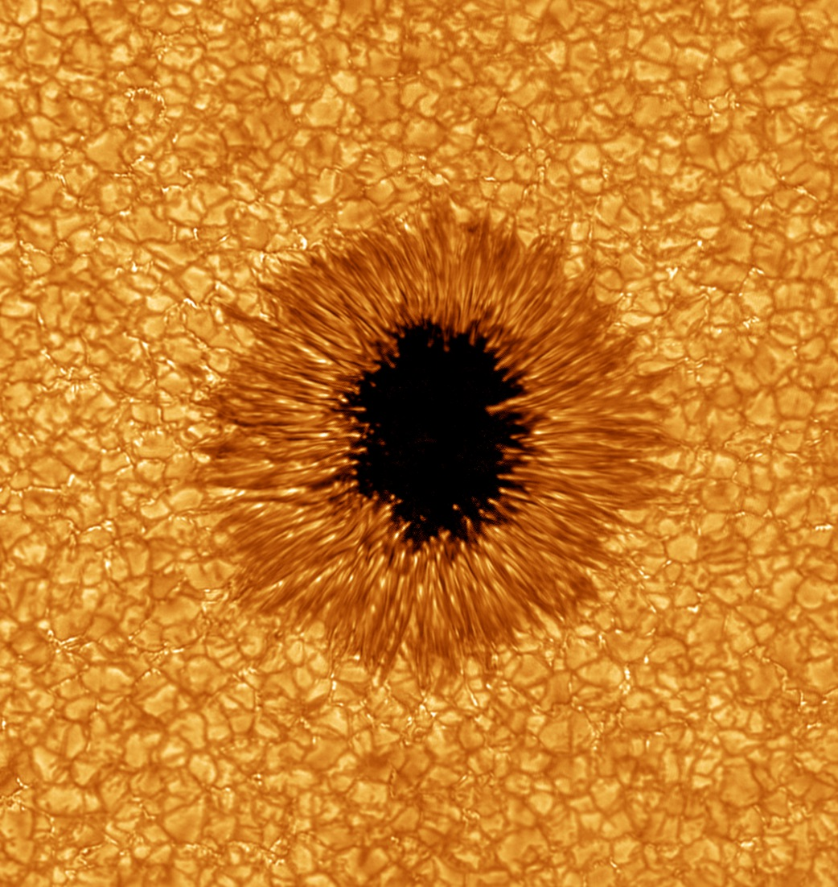
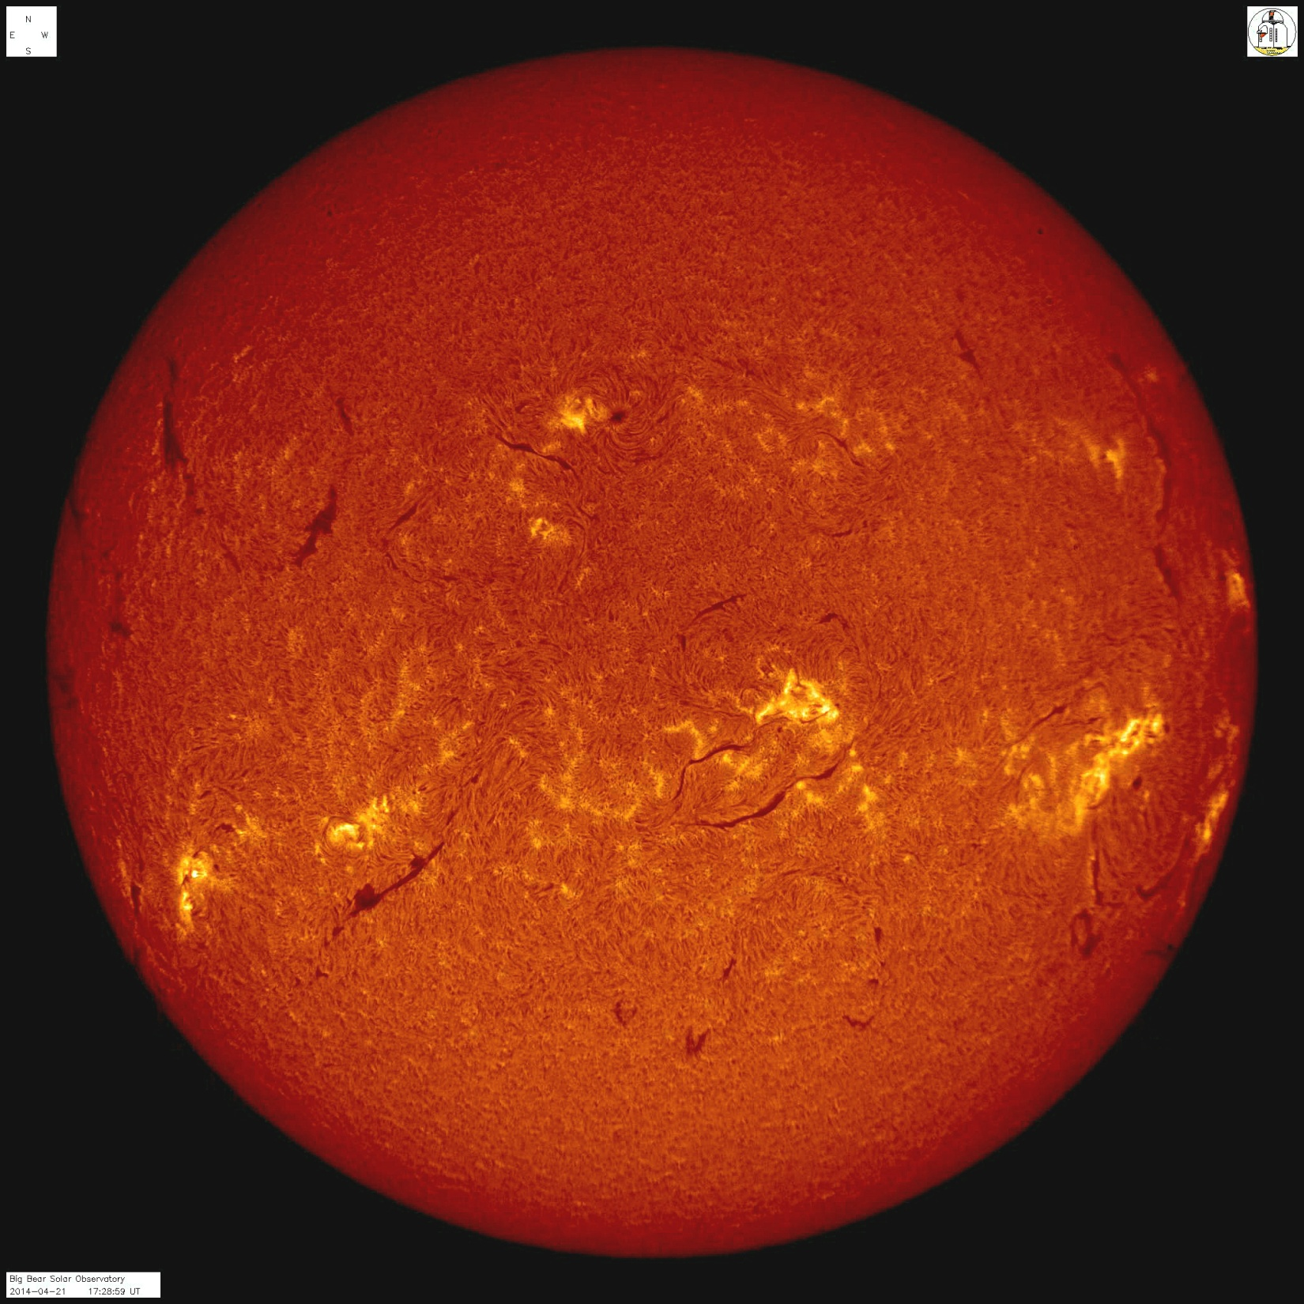

Big Bear Solar Observatory
The BBSO New Solar Telescope (NST) is currently the most powerful solar
telescope in the world and is unmatched in image quality.
The BBSO is part of a world wide of network of Earth and space-based telescopes that
collaborate in solar research.
The National Solar Observatory is developing the $360M DKIST in Hawaii which the NST
will support when operational in the early 2020s.

Slide 3
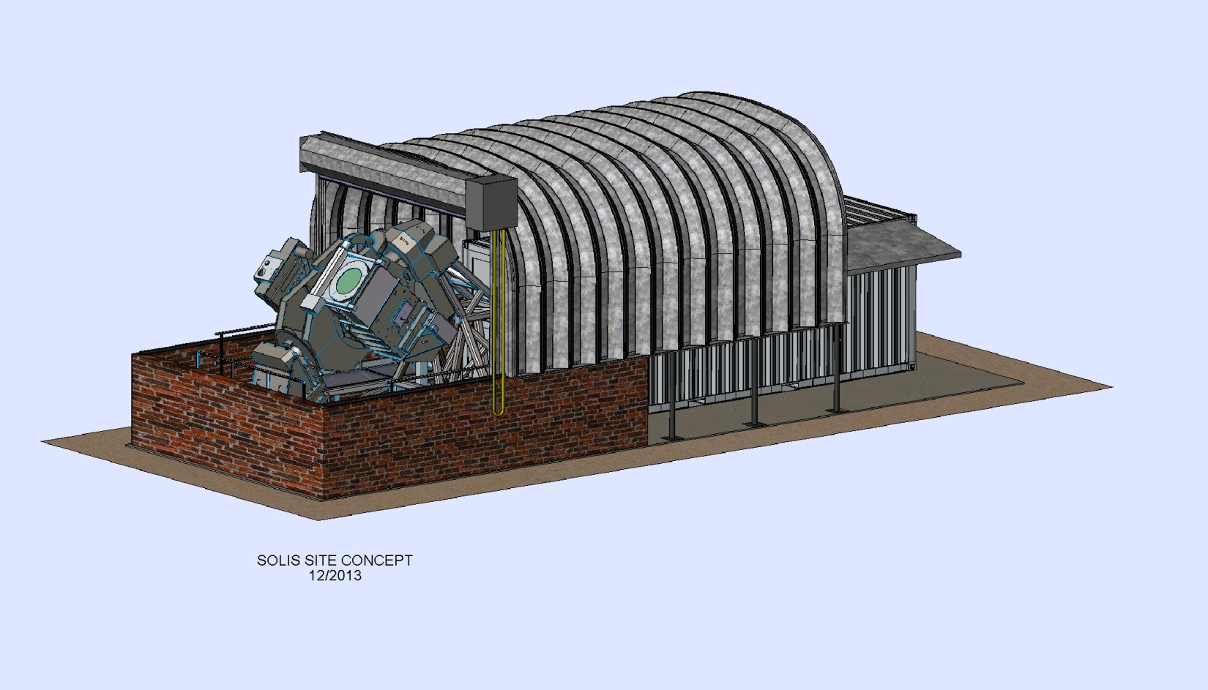
SOLIS
Synoptic Optical Long-term Investigations of the Sun
Developed by the National Solar Observatory (NSO) in Tucson, AZ
  BBSO collaborates with NSO on many projects and SOLIS would be another
Three instruments for solar observations on a single tracking mount.
  Vector Spectro Magnetograph (VSM) giving magnetic maps of the solar surface.
  Full Disk Patrol (FDP) full Sun multi-wavelength imager.
  Integrated Sunlight Spectrometer (ISS) “Sun as a star” spectra of the Sun.

Slide 4
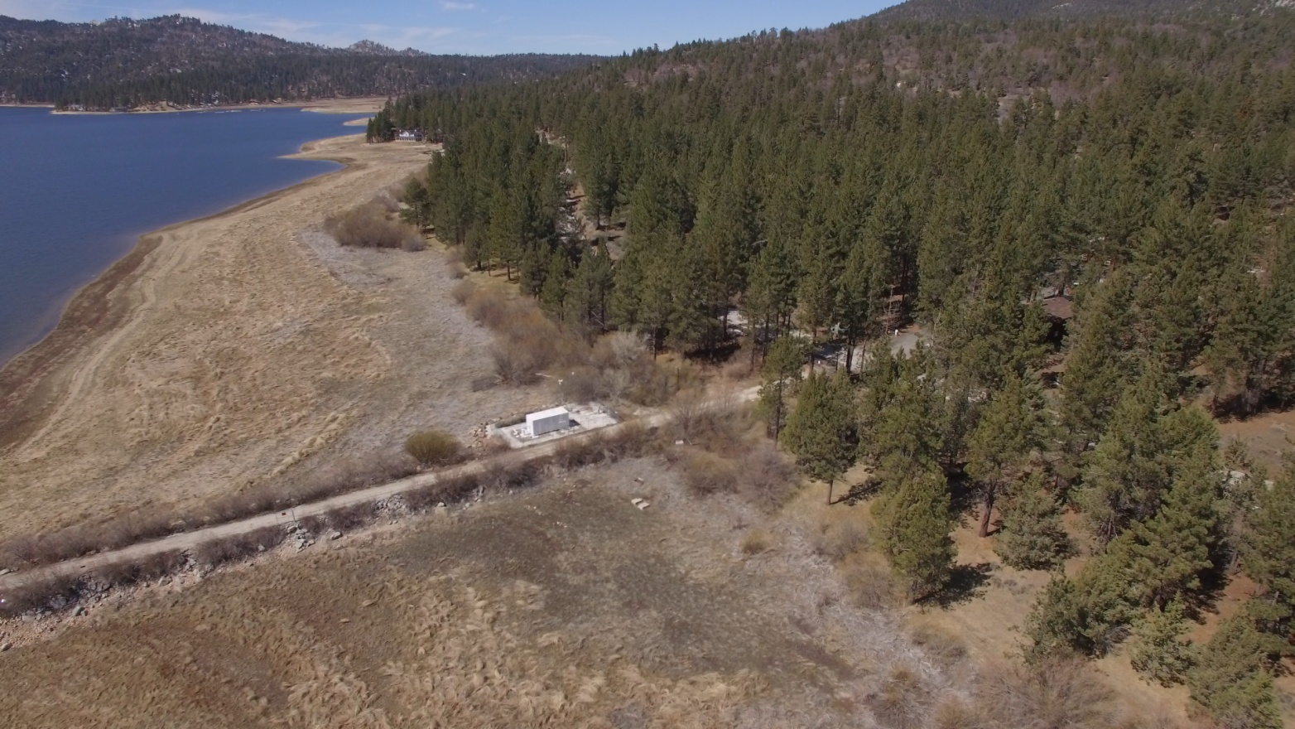
Siting SOLIS at BBSO
Preference is to co-locate SOLIS next the GONG instrument.
  Minimizes overall facility footprint.
  Clear horizons without need for tree removal.
  Better astronomical “seeing”
    Takes advantage of the daytime lake effect.
    Natural airflow not disturbed by trees.

Slide 5

Siting SOLIS at BBSO
Preference is to colocate SOLIS next the GONG instrument.
  Minimizes overall facility footprint.
  Clear horizons without need for tree removal.
  Better astronomical “seeing”
    Takes advantage of the daytime lake effect.
    Natural airflow not disturbed by trees.

Slide 6
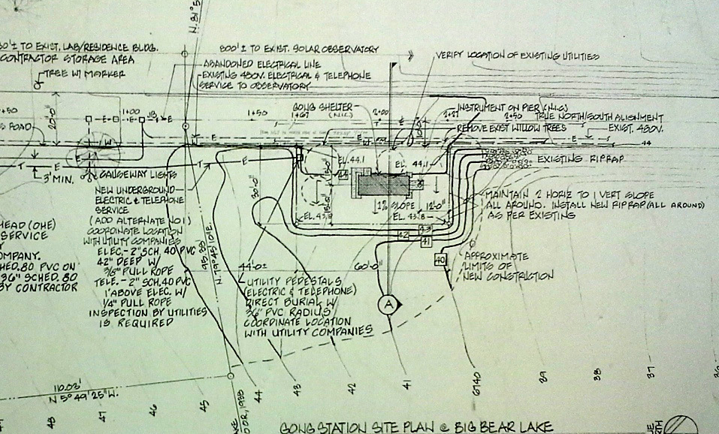
Siting SOLIS at BBSO
Preference is to co-locate SOLIS next the GONG instrument.
  Minimizes site preparation.
    Only adds a small extension to the GONG fill.
    Shares electrical and data services.
    Uses existing access road.

Slide 7
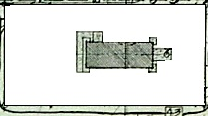
Siting SOLIS at BBSO
Preference is to colocate SOLIS next the GONG instrument.
  Minimizes site preparation.
    Only adds a small extension to the GONG fill.
    Shares electrical and data services.
    Uses existing access road.

Slide 8
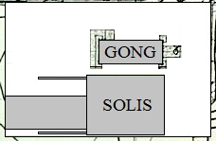
Siting SOLIS at BBSO
Preference is to colocate SOLIS next the GONG instrument.
  Minimizes site preparation.
    Only adds a small extension to the GONG fill.
    Shares electrical and data services.
    Uses existing access road.

Slide 9
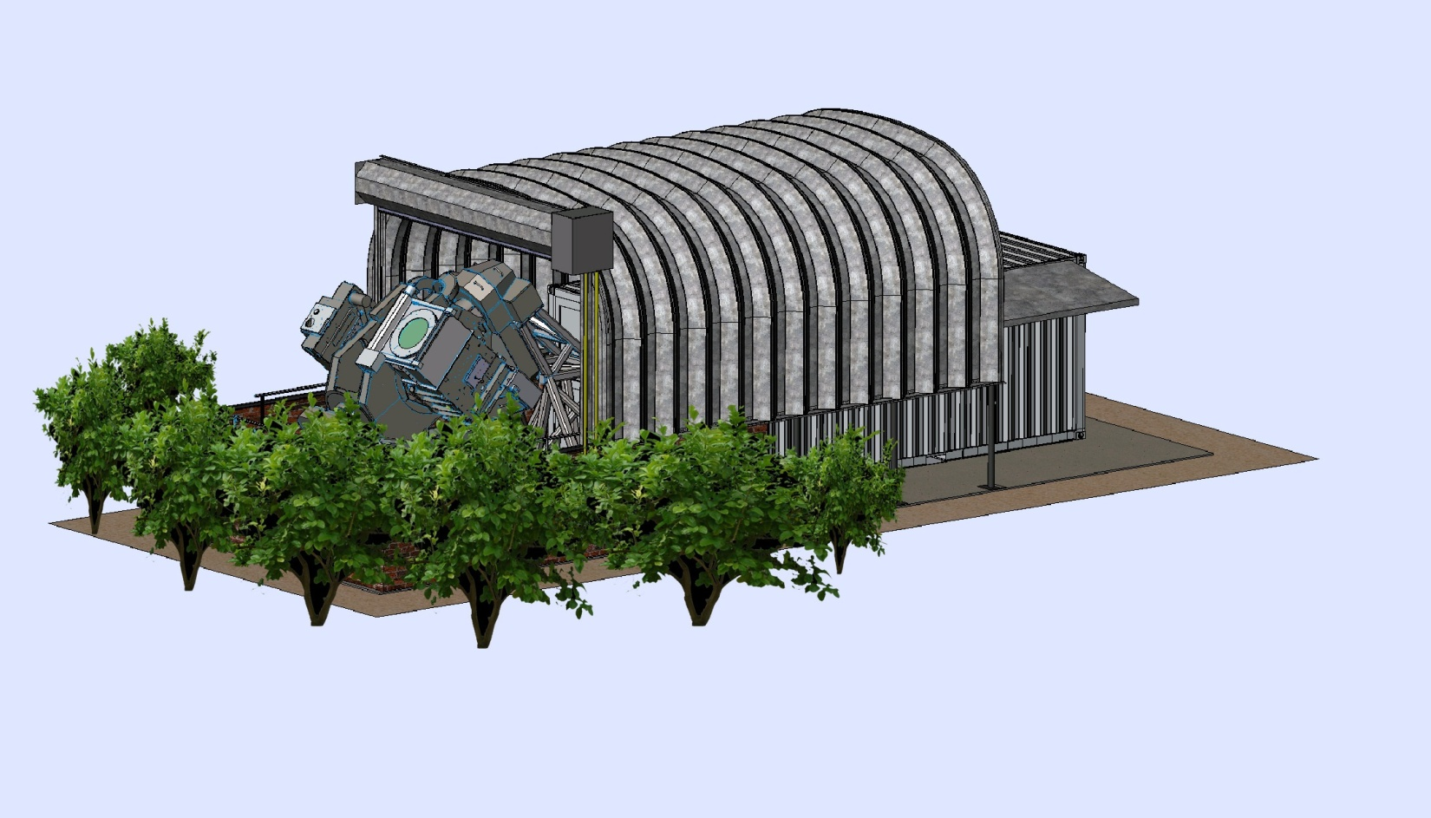
Siting SOLIS at BBSO
Preference is to co-locate SOLIS next the GONG instrument.
  Minimal visual impact.
    Not visible from North Shore Ln or the Forestry campground.
    Easily blended to the surroundings by planting natural shrubs as a visual block.
  Eliminates a need to remove any trees.

Slide 10
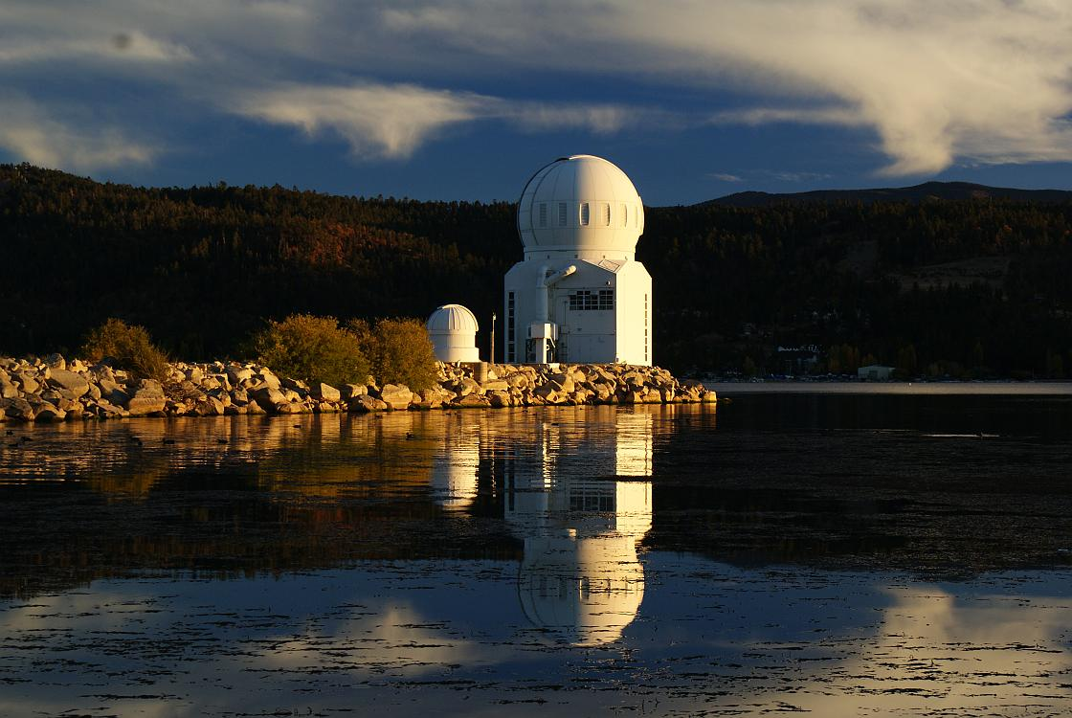
Thank You!

