Slide 1



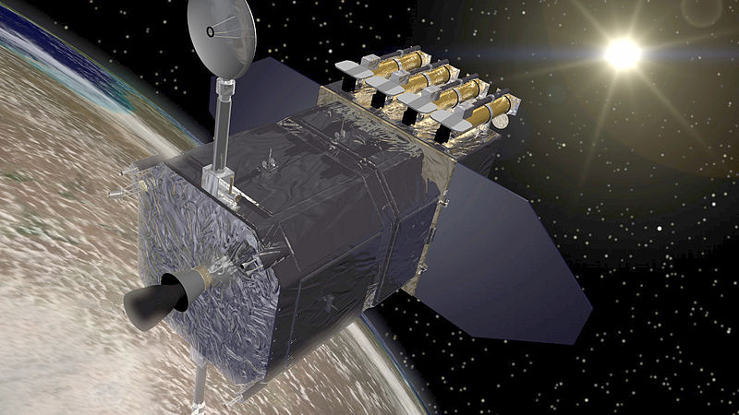
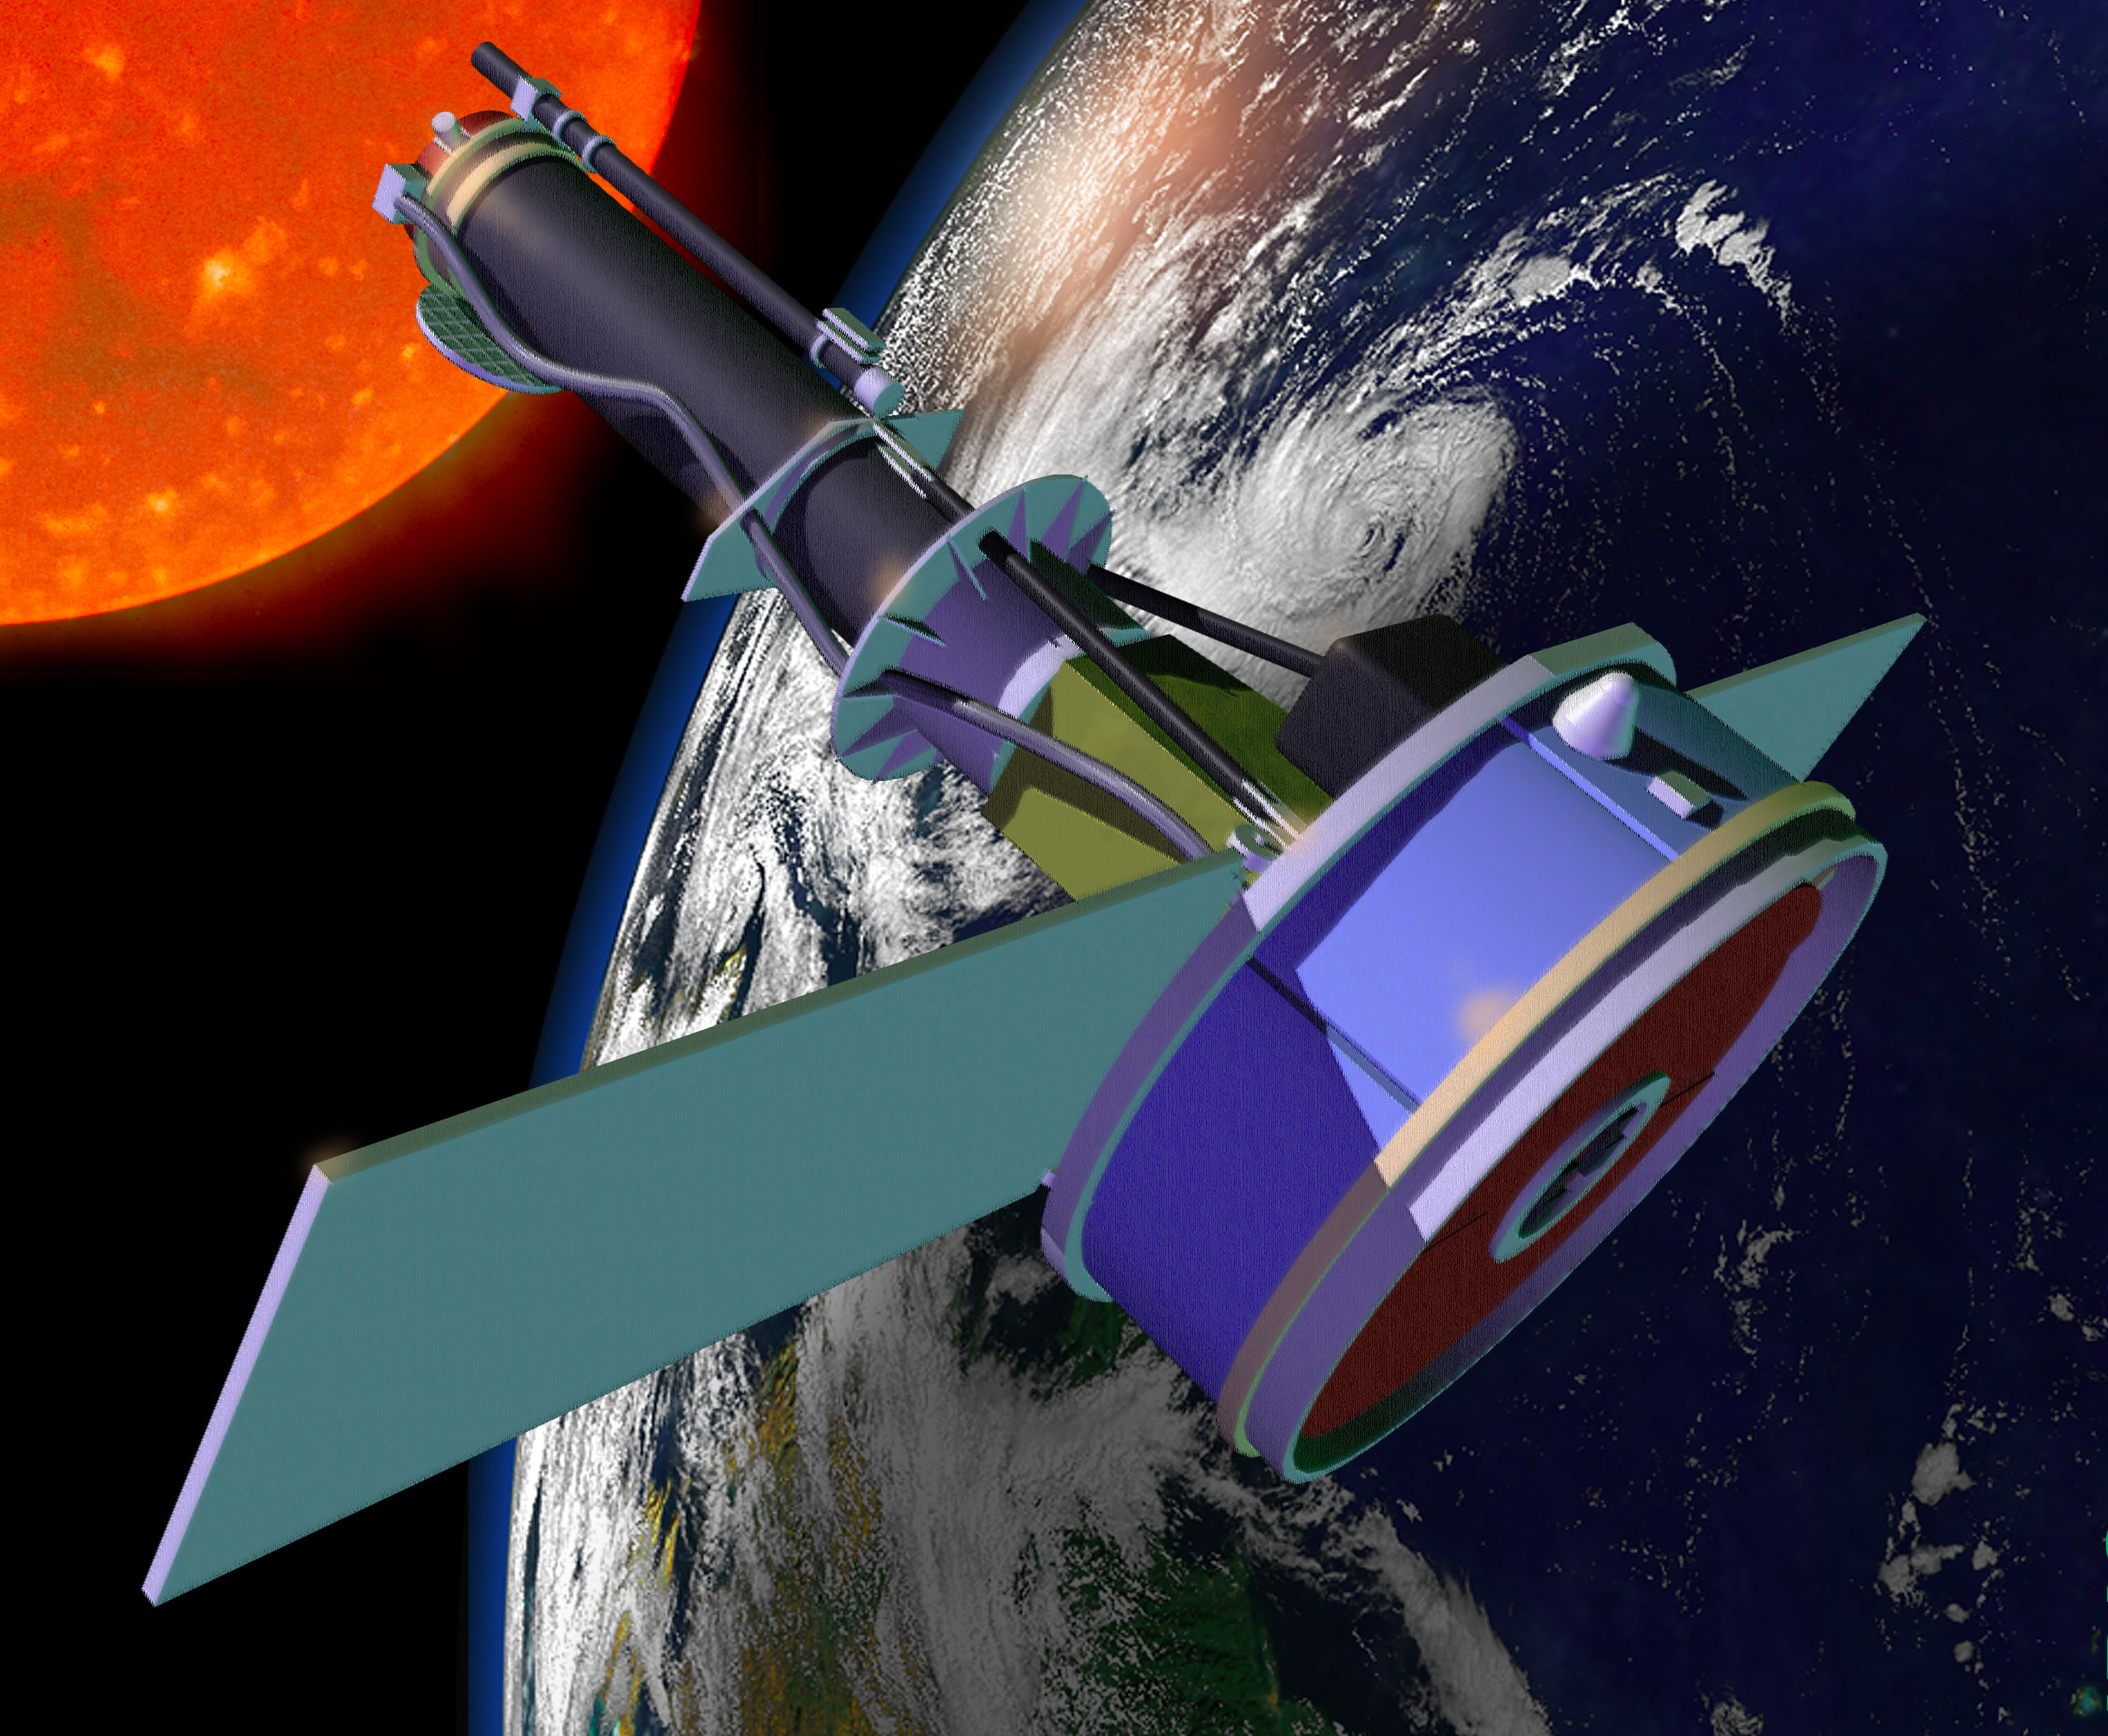
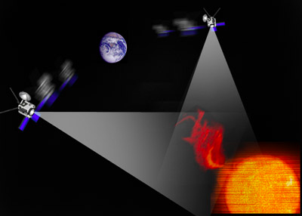
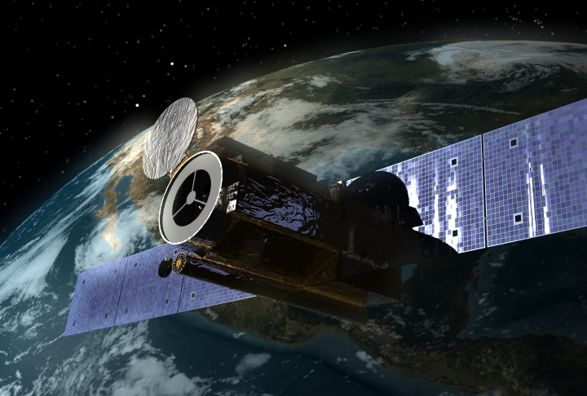
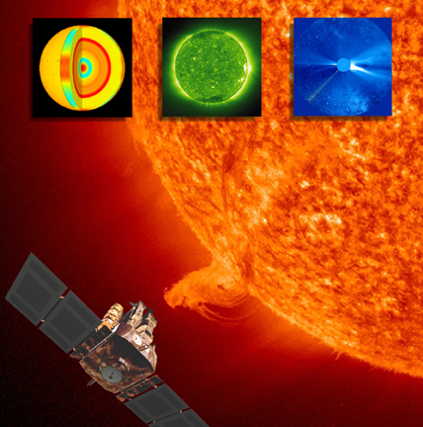
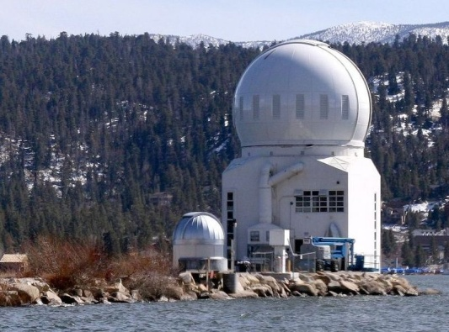
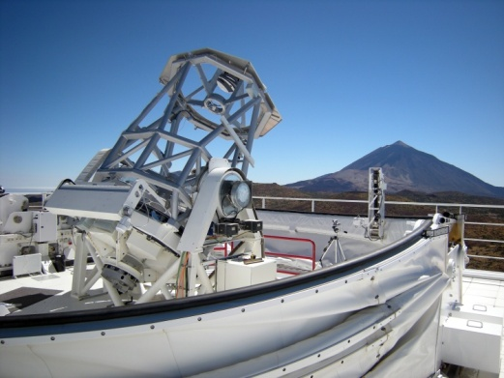
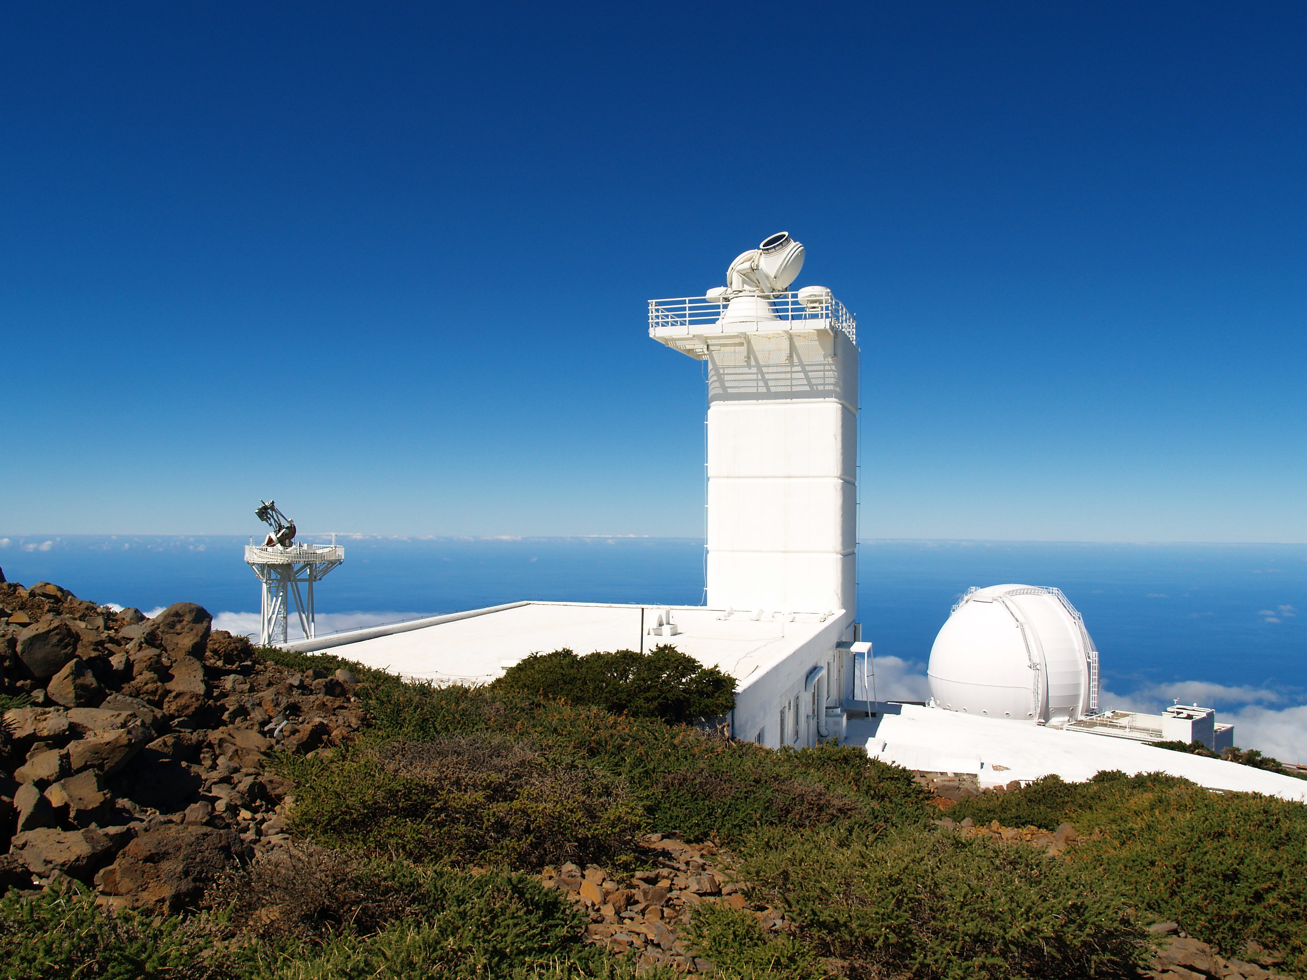
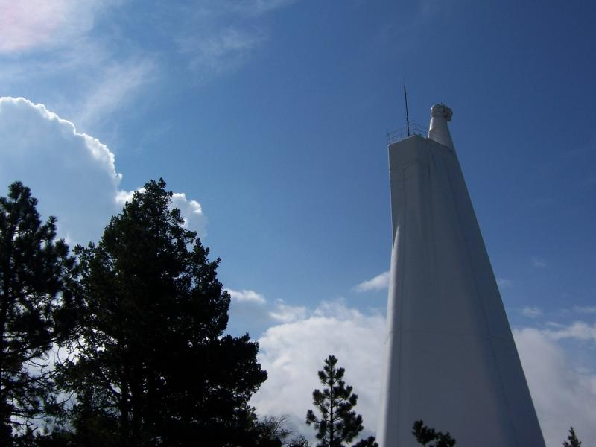
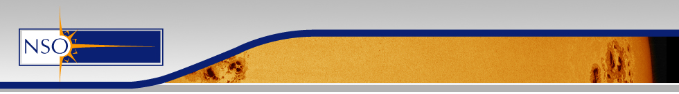
DKIST in the broader context
5 space observatories at 1 AU
4 telescopes in the 1m range
A golden age in Solar Physics driven by Space Observatories

Slide 2
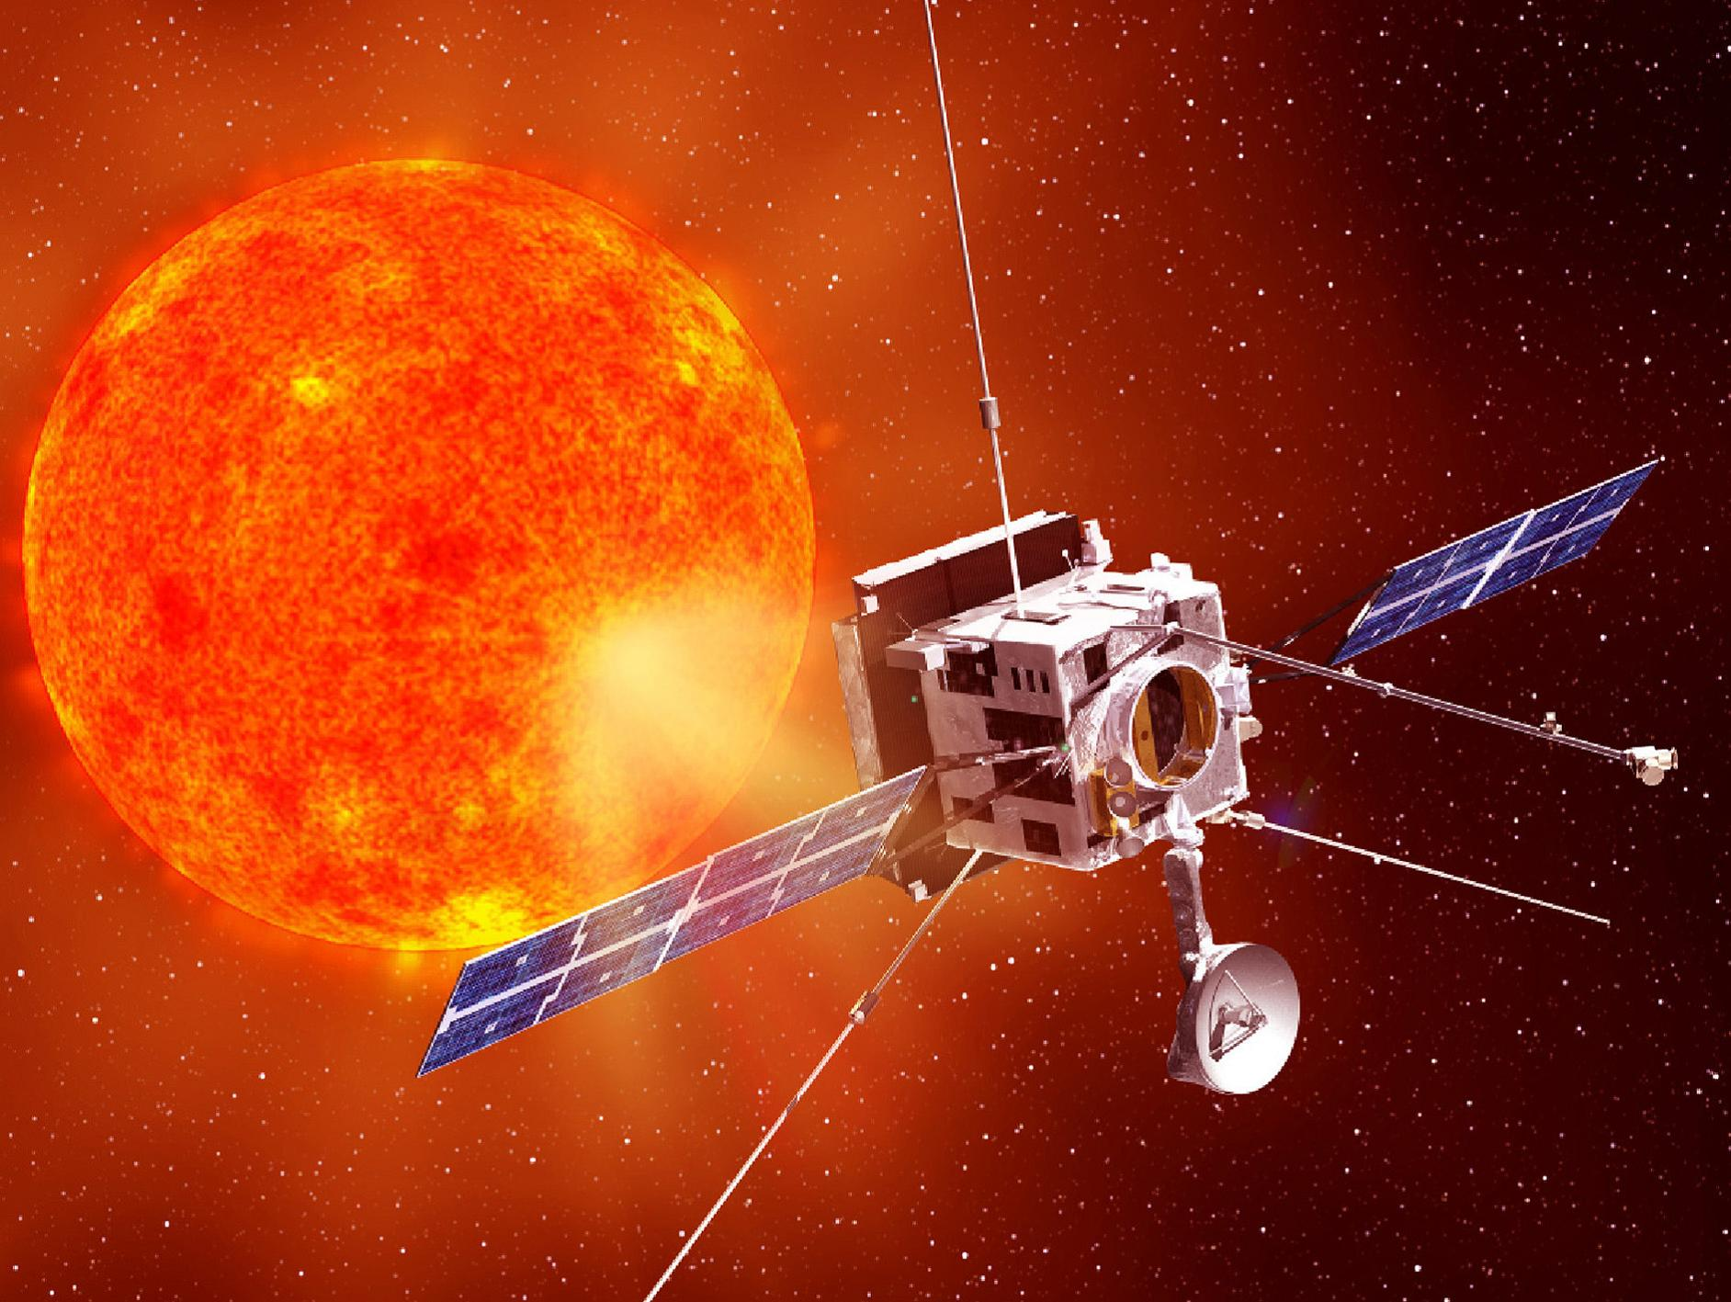
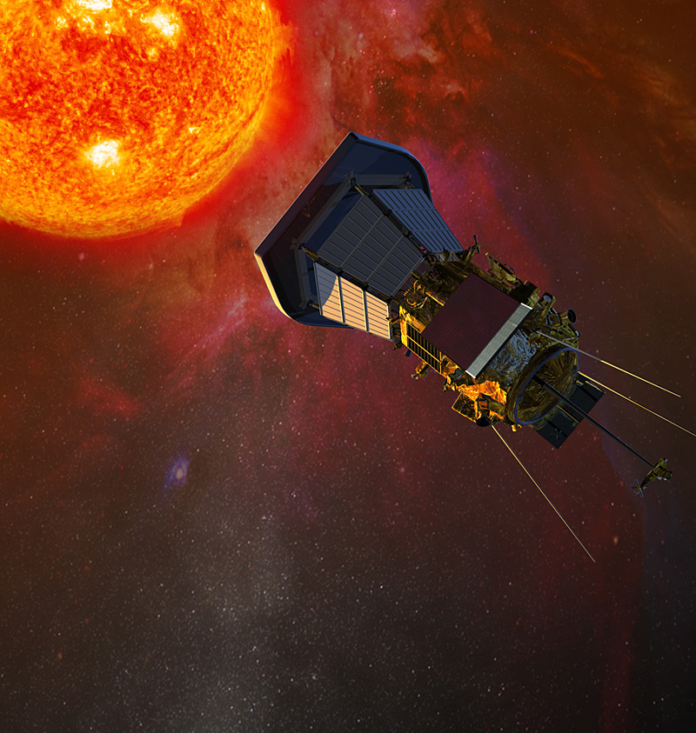
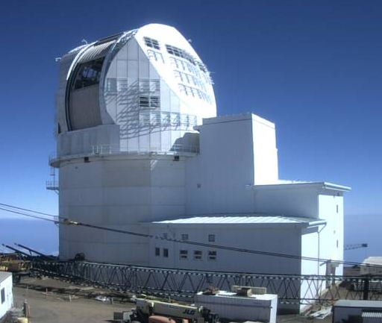
DKIST in the broader context
2 encounter missions inside 0.5 AU
4m class solar telescope
Recommendation: NASA, NSF, and other agencies should coordinate ground- and space-based solar-terrestrial observational and technology programs and expand efforts to take advantage of the synergy gained by multiscale observations.
Notes:
Solar Orbiter 10 days/3 months & no observing proposals – observations pre-defined – Solar Probe is second probe and has no telescope

