Slide 1
NSO Thermal Study 349 channel 5mm DM
Jeffrey Cavaco
September 31, 2009

Slide 2
Weather Data Analysis
Actual weather data sent by Kit Richards on 9/25/2009
Note peak flux is 50% greater than specification

Slide 3
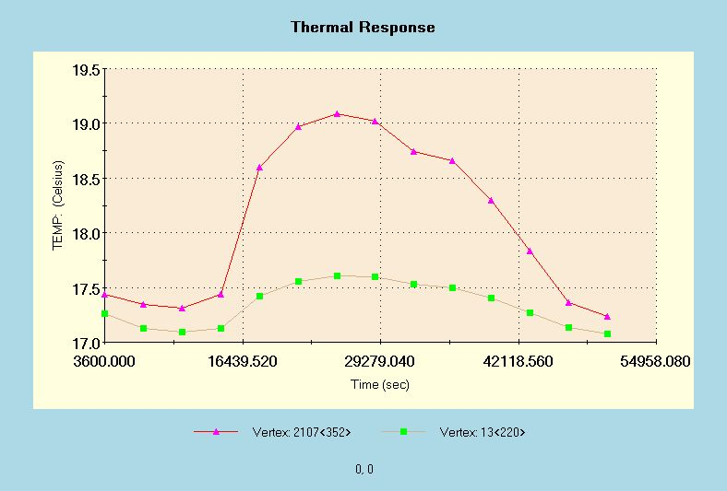
Weather Data Analysis
Convection coefficient of 5 W/(m^2.K), 18°C bulk temperature
One face of bezel cooled to 17°C during entire cycle
Facesheet heats to 19°C peek temperature
Facesheet
Base

Slide 4
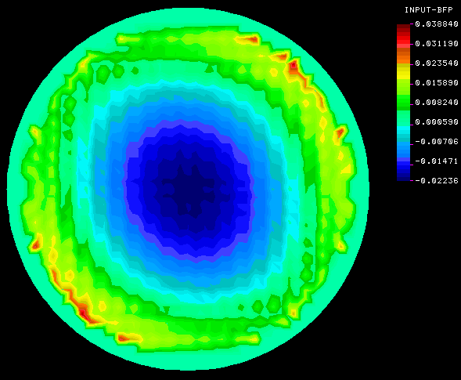
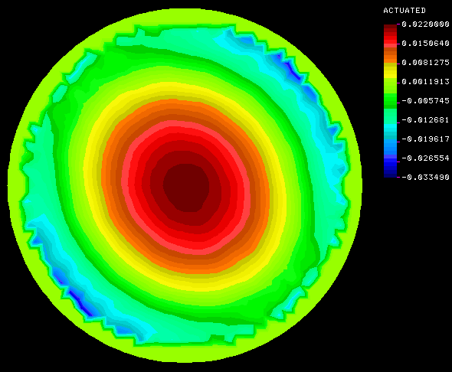
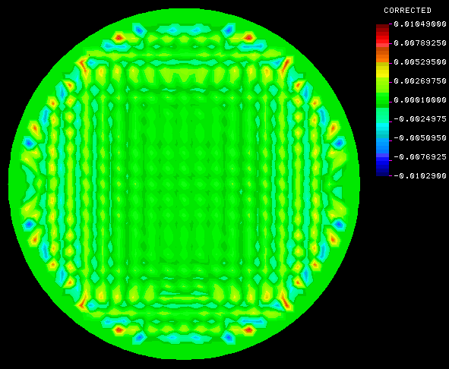
Weather Data Analysis Thermal Distortion and Correctability
Thermal Distortion
Actuated Surface
Residual Error
61nm PV
12nm rms
21nm PV
2nm rms

Slide 5
Zernike Decomposition

Slide 6
Step Function Analysis
Profile
1 hour at 50 W/m^2
1 hour at 0 W/m^2
1 hour at 50 W/m^2

Slide 7
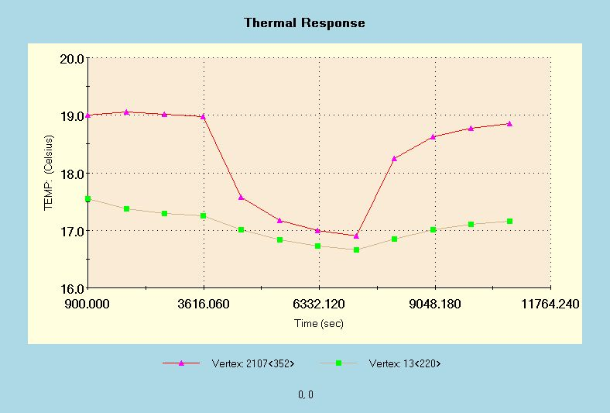
Step Function Thermal Analysis
Convection coefficient of 5 W/(m^2.K), 18°C bulk temperature
One face of bezel cooled to 16.5°C during entire cycle
Facesheet heats to 19°C peek temperature
Facesheet
Base

Slide 8
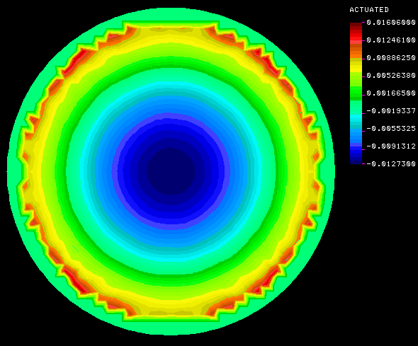
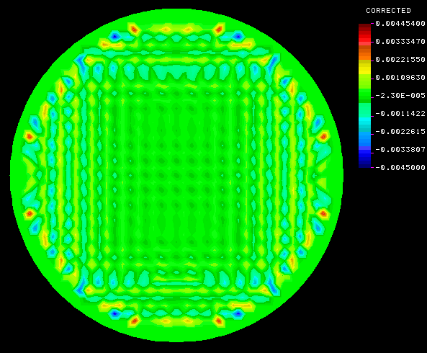
Step Function Analysis Thermal Distortion at 1 hour
Thermal Distortion
Actuated Surface
Residual Error
31nm PV
7nm rms
9nm PV
1nm rms

Slide 9
Zernike Decomposition

Slide 10
Step Function 2 Analysis
Profile
1 hour at 0 W/m^2
1 hour at 50 W/m^2
1 hour at 0 W/m^2

Slide 11
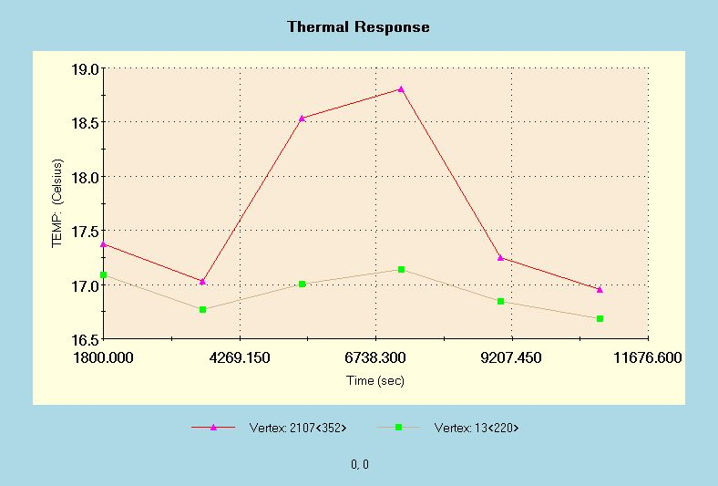
Step Function 2 Thermal Analysis
Convection coefficient of 5 W/(m^2.K), 18°C bulk temperature
One face of bezel cooled to 16.5°C during entire cycle
Facesheet heats to 18.8°C peek temperature
Facesheet
Base

