Slide 1
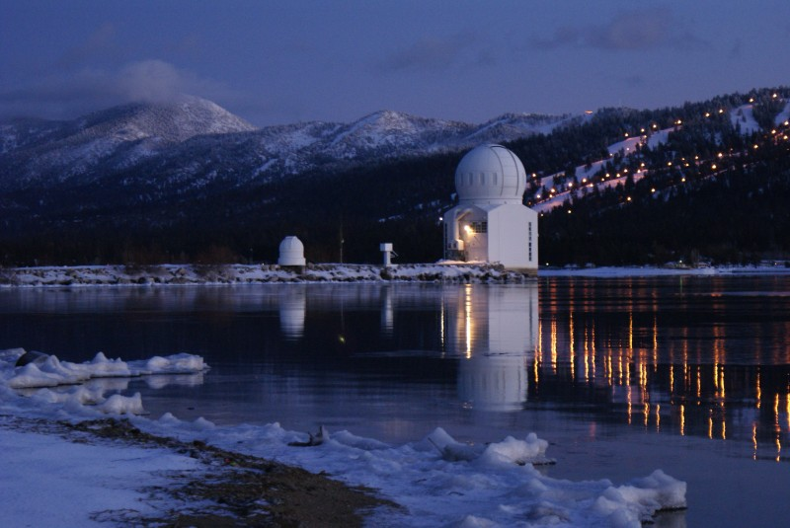
High Resolution Observations of the Sun with the 1.6 m Off-Axis Telescope in Big Bear
Philip R. Goode
Vasyl B. Yurchyshyn
Big Bear Solar Observatory
New Jersey Institute of Technology
Notes:
NJIT team has built the world’s largest aperture and most capable solar telescope. The picture is at night and shows our domes with both domes on a 1000 foot long causeway out into the middle of the lake. Winds come from the west with 2 miles of open water to the west minimizing ground layer turbulence with a natural inversion ensuring a laminar air flow to the telescope.

Slide 2
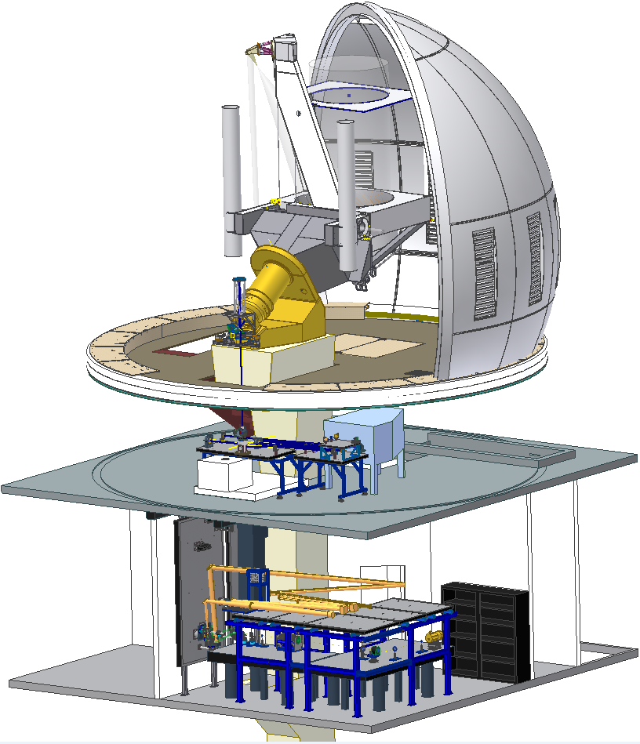
GST Scientific Instruments
Adaptive Optics System (AO:
GenI-III CAO,GLAO & MCAO)
Visible Imaging Spectrometer (VIS, VISP)
Near InfraRed Imaging Spectro-polarimeters (NIRIS) –
Cryogenic Infrared Spectrograph (CYRA)
Broad-band Filter Imager (BFI)
Fast Imaging Solar Spectrograph (FISS)
CYRA
AO
FISS
BFI
MCAO
VIS
NIRIS
Notes:
1
NST is outfitted with facility-class instruments. Most of these instruments are placed in this Coude Lab, two floors beneath the telescope deck. (This figure shows a cutaway sketch of the NST’s scientific instruments.)
The current NST post-focus instruments include: the AO system, the visible imaging spectrometer, the NIR imaging spectro-polarimeter, the cryogenic IR spectrograph, the broad-band filter imager, and the fast imaging visible spectrograph.
All these instruments can work simultaneously except for the CYRA.
Green means the instrument is operational already, and gray means it is under development.
Here, I will only highlight four of them: AO, VIS, IRIM/NIRIS and CYRA.
(The NST is located on the top-floor telescope deck. Solar light is imaged by PM and SM, then folded through the declination axis by M3 and then directed by M4 along the polar axis down to the telescope Gregorian focus, around here. Relay optics feed light down to the Coude Lab, two floors beneath the telescope deck with the first stop being the adaptive optics.)

Slide 3
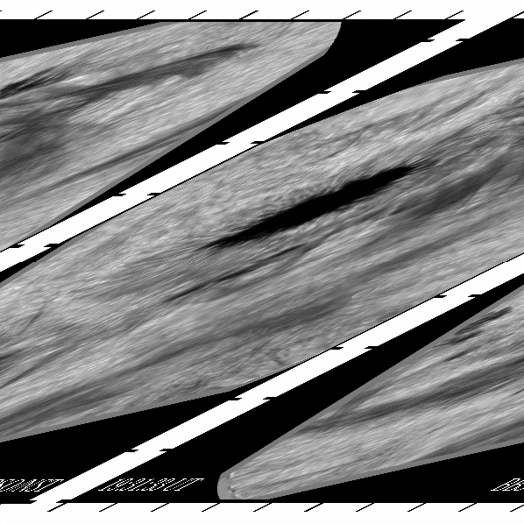
Flare 5 July 2012
1083.0 nm
Nearly 3 hrs
CAO & Speckle
At 21:47 FOV Lit
Need sub-second timestep over FOV
50000 km x 50000 km field
Spot roughly the size of Earth
Notes:
MCAO is needed to get needed <1 sec cadence on Intensity & B-Field. Further, speckle has problems during dynamical changes.
Movie is Flare_M1.2_20120705-4(converted).mov

Slide 4
All Solar Observatories – 1 DM AO
& Generic Solar MCAO(?):
WFS, DMs, & Guide Regions
Why 3 DMs?
  Rough expection:
  - One for groundlayer
  - One for transition layer
  - One for jetstream?
How Many Guide Regions are Required?
  FOV & location of turbulent layers
  Use 9 Guide Regions Currently (19 allowed)
WFSs
  Ultimately use only one WFS (not two)
Notes:
Ground level thermals turbulence, wind-shear layer where clouds form and turbulent jet stream

Slide 5

CAO/MCAO 27 July 2016 (53”x53”) TiO (705.7 nm)
Clear: MCAO Pathfinder for Observations of the Sun
Notes:
bbso_tio_pcoi_20160727_174945z76_MCAO_CAO_1024x1024_0.20-0.90_reverse_no-glao_gray-1.mp4
July 27, 2016 CAO and MCAO ~150 Frames of each. Burst is 450 frames lasting 31 s
TiO 705.7 nm

Slide 6
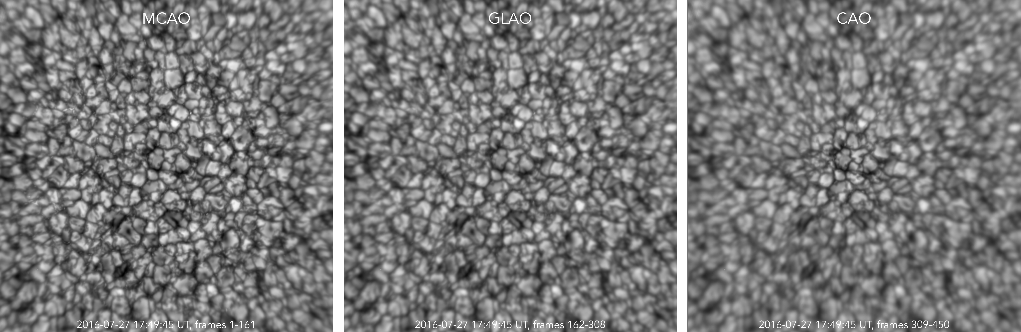
MCAO (53’’x53’’) GLAO (7/27/16) CAO
Notes:
Fried parameter is defined as the diameter of a circular area over which the rms wavefront aberration due to passage through the atmosphere is equal to 1 radian.
The generalized Fried parameter is an estimate of the apparent Fried parameter due to the CAO, GLAO and MCAO corrections.
The Fried parameter is widely used to characterize strength of optical aberrations due to atmospheric turbulence.
KISP uses the Spectral Ratio method to estimate the generalized Fried parameter from the extended solar scenery. This method is sensitive to strong static aberrations, however, unless the static aberrations are strong enough to inhibit the transfer of spatial frequencies lower than those corresponding to $\lambda/\rho_0, the estimates can be used safely to gauge the effectiveness of the correction over the FOV provided by any type of AO system

Slide 7
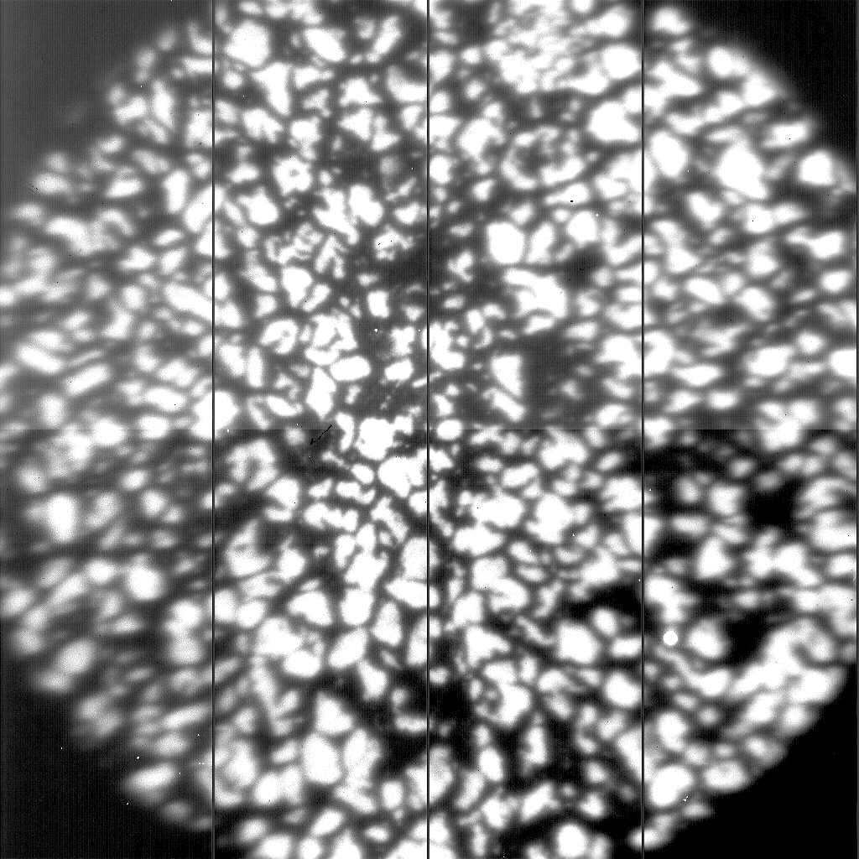
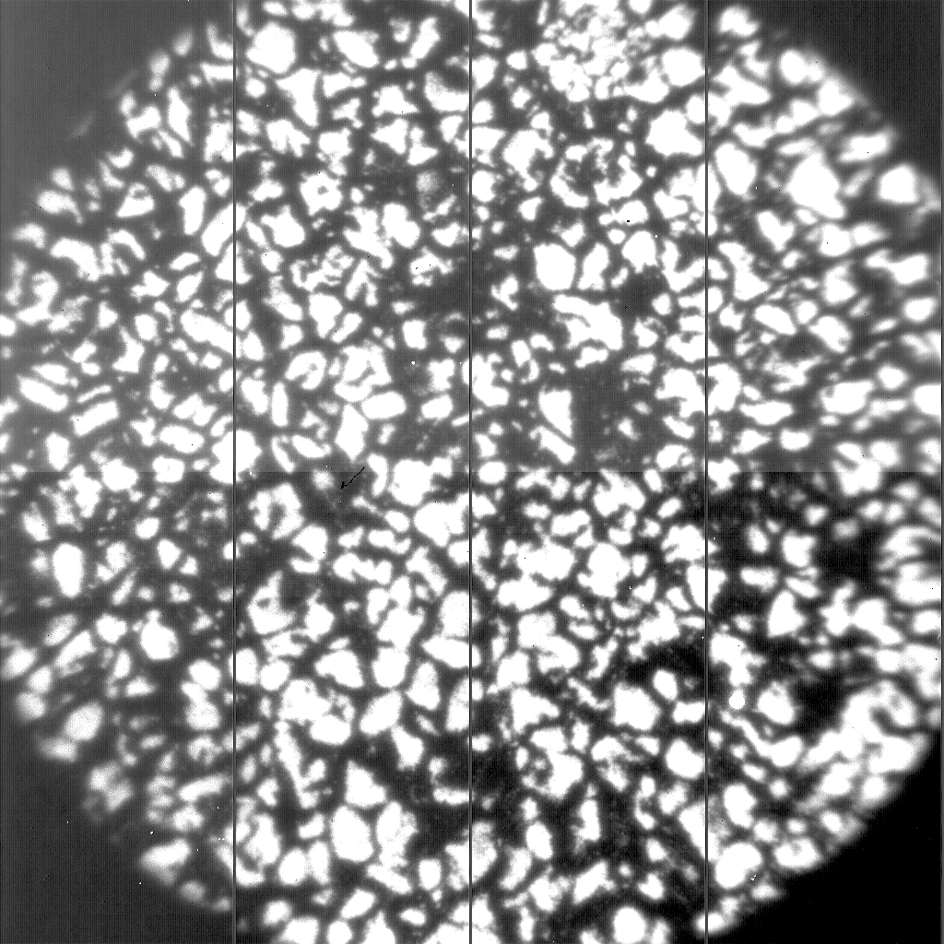
MCAO Lab Tests with 70” Corrected FOV
October 2018 Series
CAO MCAO
Notes:
Superposition of ~150 frames in 1.56 mm light from a lab target of granulation with a cooktop in front of
each DM. CAO is on the left and MCAO is on the right. The optics is for a 70’’ FOV (double size of subapertures) but the camera has a 60’’, hence
the clipping. Nonetheless, lab test are encouraging. We used 55 KL modes on-axis and an additional 22 modes for
wide field, but this was just a quick (and successful) lab test of our NIR-MCAO optical setup.
Can do 10830A as well for chromosphere structures.

Slide 8
What Next?
Have made Prominence AO Work (October 2018)
More details on MCAO, visit cuna.nso.edu/clear
Feed current MCAO setup to BBSO spectro-polarimeters for origins of space weather studies
  Lead in to Prof. Vasyl Yurchyshyn’s Talk

