Slide 1
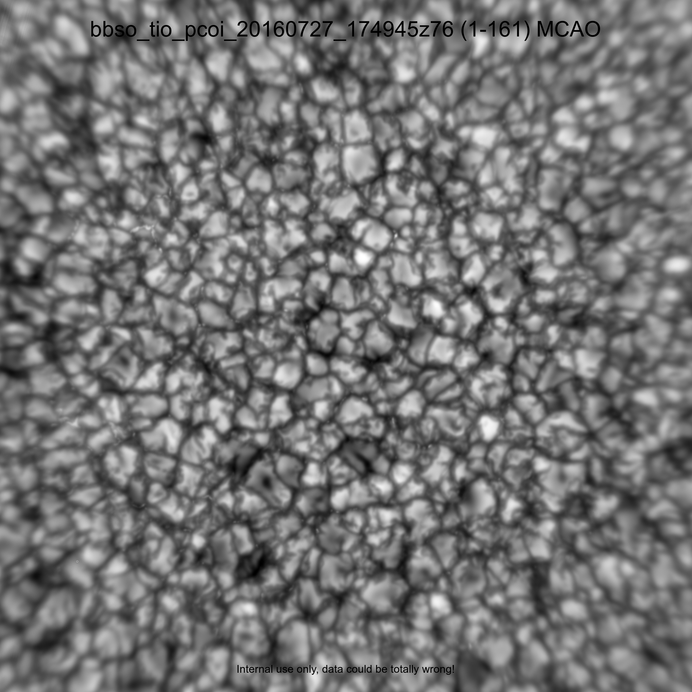
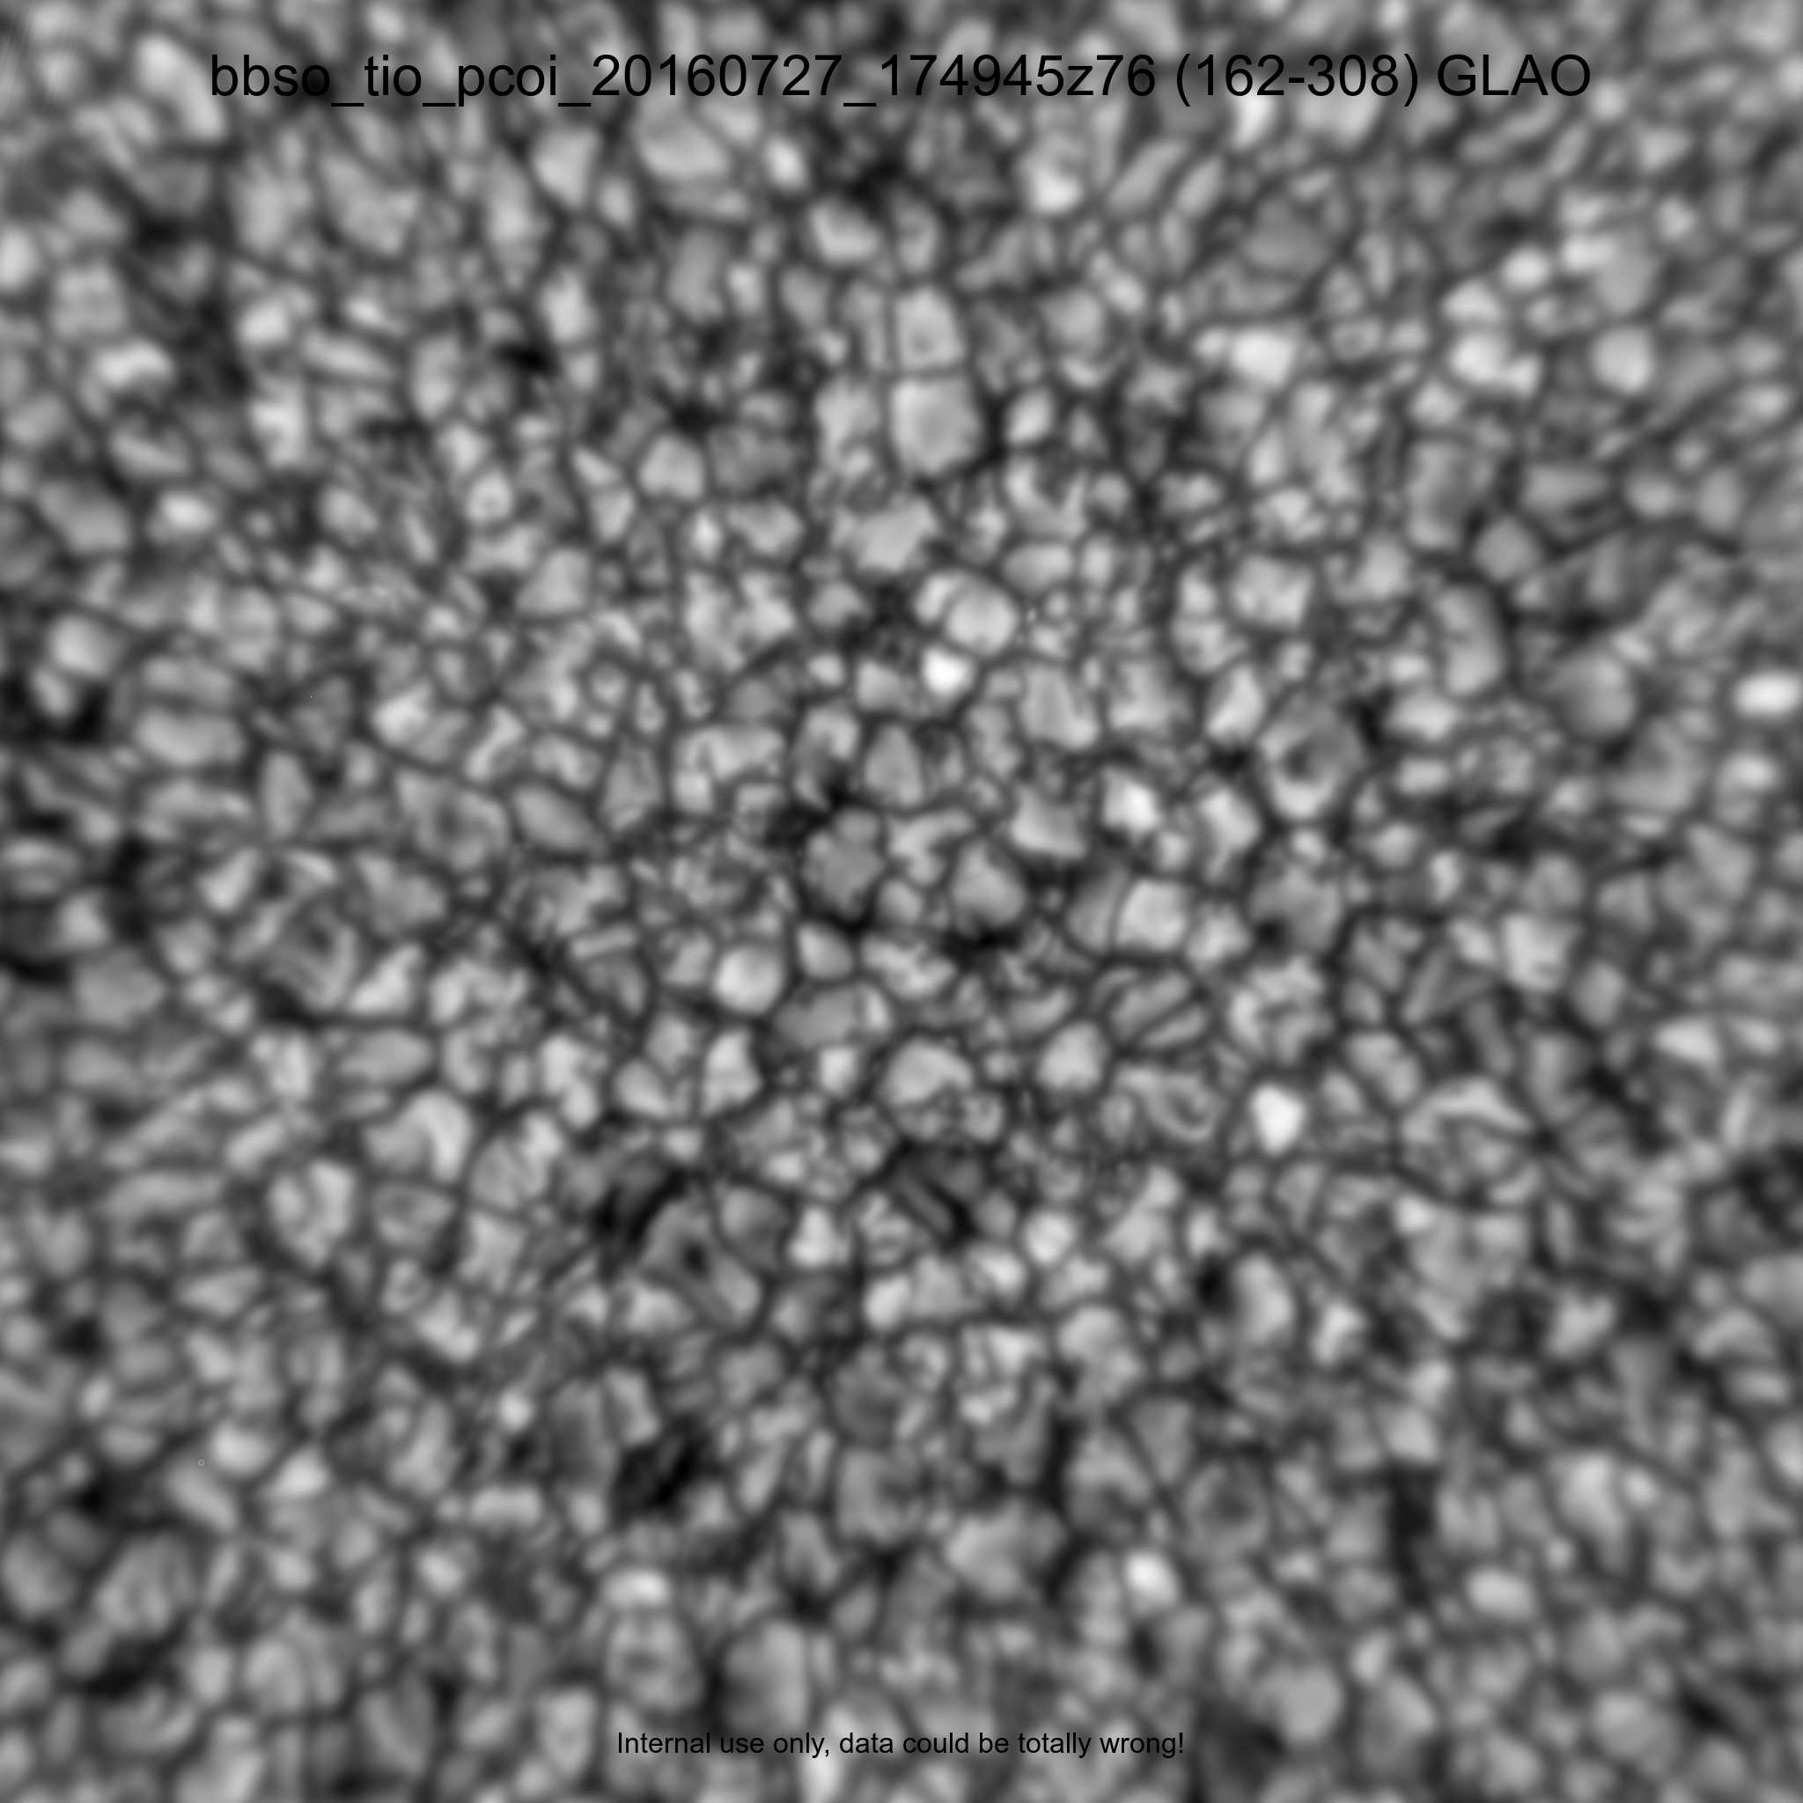
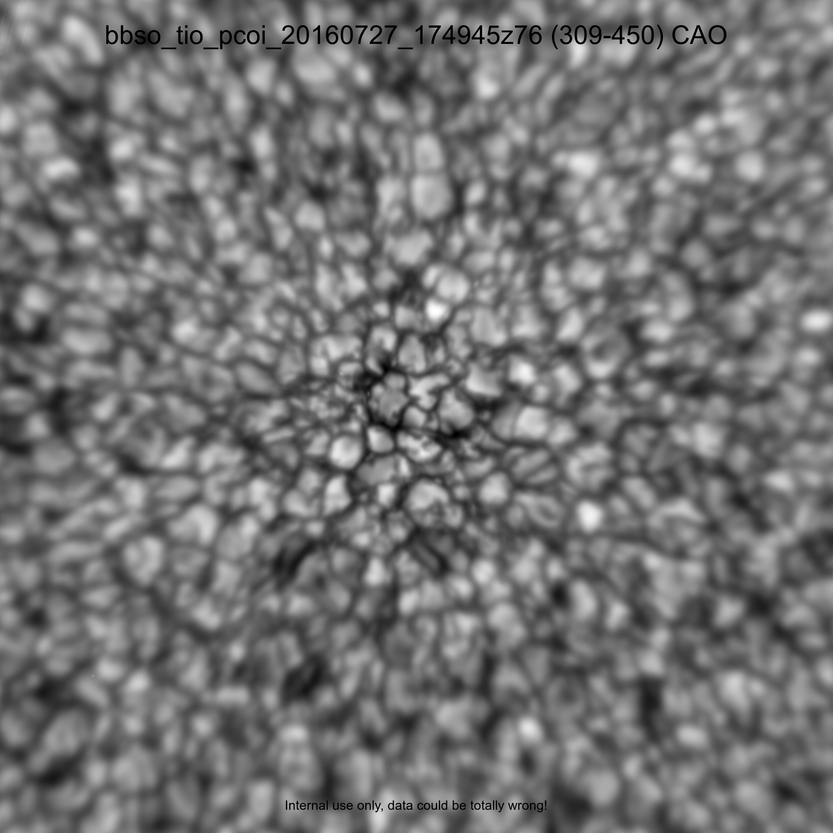
MCAO (50’’x50’’) GLAO (7/27/16) CAO
Notes:
The generalized Fried parameter is an estimate of the apparent Fried parameter due to the CAO, GLAO and MCAO corrections.
The Fried parameter is widely used to characterize strength of optical aberrations due to atmospheric turbulence.
KISP uses the Spectral Ratio method to estimate the generalized Fried parameter from the extended solar scenery. This method is sensitive to strong static aberrations, however, unless the static aberrations are strong enough to inhibit the transfer of spatial frequencies lower than those corresponding to $\lambda/\rho_0, the estimates can be used safely to gauge the effectiveness of the correction over the FOV provided by any type of AO system \citep{2002AN....323..236S

