Slide 1
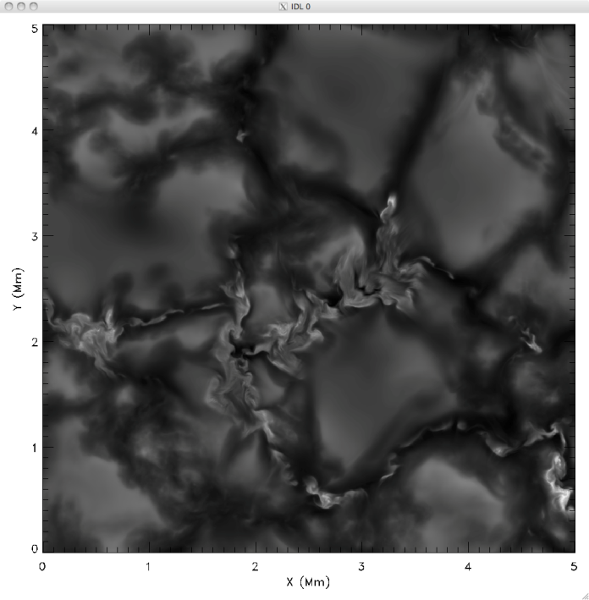
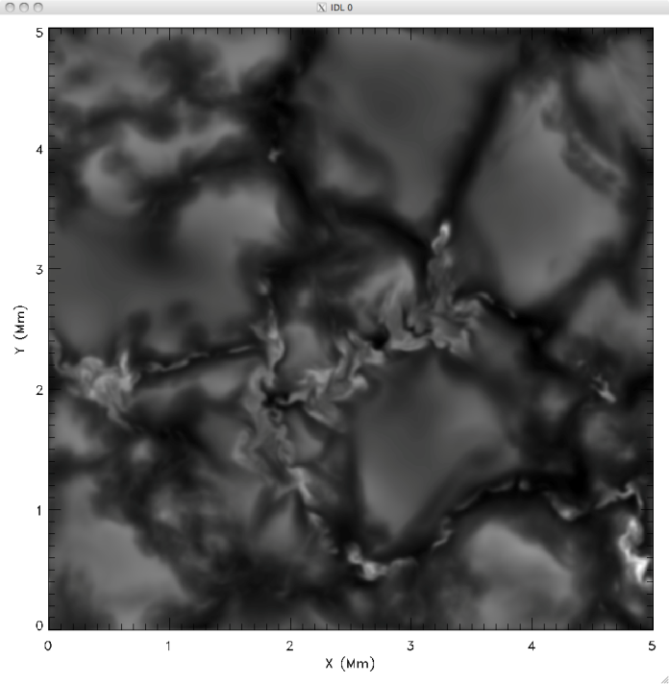
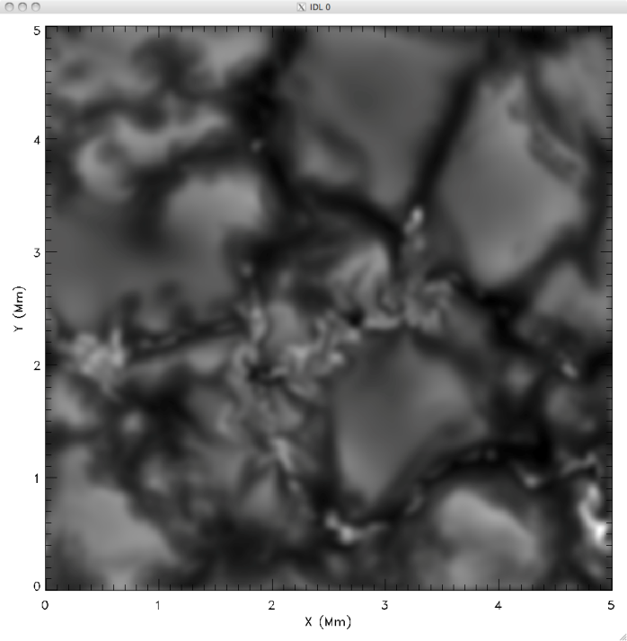
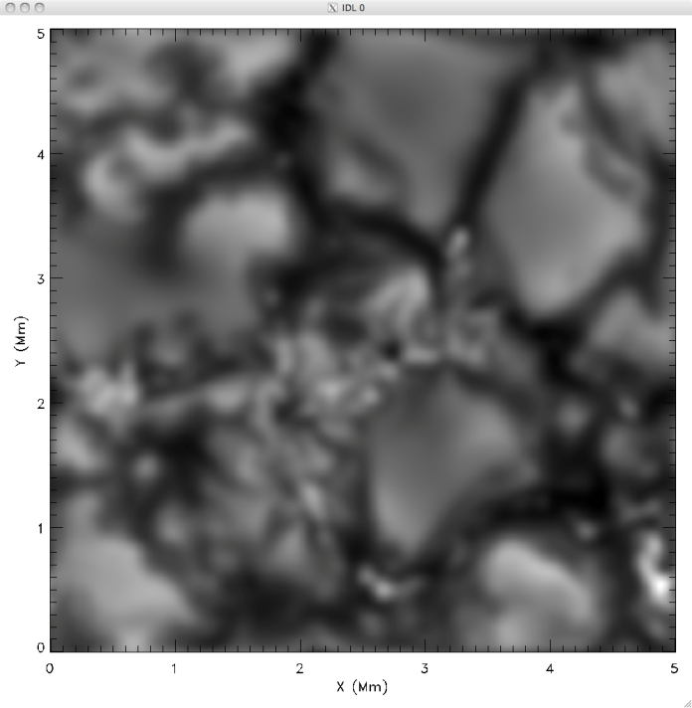
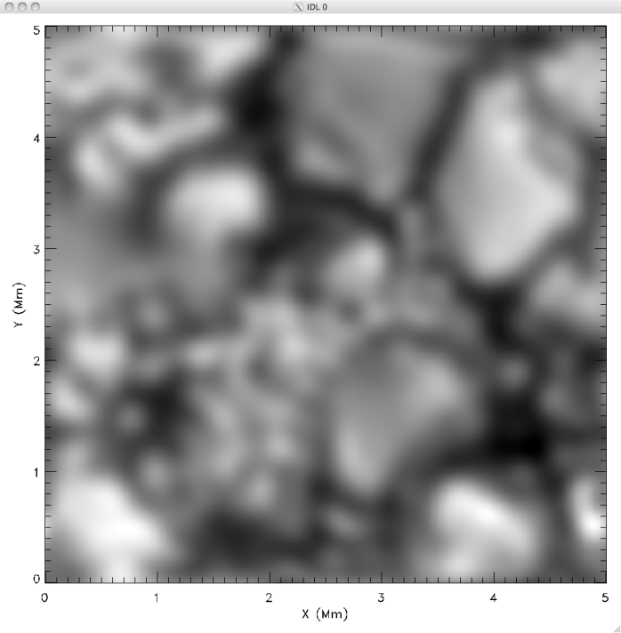
Effect of Telescope Resolution - Intensity
Simulation, ATST, NST
SST, Hinode
Notes:
Simulations (<10 km spatial steps) degraded to show aperture effect in reducing ability of telescope to resolve. Huge changes going from 0.5 to 1.0 to 1.6 m, but small change going to 4 m.
Why? Photon mean free path is about 100 km in photosphere, so by resolving 50 km with NST nearly all features that can be resolved are revealed.

Slide 2
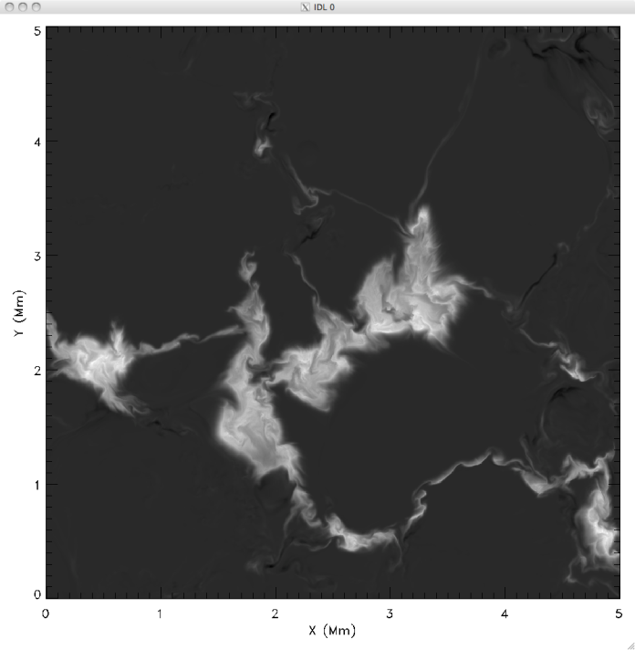
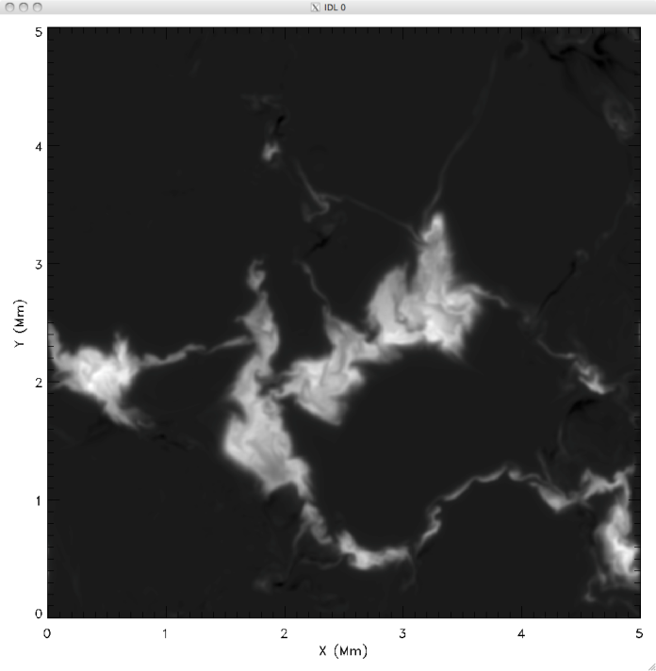
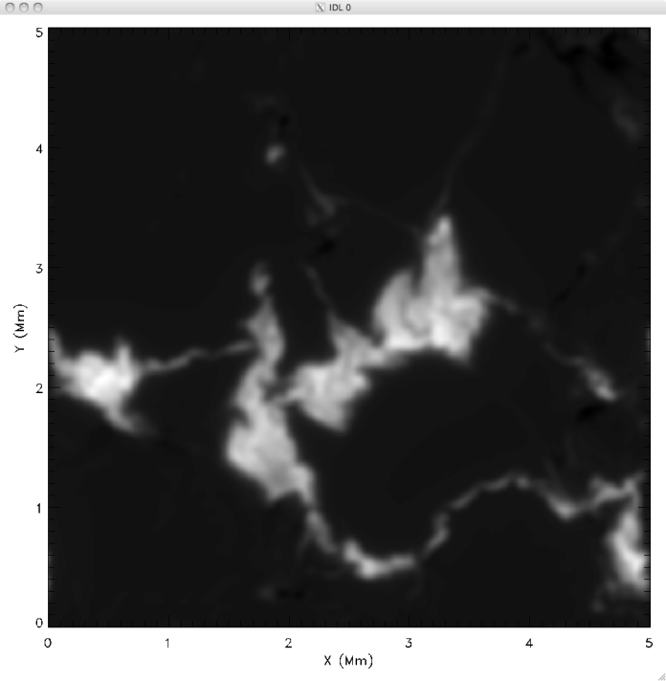
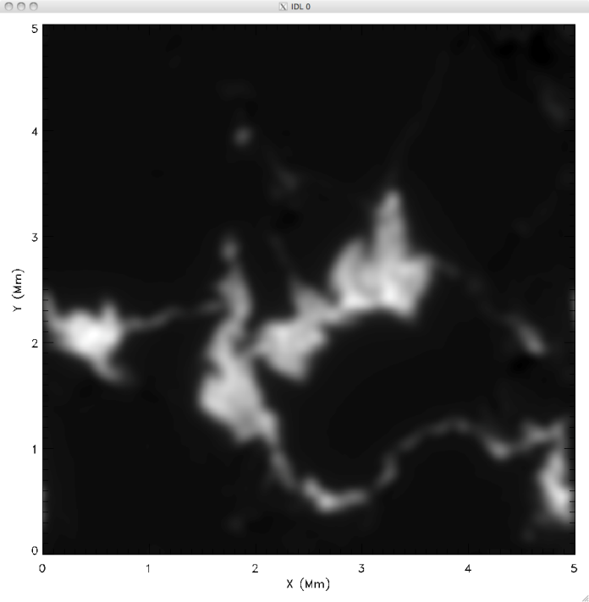
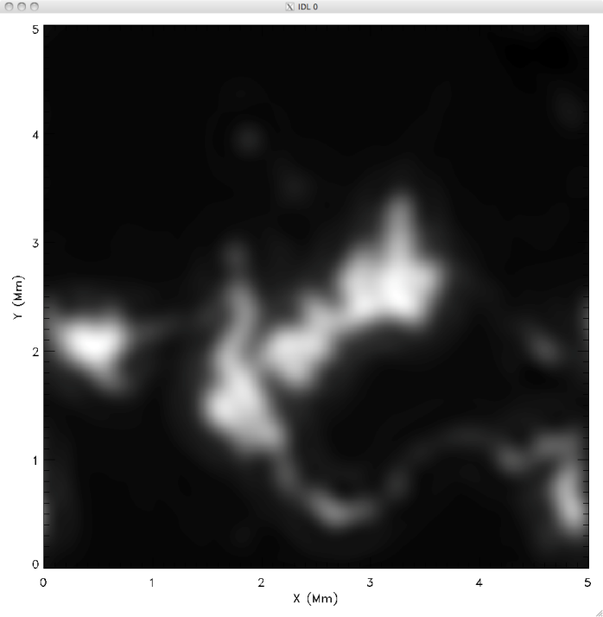
Effect of Telescope Resolution - B
Simulation, ATST, NST
SST, Hinode
Notes:
Same as for intensity

