Slide 1



Big Bear Solar Observatory

Slide 2
New View on Quiet Sun Photospheric Dynamics Offered by NST Data
Valentina Abramenko, Vasyl Yurchyshyn,
Philip R. Goode, Robert Stein
and the NST team
Big Bear Solar Observatory, CA
Email: avi@bbso.njit.edu
Big Bear Solar Observatory

Slide 3
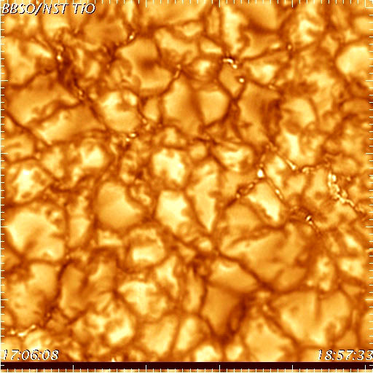
A fragment of the 2-hour NST/TiO data set recorded on Aug 3, 2010
AO corrected
Speckle reconstructed
Aligned
Destretched
Image size: 14 x 14 Mm,
or 510 x 510 pixels

Slide 4
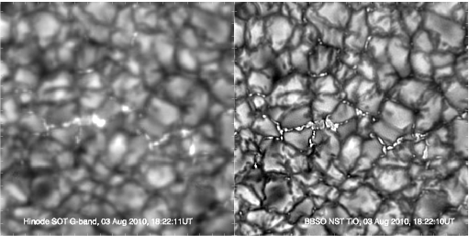
Hinode/G-band
NST TiO
The same area on the Sun. The same moment.

Slide 5
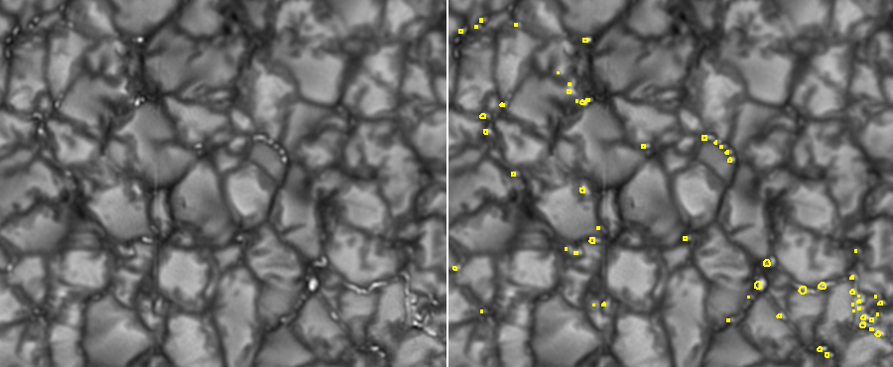
Bright points detection
Detection criteria: lifetime longer than 20 s;
area larger than 2 pixels;
brightness above the mean image brightness.
Total: 13597 tracked BBs for th=85 DN
7148 tracked BPs for th=120 DN

Slide 6
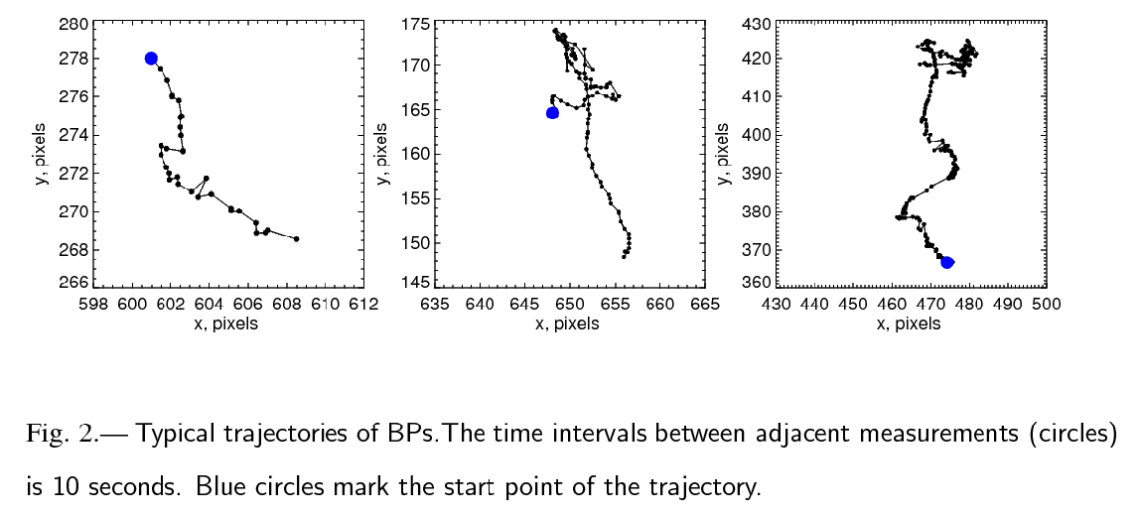
Trajectories of BPs
﻿This is placeholder copy
﻿This is also placeholder copy
Typical examples of BPs trajectories. Time intervals between adjacent circles
is 10 s. The blue large circles mark the start points of the trajectories.
For each tracked BP, the average diameter was calculated.
Big Bear Solar Observatory
Notes:
6

Slide 7
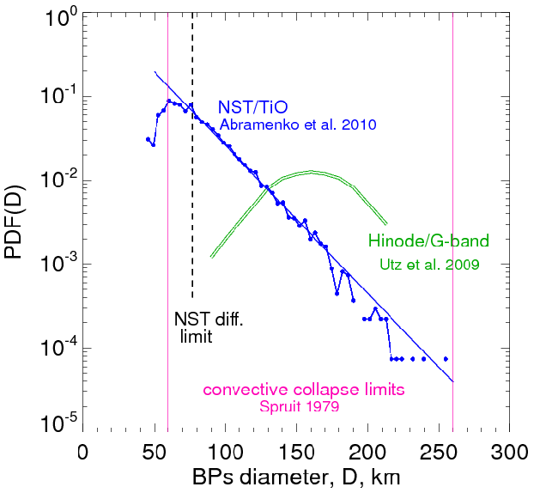
Size Distribution of BPs
Notes:
Convective collapse: Spruit states that After the collapse, the tubes with r>> 30 km enter a long period of quasi-static existence (when the upper layers are in temperature equilibrium while the deeper layers gradually heat up.) The convective collapse theory is applicable for the thin tube approximation, i.e., for tubes with r smaller than the temperature scale height, about 130 km for isothermal atmosphere on the low photospheric heights (0-500 km).

Slide 8


Diffusivity in the Photosphere
(x₀,y₀)
For each BP, we compute a set of
displacements from the start point:
(Δ l)²_{i} = (x_{i}-x_{o})²+(y_{i}-y₀)²
(x₁₀,y₁₀)
and a set of corresponding time delays:
(x_{N},y_{N})
Then for each
we average
displacements from all tracked BPs.
We thus obtain Displacement Spectrum:
Big Bear Solar Observatory
Notes:
8

Slide 9
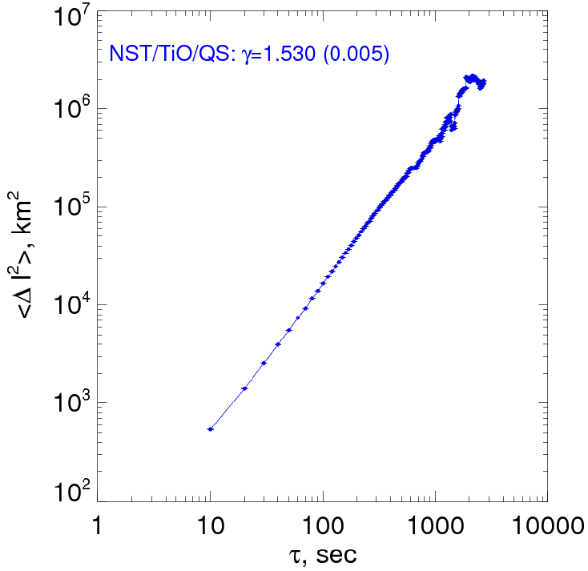
Diffusivity: Displacement Spectrum

Slide 10
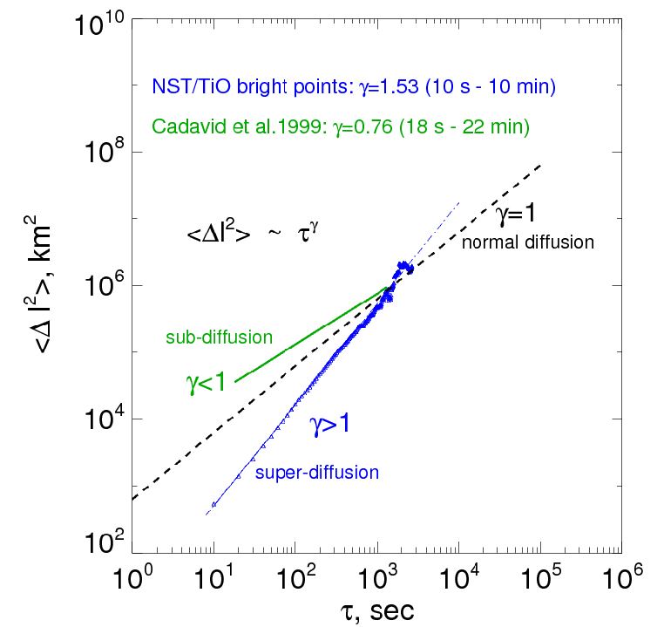
Slide Title Here
Big Bear Solar Observatory
Notes:
10

Slide 11
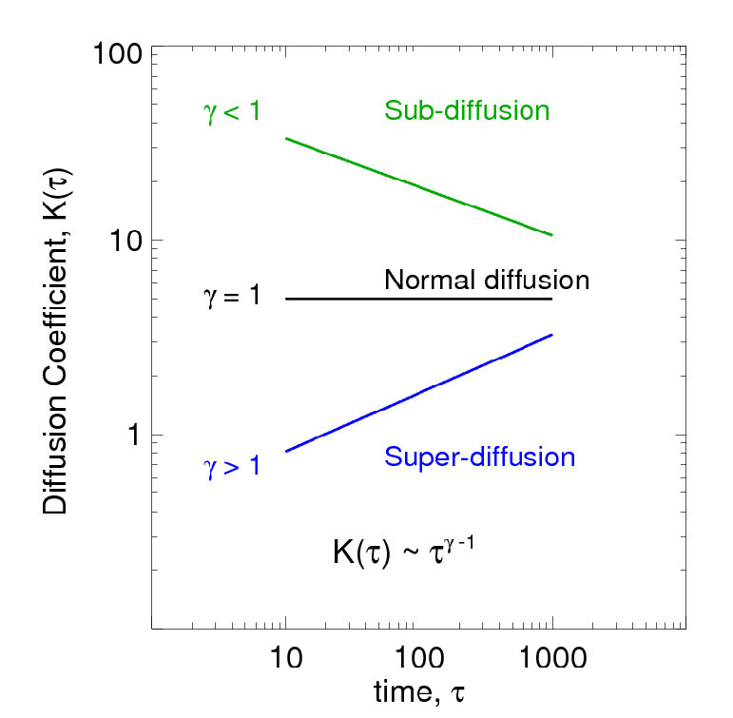
Diffusivity : Some Definitions

Slide 12
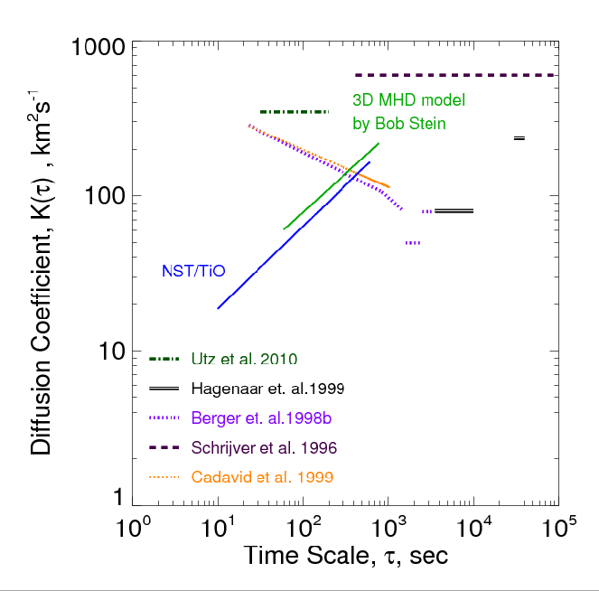
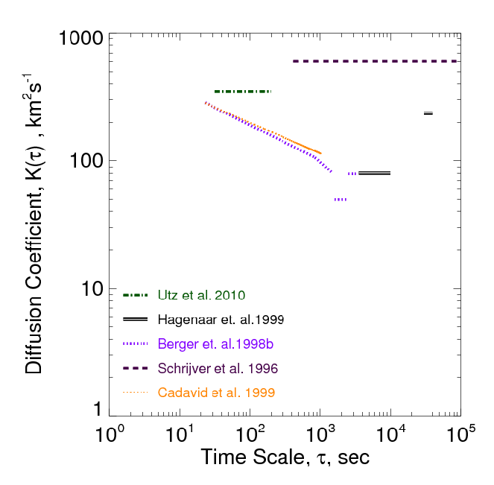
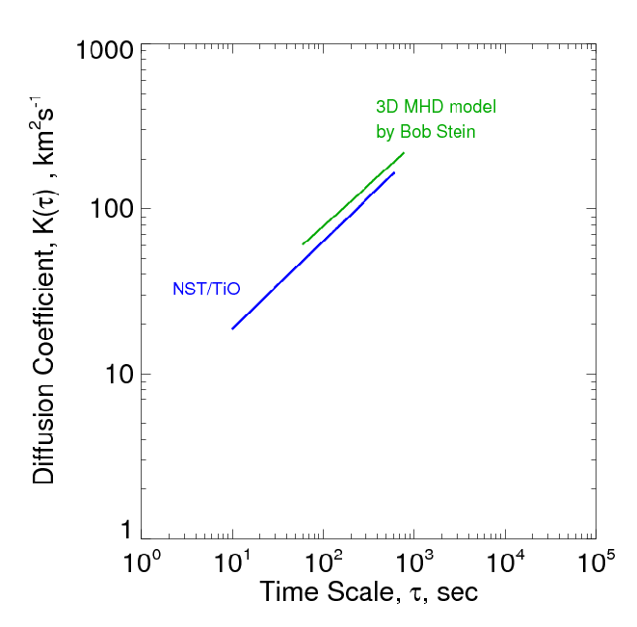

Slide 13
Main Results from the NST data
The histogram of bright points (BPs) sizes extents down to the diffraction limit of the NST (77 km), which indicates that the minimal size of BPs (or, magnetic elements) is not reached yet.
Magnetic diffusion in the photosphere occurs in a super-diffusion regime.
Diffusivity in the photosphere depends on scales: the diffusion coefficient increases as the spatial and time scales increase.
Big Bear Solar Observatory
Notes:
13

